Slide 1

Introduction to Juvenile e-Filing
Filing a Motion and Hearing Request to an Existing Case
Franklin County Clerk of Courts
Notes:
Welcome to the Franklin County Ohio Clerk of Courts’ Introduction to Criminal e-Filing. This e-filing system will allow cases and documents to be electronically filed for cases in the Common Pleas courts. During this tutorial, you will learn how to file a Motion to an Existing Case.

Slide 2
Topics for this Presentation
Helpful Technologies
How to File…
  Filing A Motion to an Existing Case
  Filing A Hearing Request for an Existing Case
How to check the Filing Status
Where to Get Help
Notes:
During this presentation, we will cover helpful technologies, how to file a motion to an existing case, how to check the filing status on cases, and where to get help

Slide 3
Helpful Technologies
A Scanner - with a recommended setting of 300 dpi
A PDF Converter – an online converter or ability to use the embedded PDF converter in Word
  Online Adobe Word to PDF Converter
Note – Word Documents need to be in a .docx
Notes:
Some helpful technologies are a scanner with the recommended setting of 300dpi. A way to convert documents into a PDF format such as using Print to PDF, embedded PDF Converter in Word or other similar products or an online word to PDF Converter. Word documents must be in a .docx format.

Slide 4
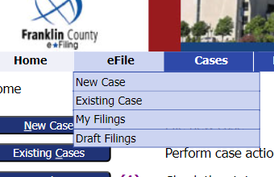
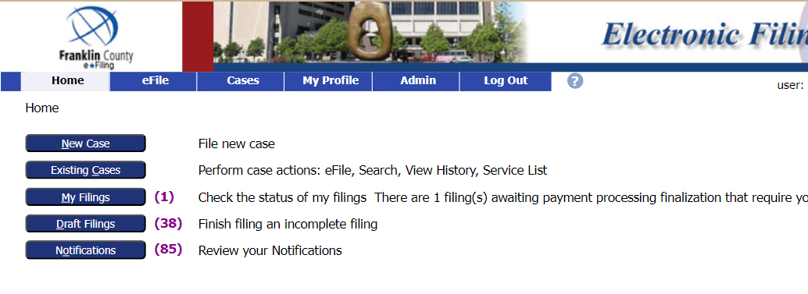
How to File a Motion to An Existing Case
Log into your e-Filing account.
Select File to an existing case from the
  Existing Case Button on the left or
  go to eFile tab, then choose Existing Case, from the dropdown menu
Notes:
After logging into your efiling account, select File to an existing case by clicking on the Existing Case button on the left or going to the efile tab and selecting Existing case from the dropdown menu.

Slide 5
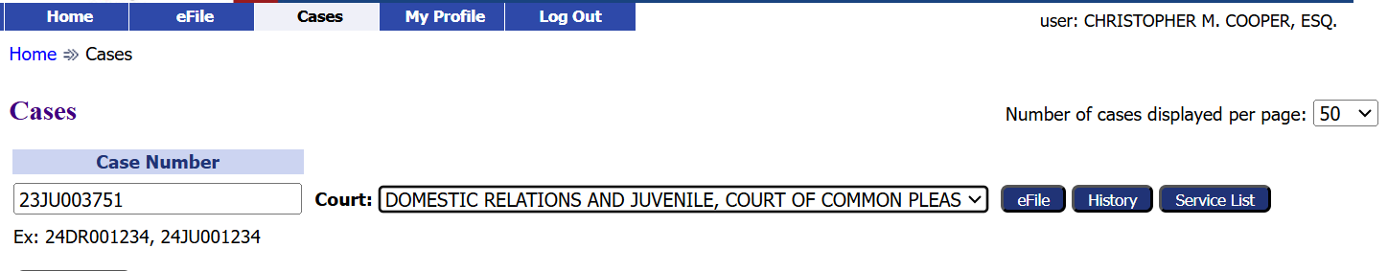
Filing a Juvenile Motion
There are several options to search for a case.
Option 1
  Enter the Case Number
  Choose the court from the dropdown menu
  Click the eFile button
Example case: 23JU003751
Notes:
There are several options to search for a case. Option 1 enter the case number, choose the court from the dropdown menu and clicking the efile button

Slide 6
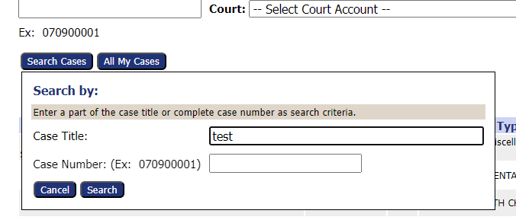
Filing a Juvenile Motion
Option 2
Click the Search Cases button
Enter part of the Case Title or complete Case Number
Click the Search button
Example: 23JU003751
Notes:
Option 2 click the Search cases button, enter part of the case title or the complete case number, then click the search button

Slide 7
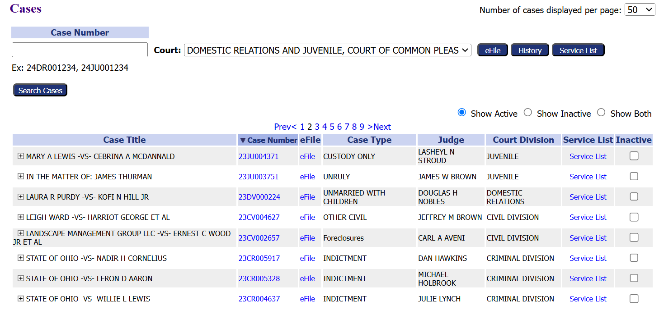
Filing a Juvenile Motion
Option 3
Find the case from the list of cases.
Click the eFile link
Example: 23JU003751
Notes:
Or Option 3 find the case from the list of cases. Click the efile link.

Slide 8
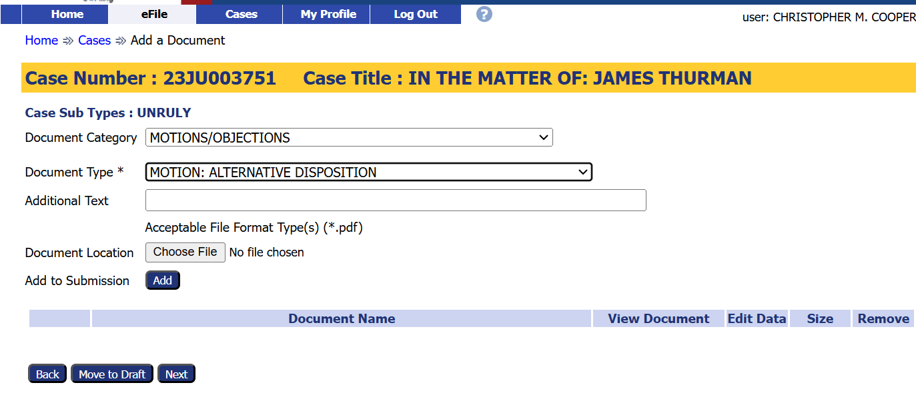
Choose a Document Category and Type
1. Choose a Document Category to filter the number of Document Type choices.
2. Choose a Document Type from the drop-down menu. This is a required field.
Notes:
Once the case is selected the filing page will appear. Confirm the Case Number and Case Title are correct. Choose a document category to filter down the number of document case type choices. Choose document type from the drop down menu. Note Document Type is a required field.

Slide 9
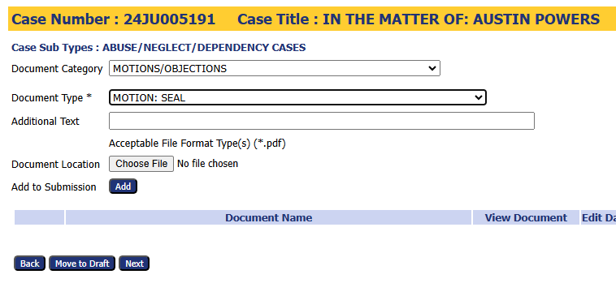
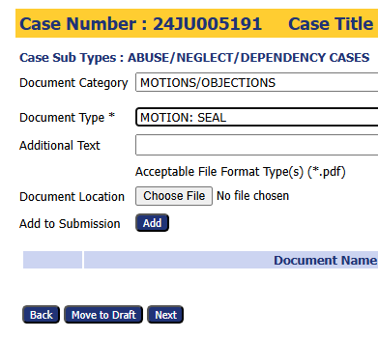
Add a Document
Note the required document format.
3. Click the Add button to add
the document to the filing.
2. Click the Choose File button to select and
upload a document.
Notes:
Before selecting the corresponding document for the filing, take note of the format required for the document. The format for the document depends on the type of filing. In this example, a PDF is required. Choose the document by clicking the choose file button to select and upload the document. After choosing upload, click the add button to add the document to the filing.

Slide 10
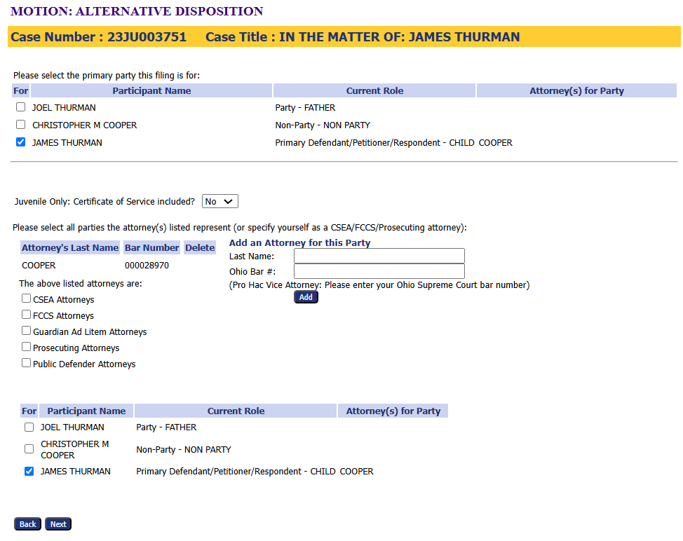
Select the Parties
1. Confirm the Participant’s name is already checked. In the top and bottom sections.
2. Confirm the attorney’s [yours] is in the middle section.
3. Add additional attorneys for the party, if needed.
4. Click the Next button.
Notes:
After clicking add, the next screen ask for confirmation of the parties. Confirm the participant’s name is already checked in the top and bottom sections. Confirm the attorney’s name is in the middle section. Add any additional attorneys for the party, if needed. If everything is correct, click the next button.

Slide 11
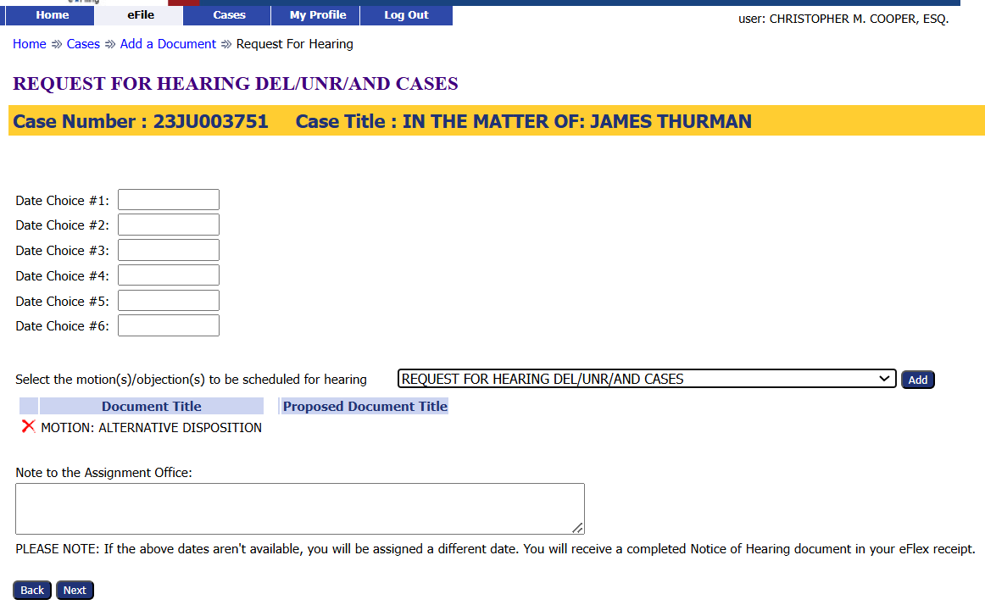
Select Court Dates
Select up to six court dates.
Add any additional notes.
Add the document(s) by selecting each one from the drop-down menu and clicking Add for each document.
Click Next.
Notes:
After confirming the parties, the add or remove documents screen reappears. Any other documents can be added at this time, if necessary. Click the Next button to continue with the file submission.

Slide 12
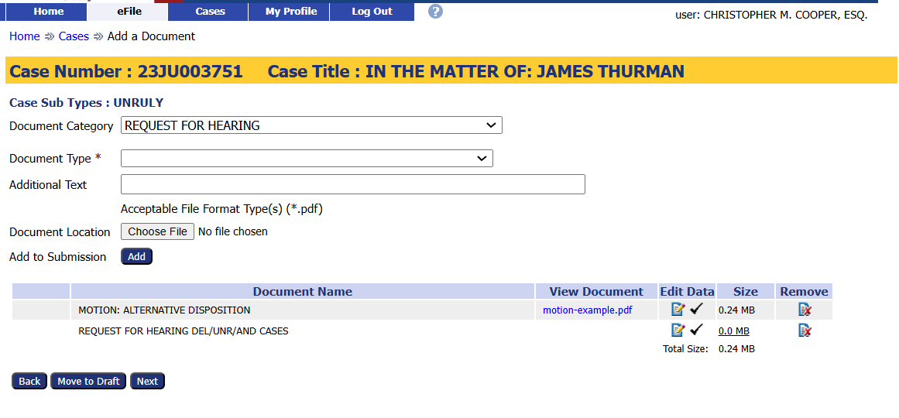
Add and/or Remove Documents
Add or remove documents before completing the filing process, if necessary.
Select the Next button to continue with file submission.
Notes:
After confirming the parties, the add or remove documents screen reappears. Any other documents can be added at this time, if necessary. Click the Next button to continue with the file submission.

Slide 13
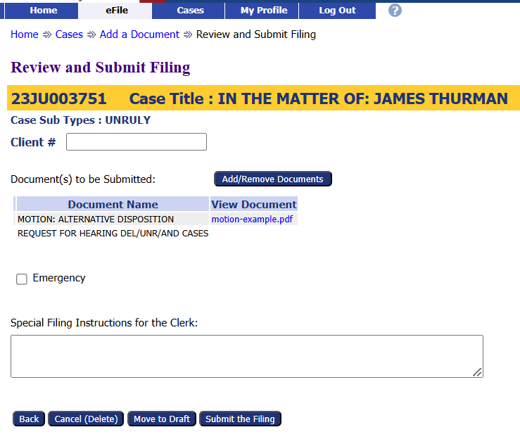
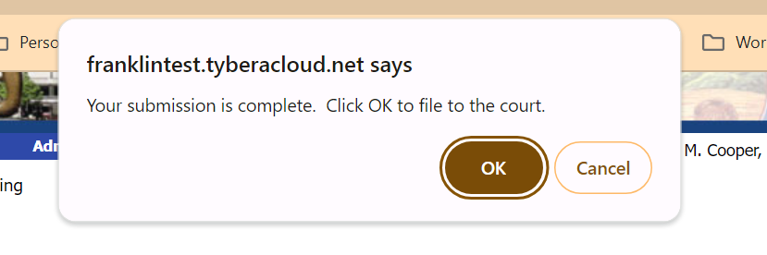
Submit the Filing
Use the optional Client # field to enter an office case reference number.
Add or Remove additional documents, if needed.
Add any filing notes
Other options
  Cancel (Delete) the filing
  Move to Draft – Save the filing to be completed later.
Submit the Filing – completes the filing process.
Notes:
Review the filing before submitting. There is an optional Client # field so an office reference number can be added. Review the documents to be submitted and add or remove as needed. Add any filing notes. At this point, if the filing is not ready, it can be cancelled (deleted), Moved to draft filings for completion later, or submitted to complete the filing process.

Slide 14
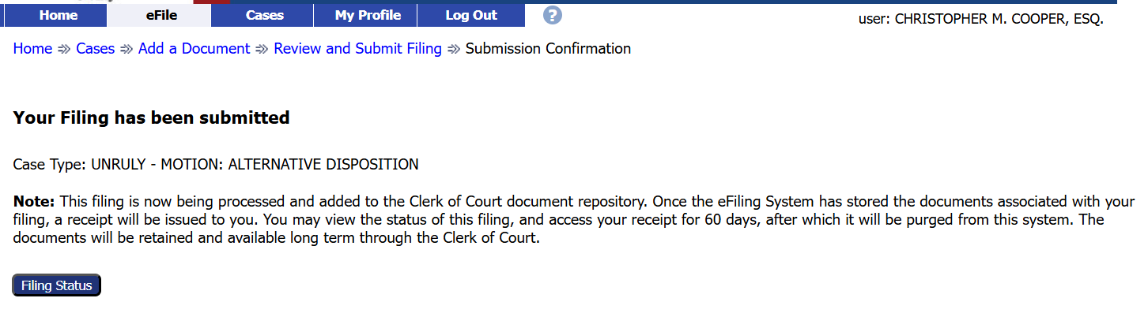
Submission Confirmation
A confirmation of submission will appear.
Click on the Filing Status to check where the case is in the approval process.
*Note- Filed references that the filing has been accepted.
Notes:
A confirmation of submission will appear. Clicking on the Filing Status button to check on the status of the approval or acceptance of the filing.

Slide 15
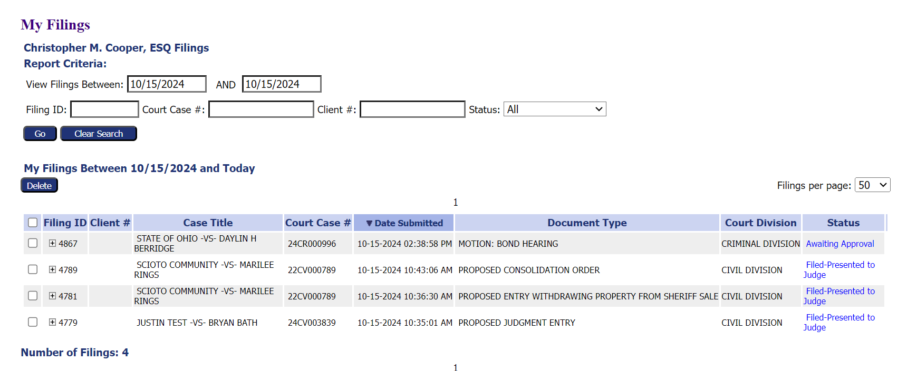
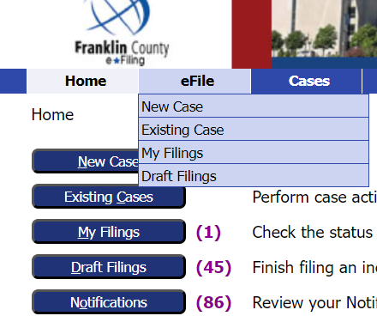
Filing Status
Clicking the Filing Status button brings up a list of all filed cases and their status.
Users can search for a specific case on this page.
This page can be reached by clicking My Filings from the Home page
or by going to the eFile tab and selecting My Filings from the drop-down menu.
Notes:
Clicking the Filing Status button will bring up a list of all cases that have been filed and show their filing status. You can search for a specific case by enter the search parameters and choosing search. The Filing Status list can always be reached by clicking My Filing from the home page or by going to the eFile tab and selecting My Filings from the drop-down menu.

Slide 16
Thank you for using the
Franklin County e-Filing System
franklincountyclerk@franklincountyohio.gov
Notes:
Thank you for using the Franklin County e-filing System. For help or questions about filing, contact the Clerk of Courts Office by email to franklincountyclerk@franklincountyohio.gov

