Slide 1
Introduction to Criminal e-Filing
Requesting a Bond Hearing
Franklin County Clerk of Courts
Notes:
Welcome to the Franklin County Ohio Clerk of Courts’ Introduction to Criminal e-Filing. This e-filing system will allow cases and documents to be electronically filed for cases in the Common Pleas courts. During this tutorial, you will learn how to file a Request for a Bond hearing.

Slide 2
Topics for this Presentation
Helpful Technologies
How to File Bond Hearing Requests
How to Check for the Filing Status
Where to Get Help
Notes:
During this presentation, we will cover helpful technologies, how to file a bond hearing request, how to check for notifications on cases, and where to get help

Slide 3
Helpful Technologies
A Scanner - with a recommended setting of 300 dpi
A PDF Converter
Print to PDF
Word or other similar product that allows Save to PDF
Online Adobe Word to PDF Converter
Note – Word documents must be in a .docx format
Notes:
Some helpful technologies are a scanner with the recommended setting of 300dpi. A way to convert documents into a PDF format such as using Print to PDF, embedded PDF Converter in Word or other similar products or an online word to PDF Converter. Word documents must be in a .docx format.

Slide 4
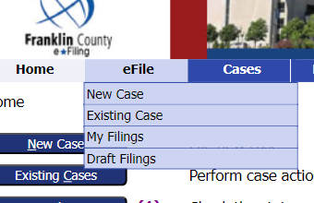
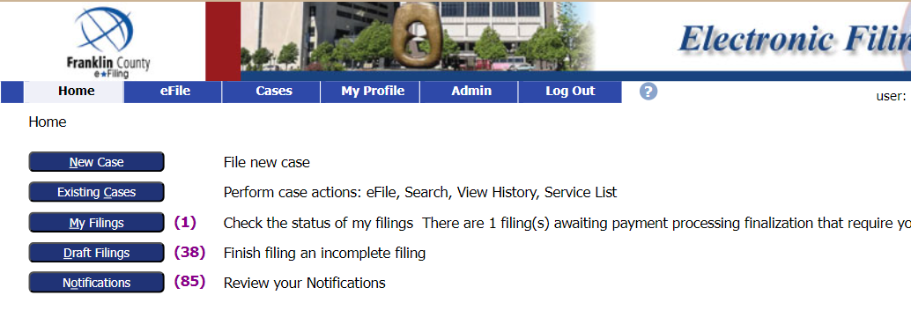
How to File a Bond Hearing Request
Log into your e-Filing account.
Select File to an existing case from the
Existing Case Button on the left or
go to eFile tab, then choose Existing Case, from the dropdown menu
Notes:
After logging into your efiling account, select File to an existing case by clicking on the Existing Case button on the left or going to the efile tab and selecting Existing case from the dropdown menu.

Slide 5
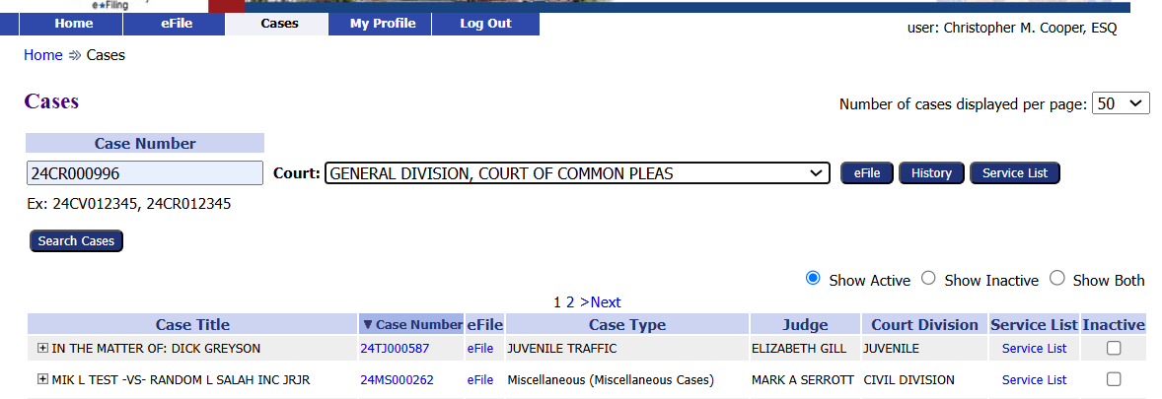
How to File a Bond Hearing Request
There are several options to search for a case.
Option 1
Enter the Case Number
Choose the court from the dropdown
Click the eFile button
Example case: 24CR000996
Notes:
There are several options to search for a case. Option 1 enter the case number, choose the court from the dropdown menu and clicking the efile button

Slide 6
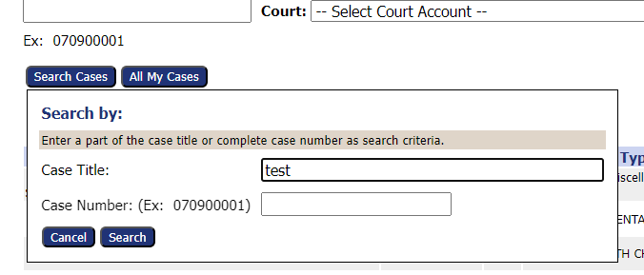
How to File a Bond Hearing Request
Option 2
Click the Search Cases button
Enter part of the Case Title or complete Case Number
Click the Search button
Example: 24CR000996
Notes:
Option 2 click the Search cases button, enter part of the case title or the complete case number, then click the search button

Slide 7
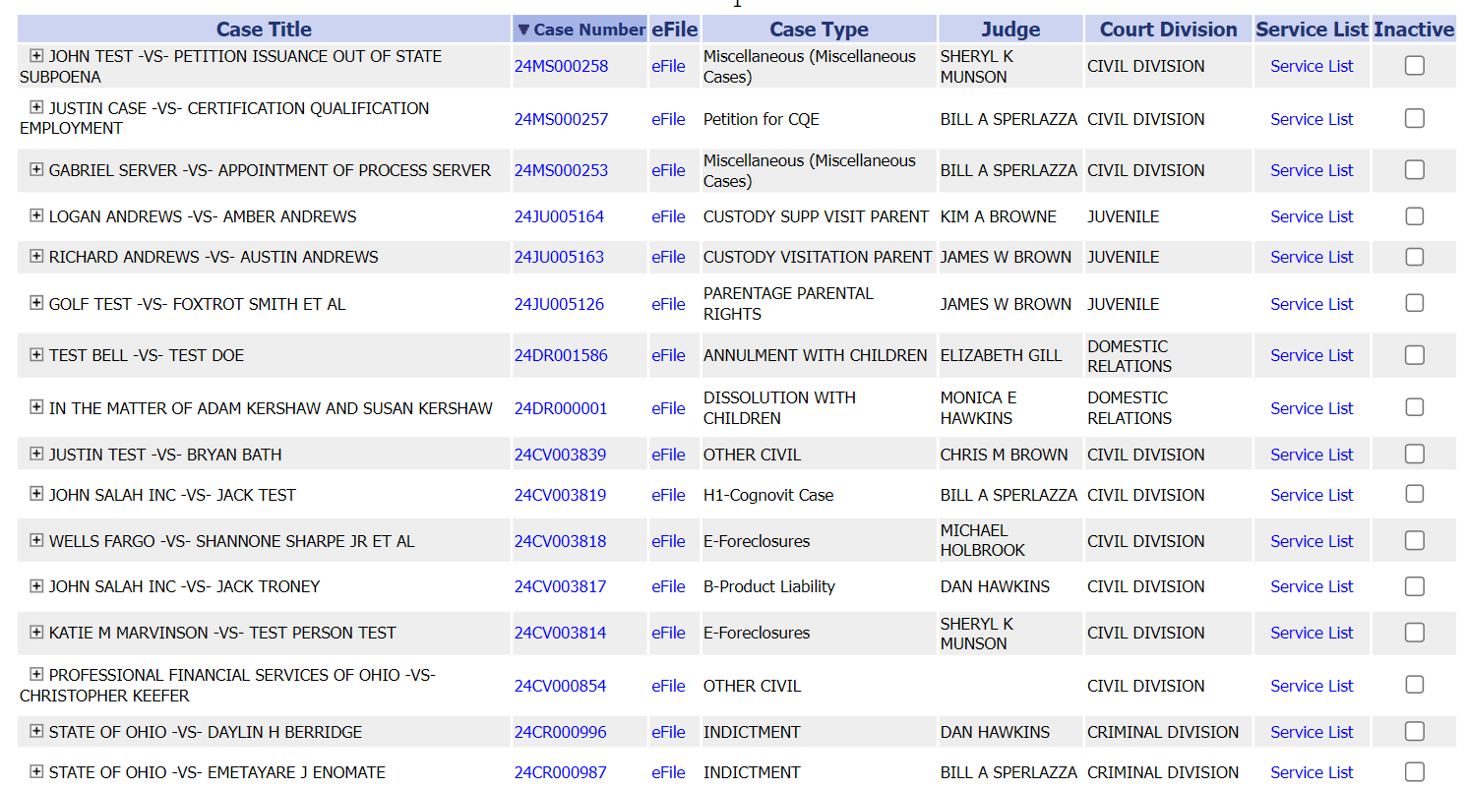
How to File a Bond Hearing Request
Option 3
Find the case from the list of cases.
Click the eFile link
Example: 24CR000996
Notes:
Or Option 3 find the case from the list of cases. Click the efile link.

Slide 8
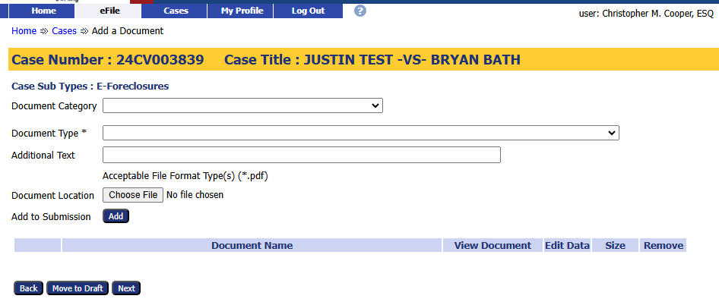
Choose a Document Category and Type
1. Choose a Document Category to filter the number of Document Type choices.
2. Choose a Document Type from the drop-down menu. This is a required field.
Notes:
Once the case is selected the filing page will appear. Confirm the Case Number and Case Title are correct. Choose a document category to filter down the number of document case type choices. Choose document type from the drop down menu. Note Document Type is a required field.

Slide 9
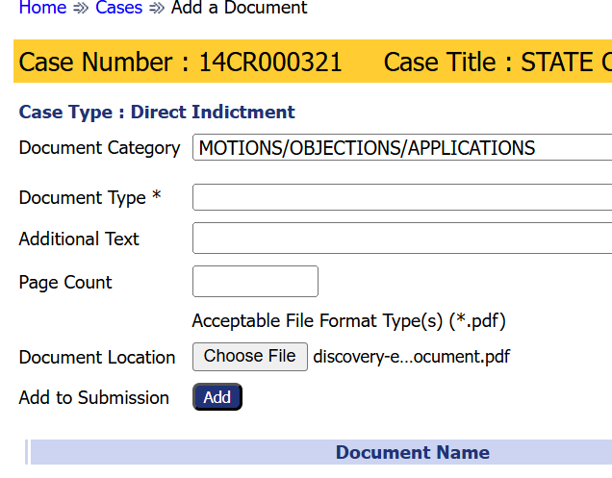
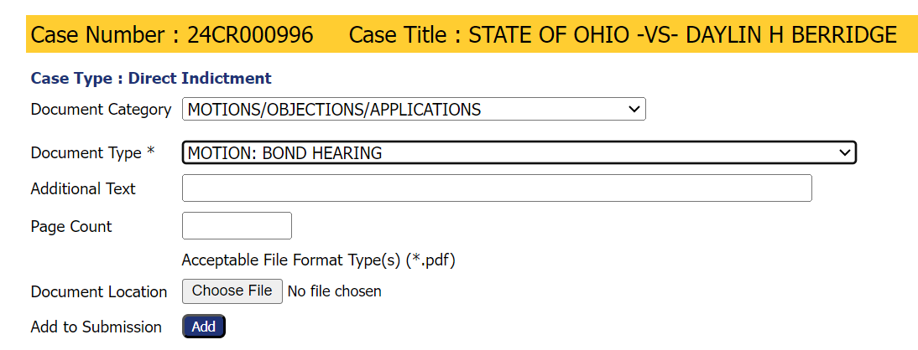
Add a Document
Note the required document format.
2. Click the Choose File button to select and
upload a document.
3. Click the Add button to add
the document to the filing.
Notes:
Before selecting the corresponding document for the filing, take note of the format required for the document. The format for the document depends on the type of filing. In this example, a PDF is required. Choose the document by clicking the choose file button to select and upload the document. After choosing upload, click the add button to add the document to the filing.

Slide 10
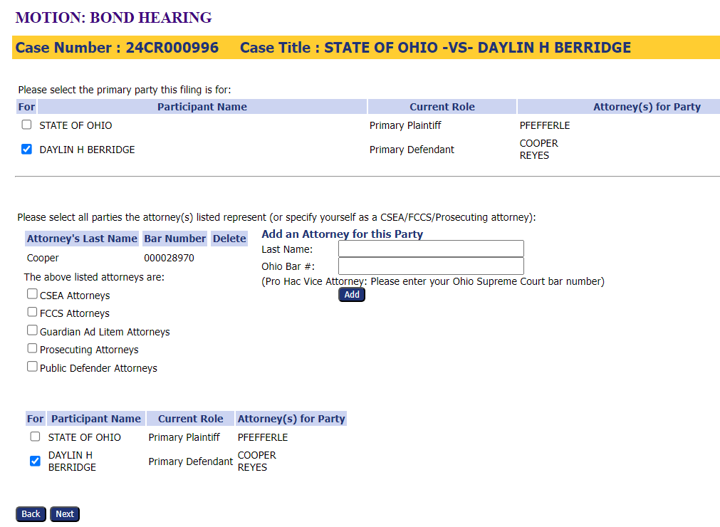
Select the Parties
1. Confirm the Participant’s name is already checked in the top and bottom sections.
2. Confirm the attorney’s [your] name is in the middle section.
3. Add additional attorneys, if needed.
4. Click the Next button.
Notes:
After clicking add, the next screen ask for confirmation of the parties. Confirm the participant’s name is already checked in the top and bottom sections. Confirm the attorney’s name is in the middle section. Add any additional attorneys for the party, if needed. If everything is correct, click the next button.

Slide 11
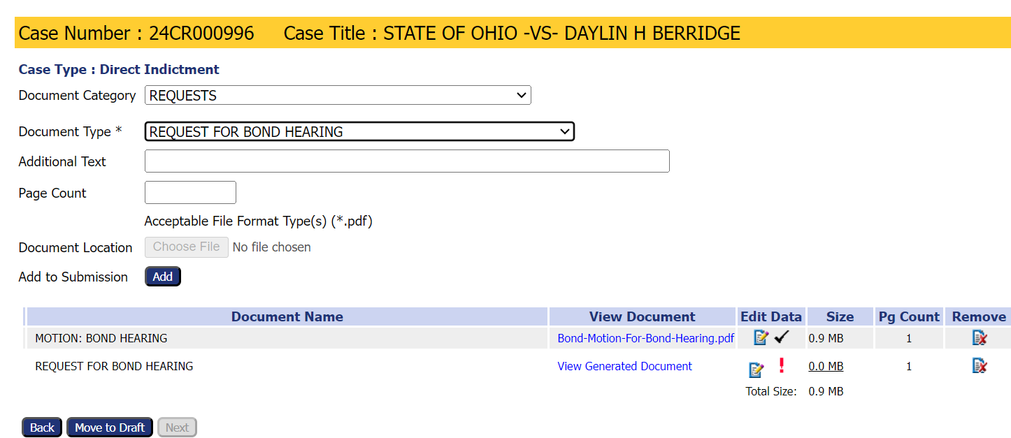
Add and/or Remove Documents
Add a Request for Bond Hearing document by choosing it from the document type menu and clicking add.
Add or remove any other needed documents before completing the filing process.
Select the Next button to continue with the file submission even if no new documents are added.
Notes:
Add a request for a bond hearing document by choosing it from the document type menu and clicking add. This is a system generated document and does not require a document upload, however, At this time you can add or remove any other necessary documents. Select the next button to continue with the filing submission

Slide 12
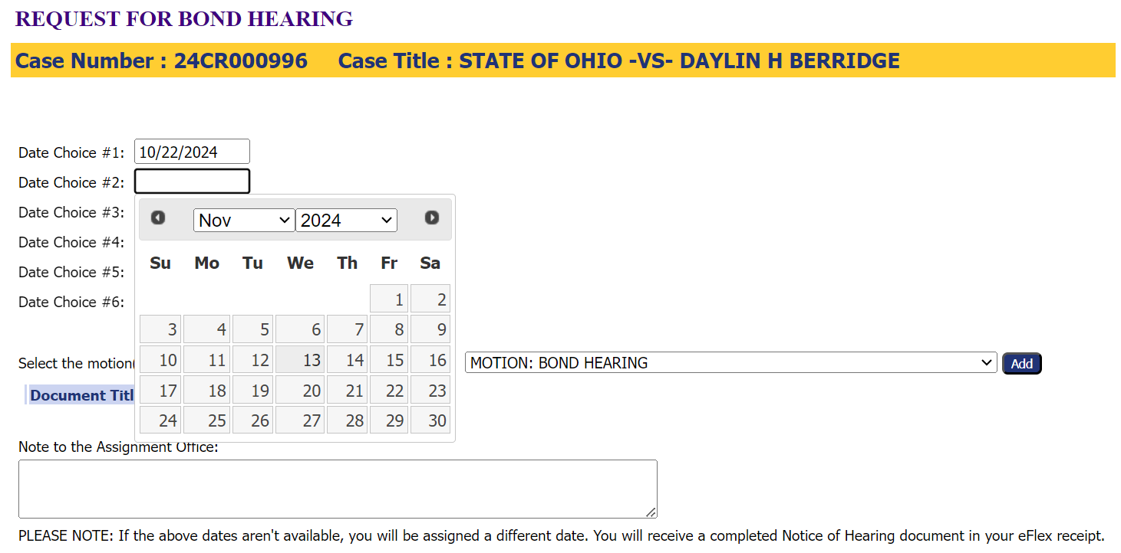
Choose Potential Court Dates
Select up to six court dates.
Add any additional notes.
Add the document(s) by selecting each one from the drop-down menu and clicking Add for each document.
Click Next.
Notes:
Choose up to 6 potential court dates. Add additional notes to the Assignment Office such as you aren’t available Fridays, or other information that may impact when the court date is scheduled if your preferences are not available. Add the document from the drop down menu to the request for bond hearing court dates and click add. Click Next to continue.

Slide 13
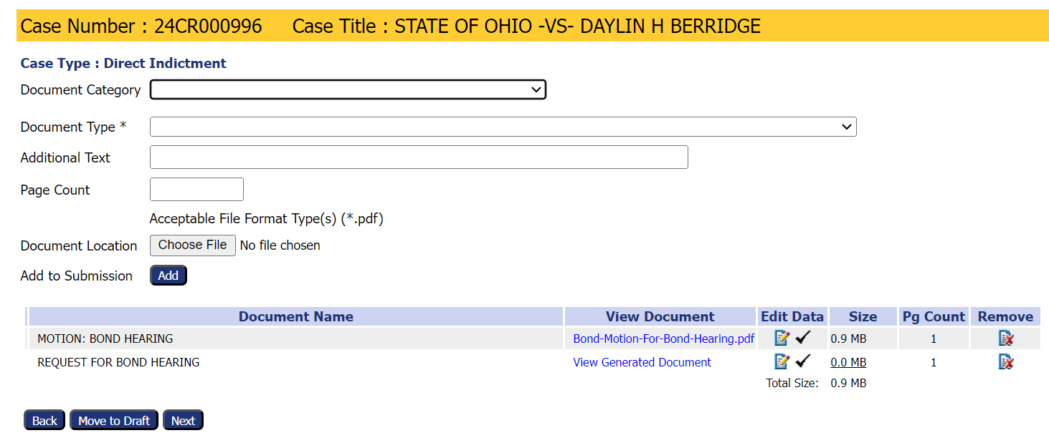
Continue with Filing
Add or remove documents before completing the filing process.
Select the Next button to continue with file submission even if no new documents are added.
Notes:
Back at the add documents screen you can ensure all the needed documents are added or remove any incorrect documents. Select the next button to continue with the file submission.

Slide 14
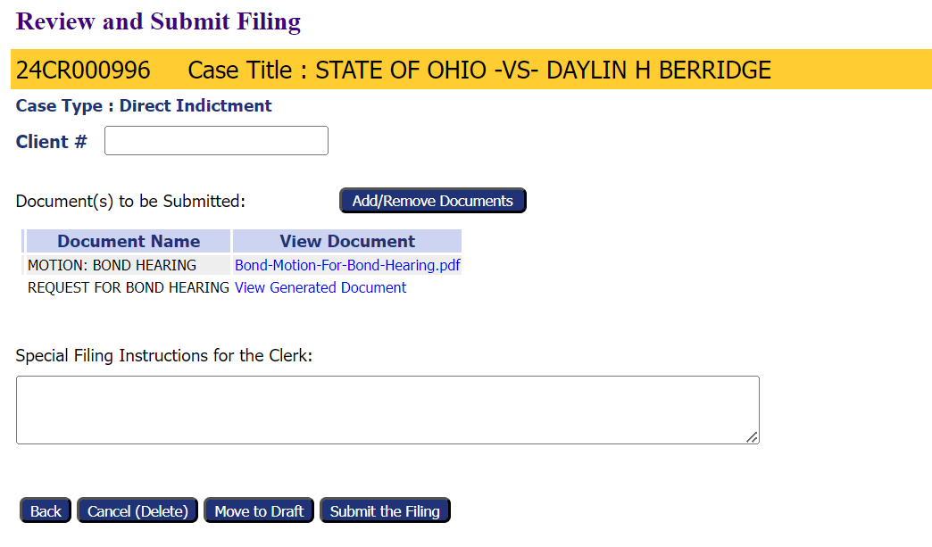
Submit the Filing
Use the optional Client # field to enter an office case reference number.
Add or Remove additional documents, if needed.
Add any filing notes
Other options
Cancel (Delete) the filing
Move to Draft – Save the filing to be completed later.
Submit the Filing – completes the filing process.
Notes:
Review the filing before submitting. There is an optional Client # field so an office reference number can be added. Review the documents to be submitted and add or remove as needed. To request a bond hearing the Motion Bond Hearing and Request for Bond Hearing are needed. Add any filing notes. At this point, if the filing is not ready, it can be cancelled (deleted), Moved to draft filings for completion later, or submitted to complete the filing process.

Slide 15
Submission Confirmation
A confirmation of submission will appear.
Click on the Filing Status to check where the filing is in the approval process.
*Note- Filed references that the filing has been accepted.
Notes:
A confirmation of submission will appear. Clicking on the Filing Status button to check on the status of the approval or acceptance of the filing.

Slide 16
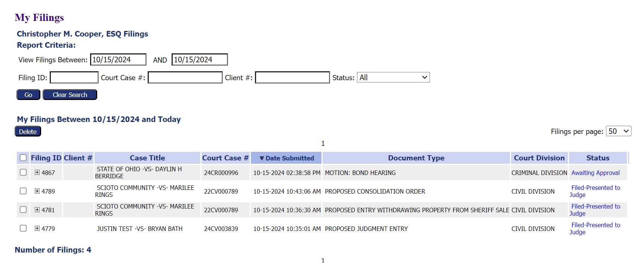
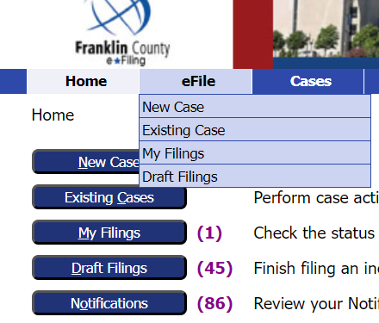
Filing Status
Clicking the Filing Status button brings up a list of all filed cases and their status.
Users can search for a specific case on this page.
This page can be reached by clicking My Filings from the Home page
or by going to the eFile tab and selecting My Filings from the drop-down menu.
Notes:
Clicking the Filing Status button will bring up a list of all cases that have been filed and show their filing status. You can search for a specific case by enter the search parameters and choosing search. The Filing Status list can always be reached by clicking My Filing from the home page or by going to the eFile tab and selecting My Filings from the drop-down menu.

Slide 17
Thank you for using the
Franklin County e-Filing System
For help or questions about e-filing, contact the Clerk of Courts Office by email at franklincountyclerk@franklincountyohio.gov.
Notes:
Thank you for using the Franklin County e-filing System. For help or questions about filing, contact the Clerk of Courts Office at 614.525.3600 or email at franklincountyclerk@franklincountyohio.gov

