Slide 1
Introduction to e-Filing
Filing to an Existing Civil Case

Slide 2
Topics for this Presentation
Helpful Technologies
How to File to an Existing Civil Case
How to Check for the Filing Status
Where to Get Help

Slide 3
Helpful Technologies
A Scanner - with a recommended setting of 300 dpi
A PDF Converter
Print to PDF
Word or other similar product that allows Save to PDF
Online Adobe Word to PDF Converter
Note – Word documents must be in a .docx format

Slide 4
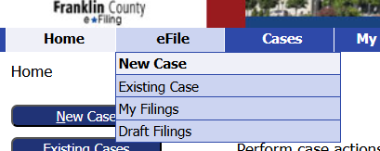
File to an Existing Civil Case
From the Home screen, click on the Existing Cases button.
Or go to the eFile tab and select Existing Cases from the dropdown menu.

Slide 5
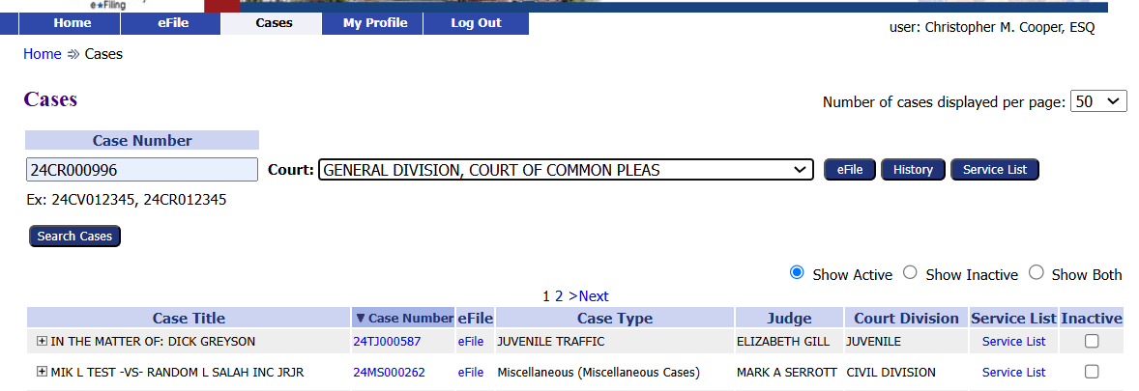
File to an Existing Civil Case
There are several options to search for a case.
Option 1
Enter the Case Number
Choose the court from the dropdown
Click the eFile button
Example case: 24CV003839
Notes:
There are several options to search for a case. Option 1 enter the case number, choose the court from the dropdown menu and clicking the efile button

Slide 6
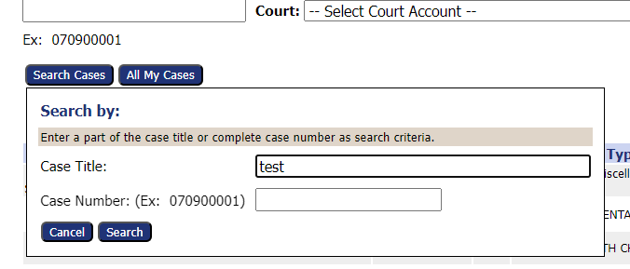
File to an Existing Civil Case
Option 2
Click the Search Cases button
Enter part of the Case Title or complete Case Number
Click the Search button
Example: 24CV003839
Notes:
Option 2 click the Search cases button, enter part of the case title or the complete case number, then click the search button

Slide 7
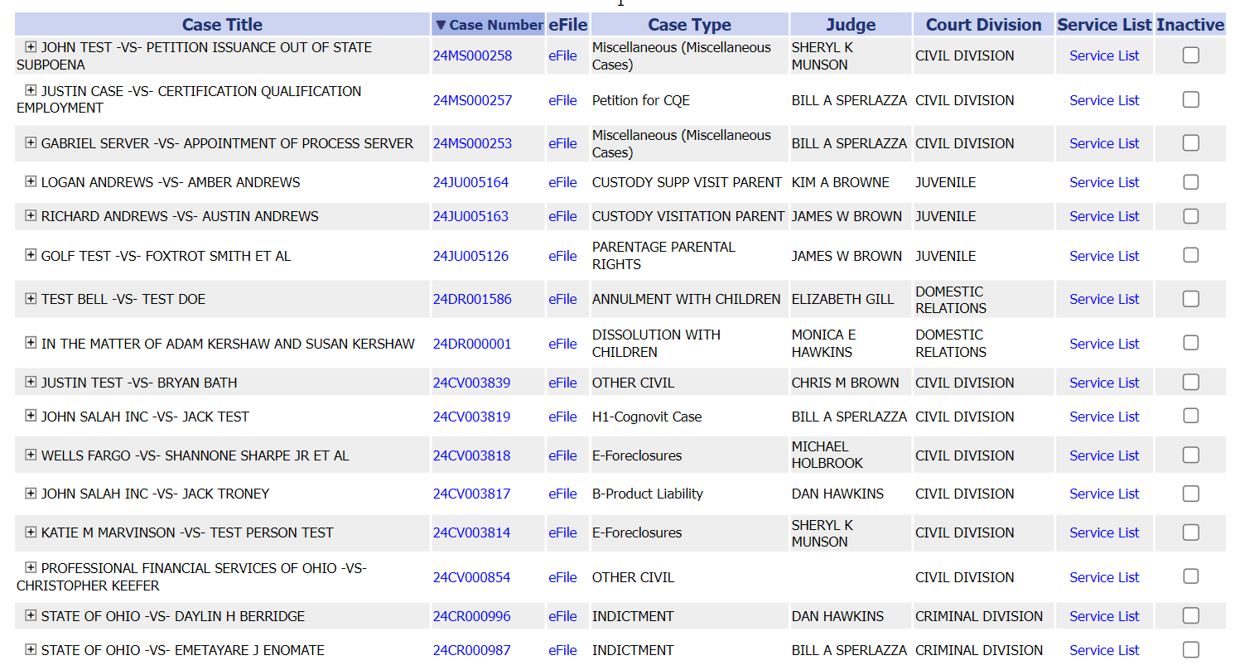
File to an Existing Civil Case
Option 3
Find the case from the list of cases.
Click the eFile link
Example: 24CV003839
Notes:
Or Option 3 find the case from the list of cases. Click the efile link.

Slide 8
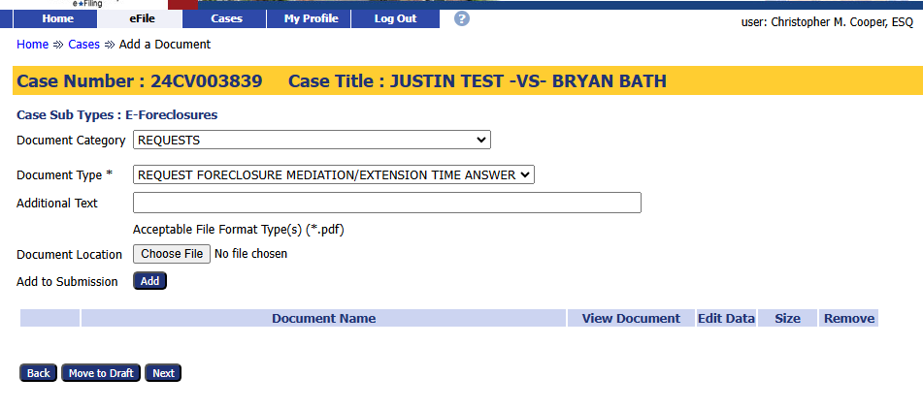
File to an Existing Civil Case
1. Choose a Document Category to filter the number of Document Type choices.
2. Choose a Document Type from the drop-down menu. This is a required field.

Slide 9
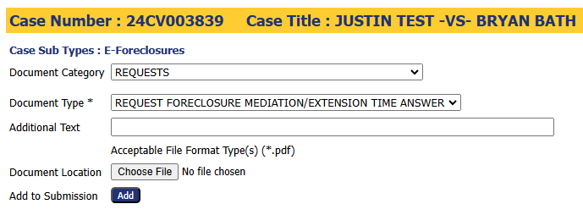
1. Note the required document format.
3. Click the Add button to add
the document to the filing.
2. Click the Choose File button to select and
upload a document.
File to an Existing Civil Case

Slide 10
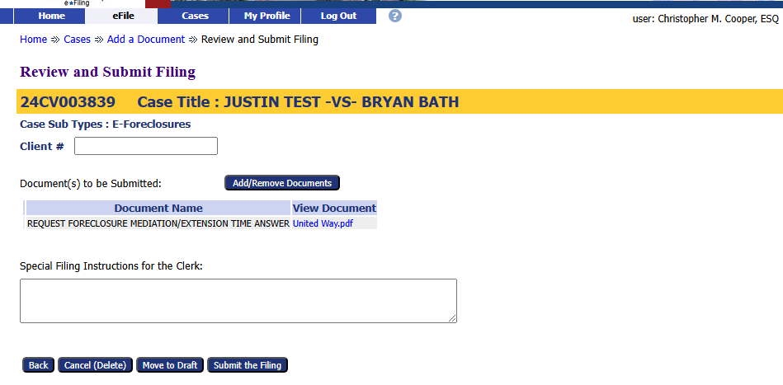
Use the optional Client # field to enter an office case reference number.
Add or Remove additional documents, if needed.
Add any filing notes
Other options
Cancel (Delete) the filing
Move to Draft – Save the filing to be completed later.
Submit the Filing – complete the filing process.
File to an Existing Civil Case

Slide 11
File to an Existing Civil Case
Click the Filing Status button to view where your filing is in the approval process.

Slide 12
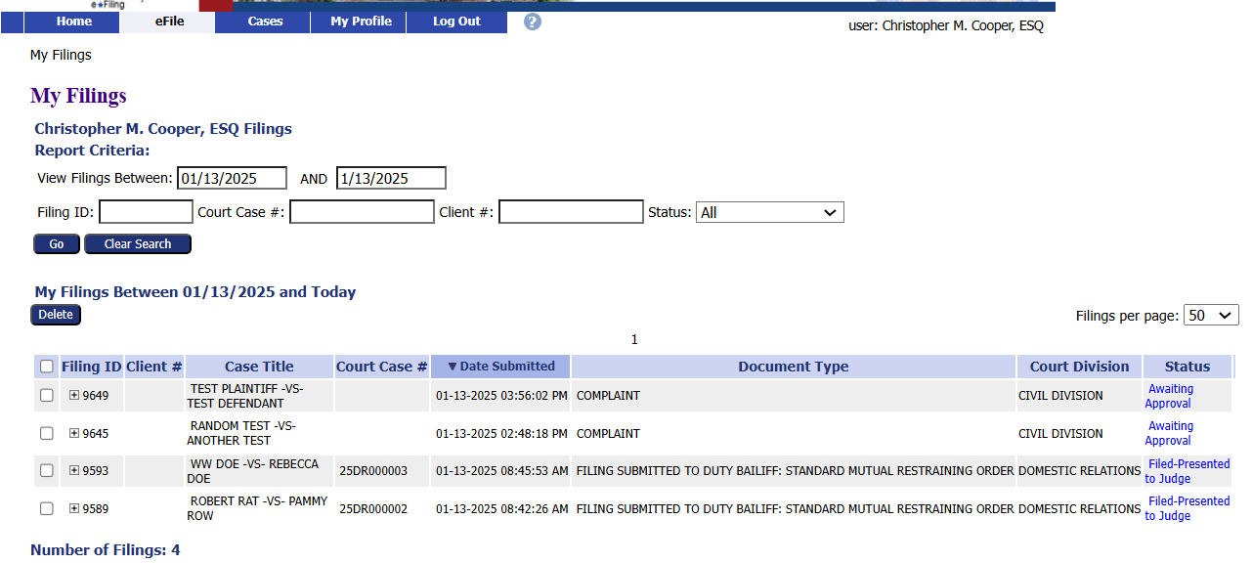
File to an Existing Civil Case
Clicking the Filing Status button brings up a list of all filed cases and their status.
Users can search for a specific case on this page.

Slide 13
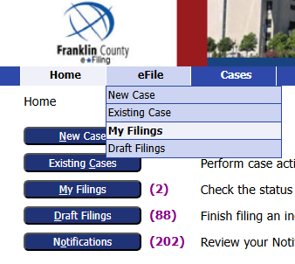
File to an Existing Civil Case
The filings status page can be reached by clicking My Filings from the Home page
or by going to the eFile tab and selecting My Filings from the drop-down menu.

Slide 14
Thank you for using the
Franklin County e-Filing System
For help or questions about e-filing, contact the Clerk of Courts Office by email at franklincountyclerk@franklincountyohio.gov.

