Slide 1
Introduction to Domestic Relations e-Filing
Filing a New Case
Franklin County Clerk of Courts
Notes:
Welcome to the Franklin County Ohio Clerk of Courts’ Introduction to Criminal e-Filing. This e-filing system will allow cases and documents to be electronically filed for cases in the Common Pleas courts. During this tutorial, you will learn how to file a Request for a Bond hearing.

Slide 2
Topics for this Presentation
Helpful Technologies
How to File A New Case
How to Check for Notifications
Where to Get Help
Notes:
During this presentation, we will cover helpful technologies, how to file a bond hearing request, how to check for notifications on cases, and where to get help

Slide 3
Helpful Technologies
A Scanner - with a recommended setting of 300 dpi
A PDF Converter
Print to PDF
Word or other similar product that allows Save to PDF
Online Adobe Word to PDF Converter
Note – Word documents must be in a .docx format
Notes:
Some helpful technologies are a scanner with the recommended setting of 300dpi. A way to convert documents into a PDF format such as using Print to PDF, embedded PDF Converter in Word or other similar products or an online word to PDF Converter. Word documents must be in a .docx format.

Slide 4
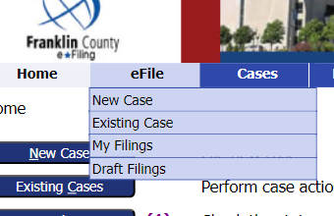
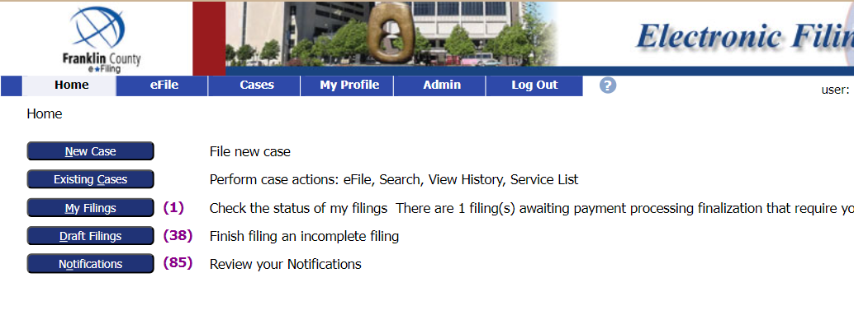
How to File a New Case
Log into your e-Filing account.
From the Home tab select
New Case Button on the left or
go to eFile tab, then choose New Case, from the dropdown menu
Notes:
After logging into your efiling account, select File to an existing case by clicking on the Existing Case button on the left or going to the efile tab and selecting Existing case from the dropdown menu.

Slide 5
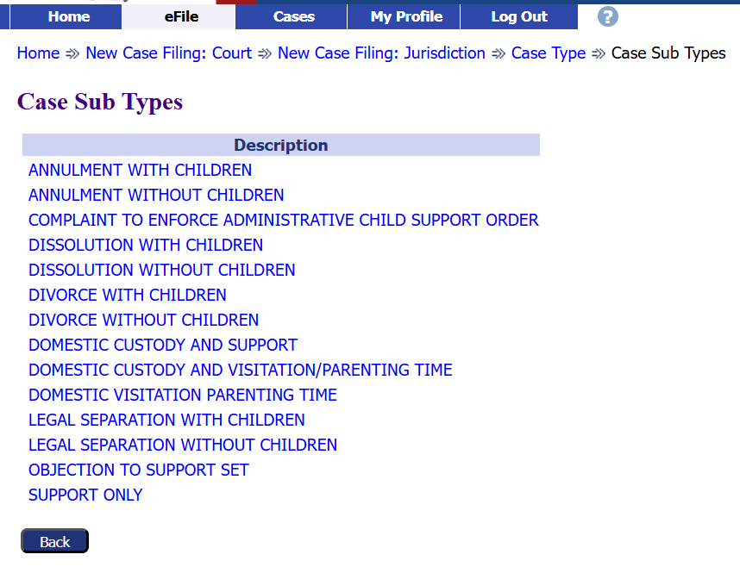
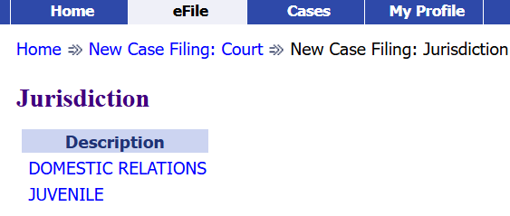
How to File a New Case
Select Domestic Relations and Juvenile, Court of Common Pleas.
Select Domestic Relations.
Select the appropriate Case Sub Type.

Slide 6
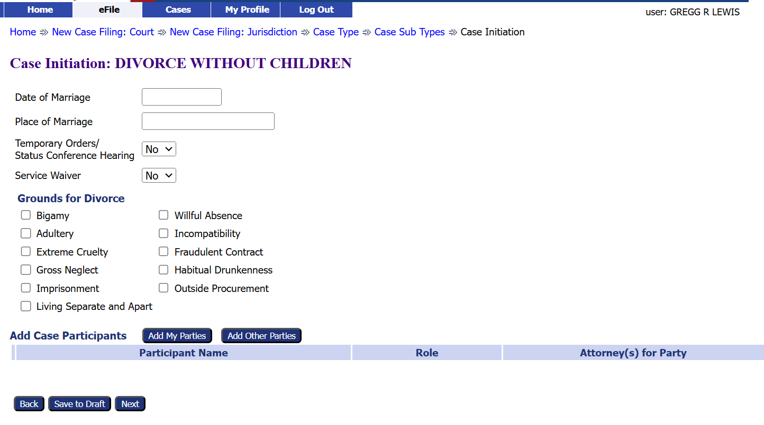
How to File a New Case
Add the case information.
Click the Add My Parties button.
Notes:
Option 2 click the Search cases button, enter part of the case title or the complete case number, then click the search button

Slide 7
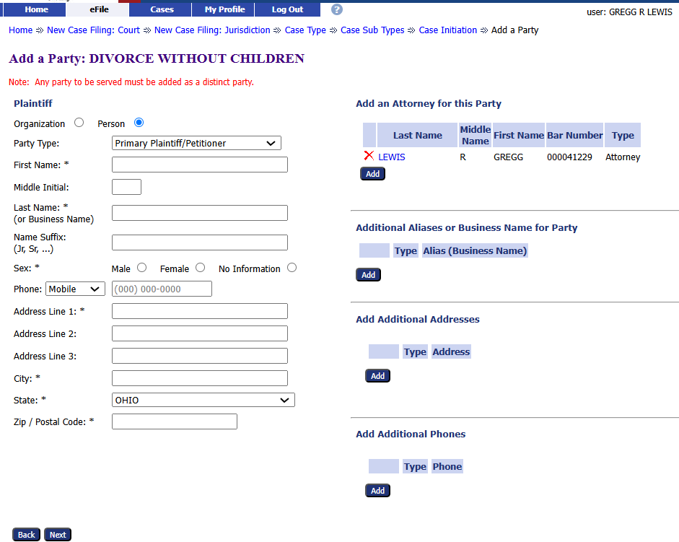
How to File a New Case
Add the party information. The * fields are required.
Add any additional attorneys.
Add any additional aliases.
Add any additional addresses.
Add any additional phones.
Notes:
Or Option 3 find the case from the list of cases. Click the efile link.

Slide 8
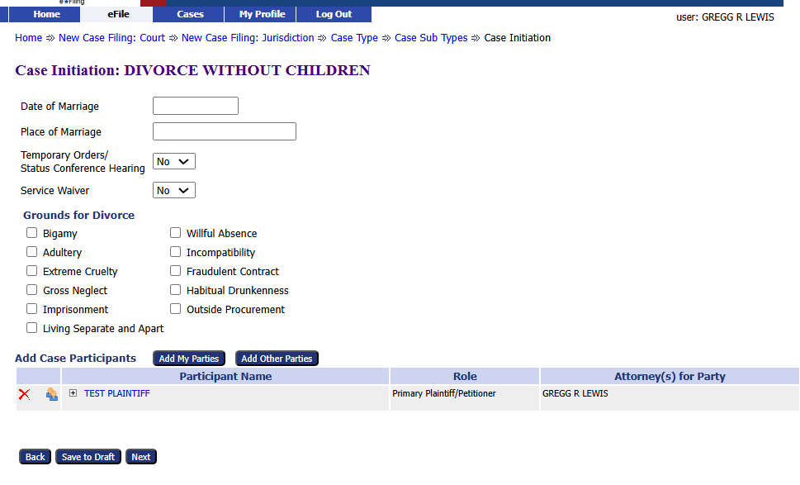
How to File a New Case
Add the case information.
Click the Add Other Parties button.
Notes:
Option 2 click the Search cases button, enter part of the case title or the complete case number, then click the search button

Slide 9
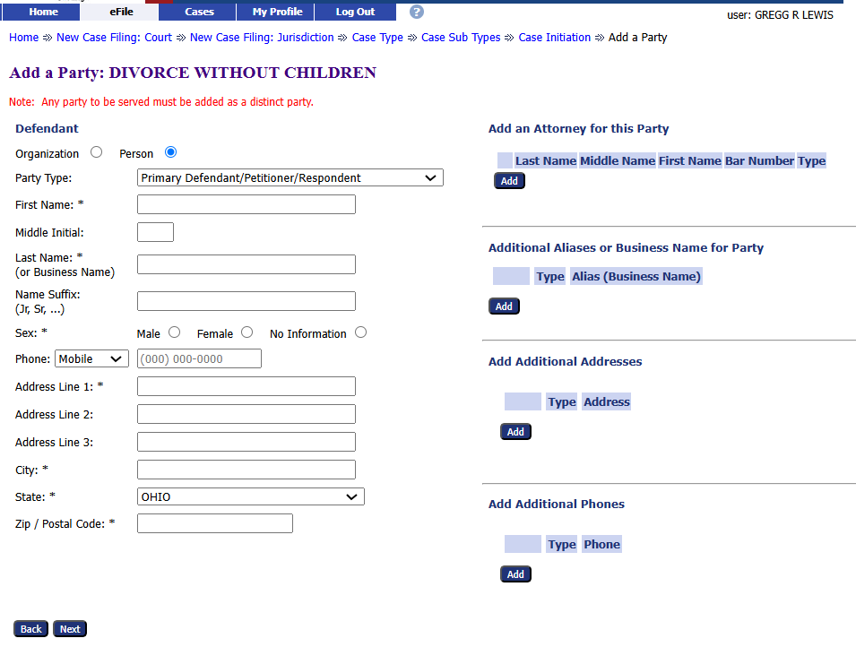
How to File a New Case
Add the party information. The * fields are required.
Add any additional attorneys.
Add any additional aliases.
Add any additional addresses.
Add any additional phones.
Notes:
Or Option 3 find the case from the list of cases. Click the efile link.

Slide 10
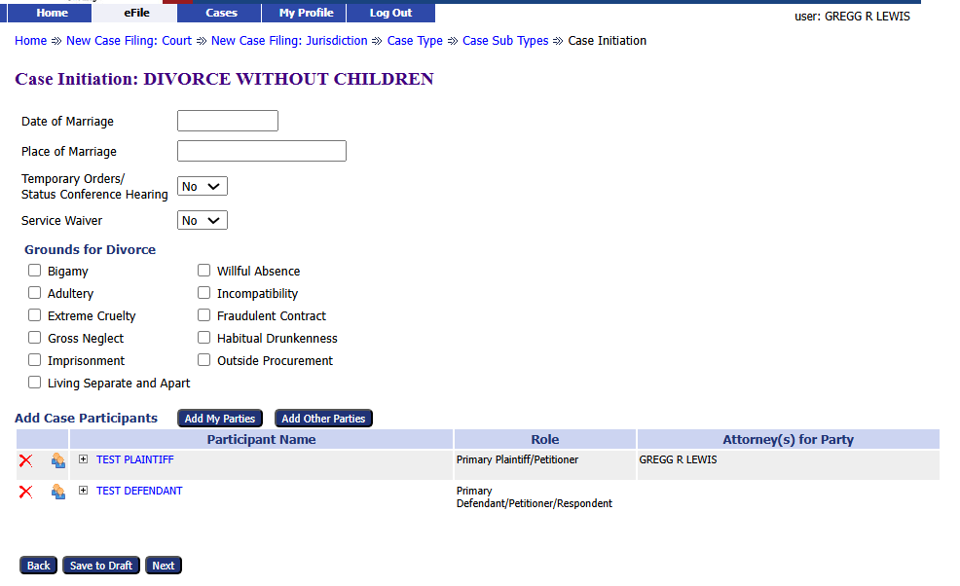
How to File a New Case
Add more parties, if needed.
Notes:
Option 2 click the Search cases button, enter part of the case title or the complete case number, then click the search button

Slide 11
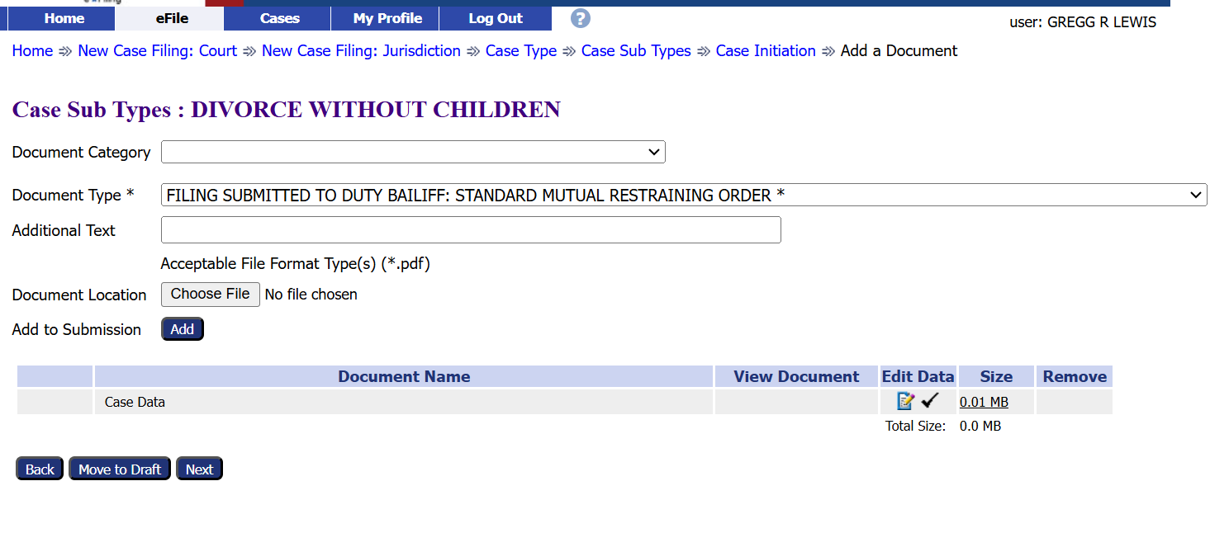
Choose a Document Category Type
1. Choose a Document Category to filter the number of Document Type choices.
2. Choose a Document Type from the drop-down menu. This is a required field.
Notes:
Once the case is selected the filing page will appear. Confirm the Case Number and Case Title are correct. Choose a document category to filter down the number of document case type choices. Choose document type from the drop down menu. Note Document Type is a required field.

Slide 12
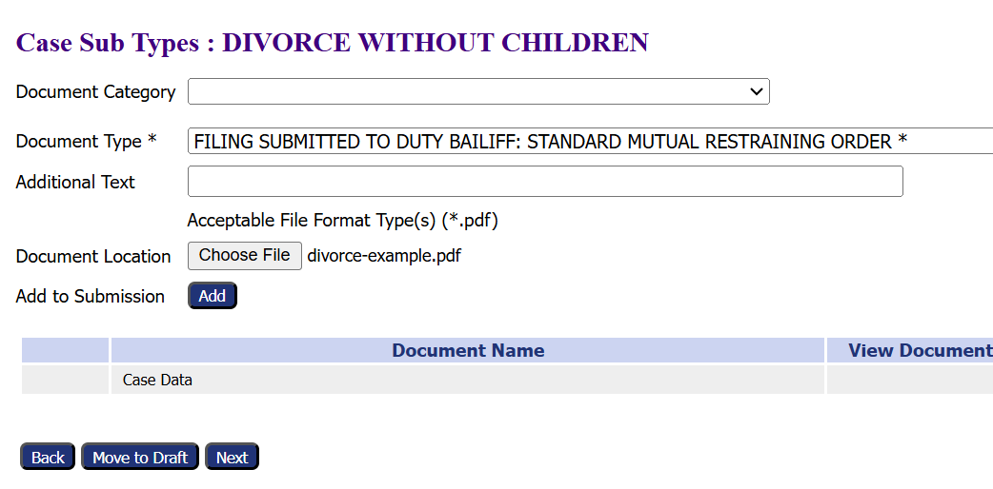
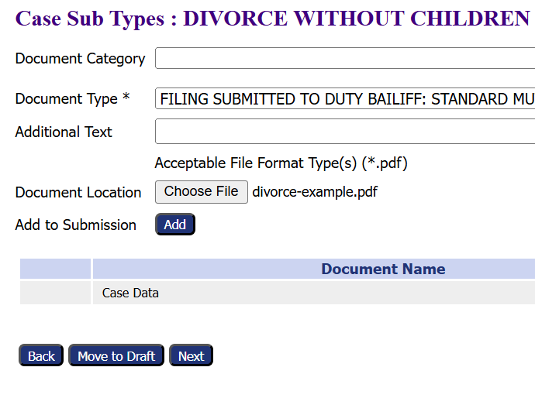
Add a Document
Note the required document format.
3. Click the Add button to add
the document to the filing.
2. Click the Choose File button to select and
upload a document.
Notes:
Before selecting the corresponding document for the filing, take note of the format required for the document. The format for the document depends on the type of filing. In this example, a PDF is required. Choose the document by clicking the choose file button to select and upload the document. After choosing upload, click the add button to add the document to the filing.

Slide 13
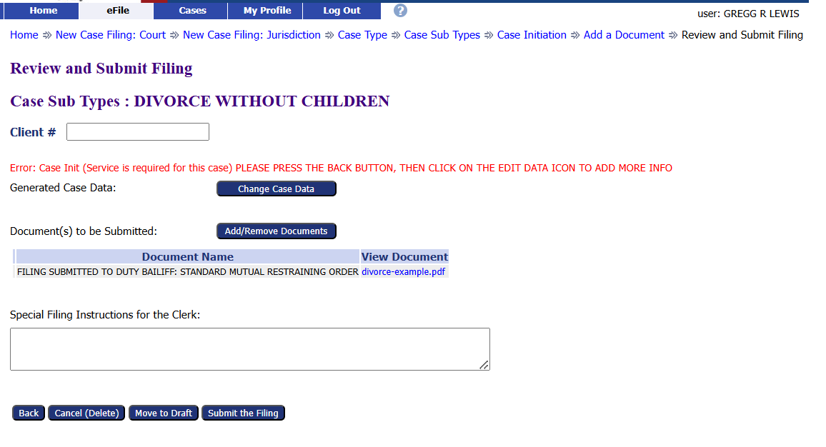
File a New Case
The message in red indicates that a service request needs to be added to the filing.
Click the Back button to return to the Add Documents page.
Notes:
Before selecting the corresponding document for the filing, take note of the format required for the document. The format for the document depends on the type of filing. In this example, a PDF is required. Choose the document by clicking the choose file button to select and upload the document. After choosing upload, click the add button to add the document to the filing.

Slide 14
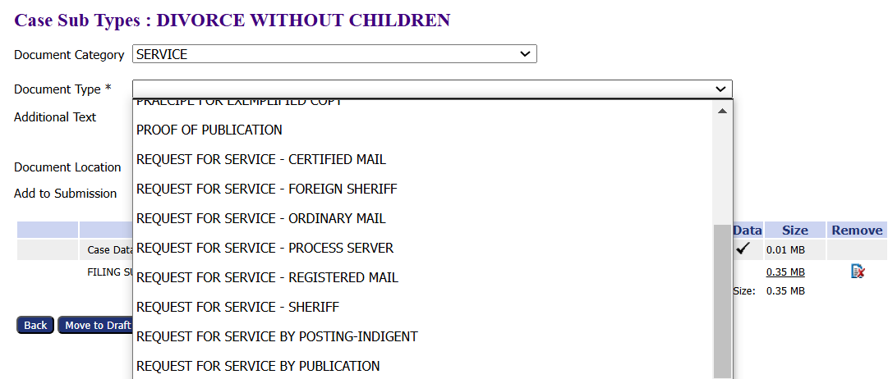
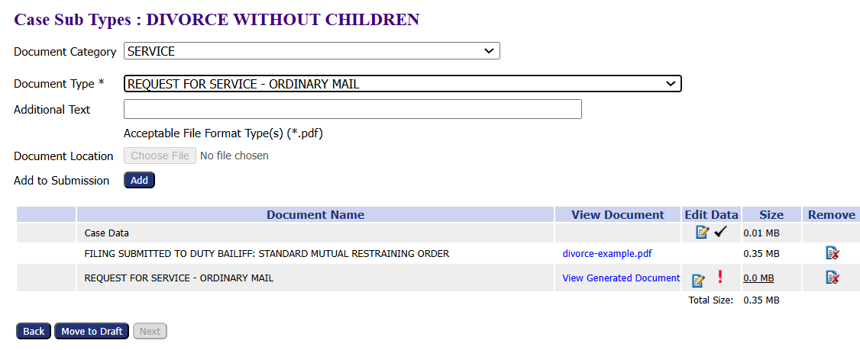
File a New Case
Select Service from the Document Category dropdown menu.
Select the type of service from the Document Type dropdown menu.
Service is a system-generated form and does not require a document upload. Just click the Add button.
Notes:
Before selecting the corresponding document for the filing, take note of the format required for the document. The format for the document depends on the type of filing. In this example, a PDF is required. Choose the document by clicking the choose file button to select and upload the document. After choosing upload, click the add button to add the document to the filing.

Slide 15
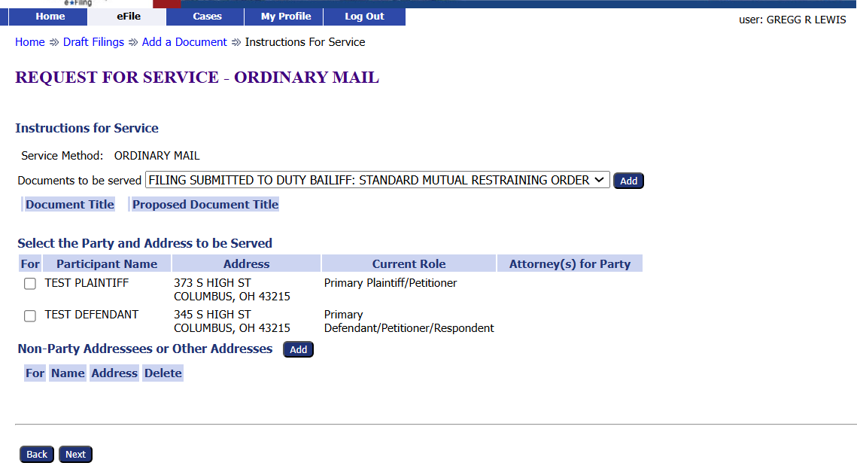
File a New Case
Select the documents to be served from the dropdown menu.
Click Add.
Use the checkboxes to select which parties should be served.
Click the Next button.
Notes:
Before selecting the corresponding document for the filing, take note of the format required for the document. The format for the document depends on the type of filing. In this example, a PDF is required. Choose the document by clicking the choose file button to select and upload the document. After choosing upload, click the add button to add the document to the filing.

Slide 16
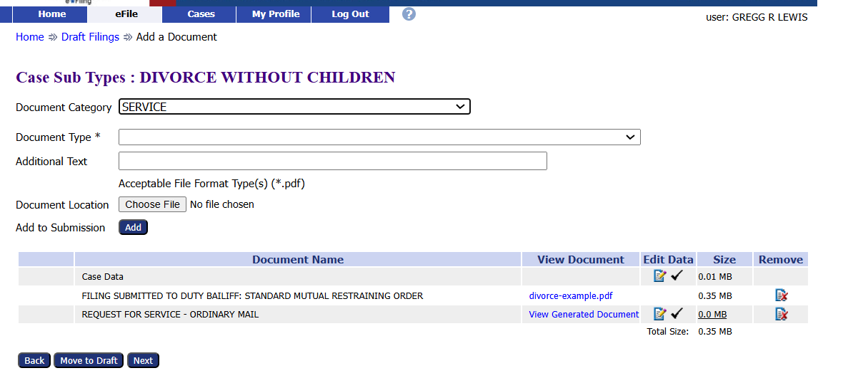
File a New Case
Add or remove additional documents, if necessary.
Click the Next button to continue with the filing.
Notes:
Before selecting the corresponding document for the filing, take note of the format required for the document. The format for the document depends on the type of filing. In this example, a PDF is required. Choose the document by clicking the choose file button to select and upload the document. After choosing upload, click the add button to add the document to the filing.

Slide 17
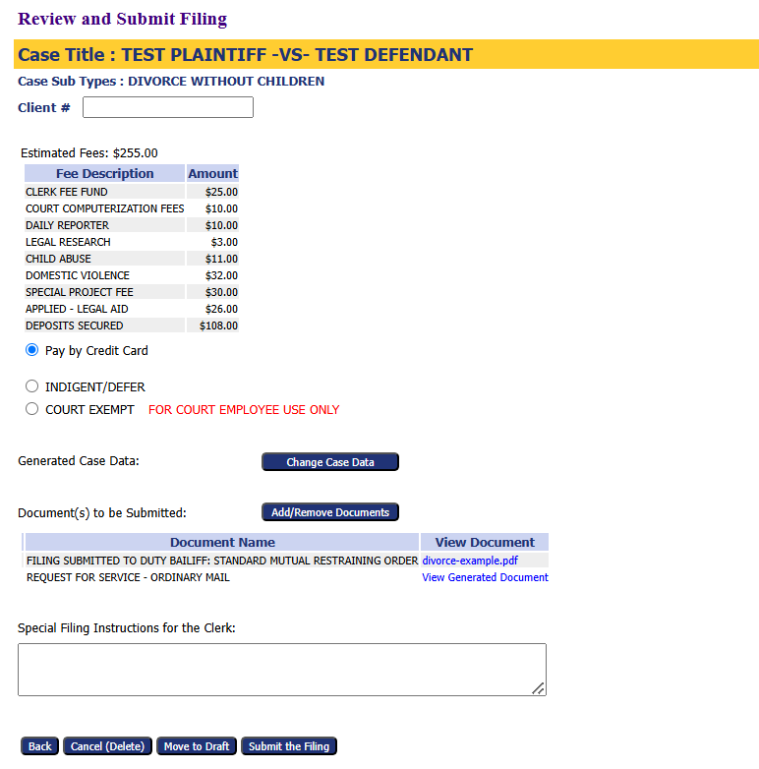
Submit the Filing
Use the optional Client # field to enter an office case reference number.
Add or Remove additional documents, if needed.
Add any filing notes
Other options
Cancel (Delete) the filing
Move to Draft – Save the filing to be completed later.
Submit the Filing – completes the filing process.
Notes:
Review the filing before submitting. There is an optional Client # field so an office reference number can be added. Review the documents to be submitted and add or remove as needed. To request a bond hearing the Motion Bond Hearing and Request for Bond Hearing are needed. Add any filing notes. At this point, if the filing is not ready, it can be cancelled (deleted), Moved to draft filings for completion later, or submitted to complete the filing process.

Slide 18
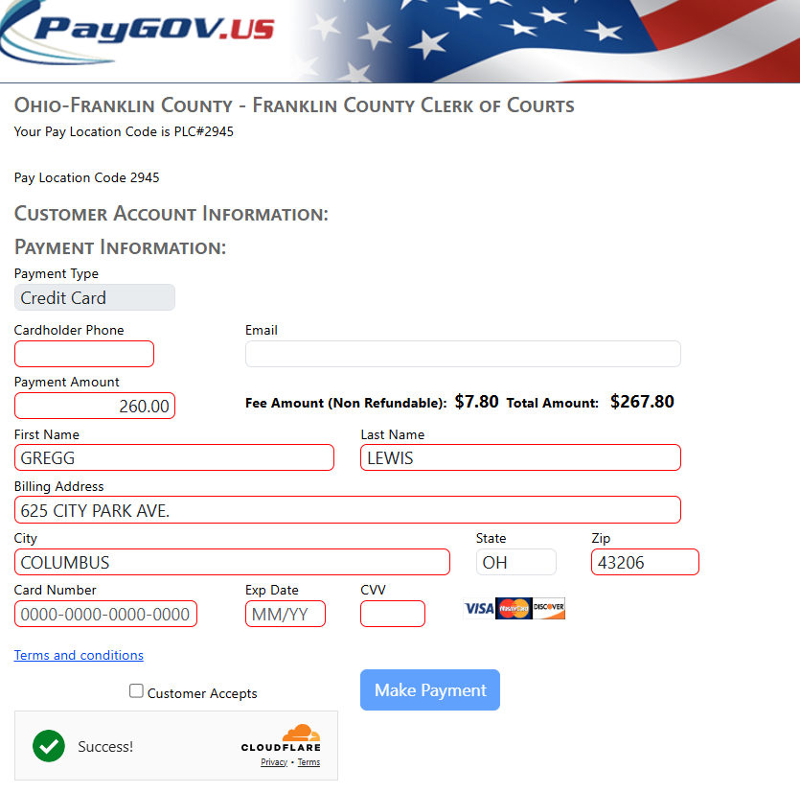
File a New Domestic Relations Case
You are taken to the PayGov.US website to pay any filing fees.
Enter the payment information.
Accept the Terms and Conditions by checking the Customer Accepts box.
Verify the Captcha by checking the Cloudflare box.
Click the Make Payment button to submit the payment.
Notes:
A confirmation of submission will appear. Clicking on the Filing Status button to check on the status of the approval or acceptance of the filing.

Slide 19
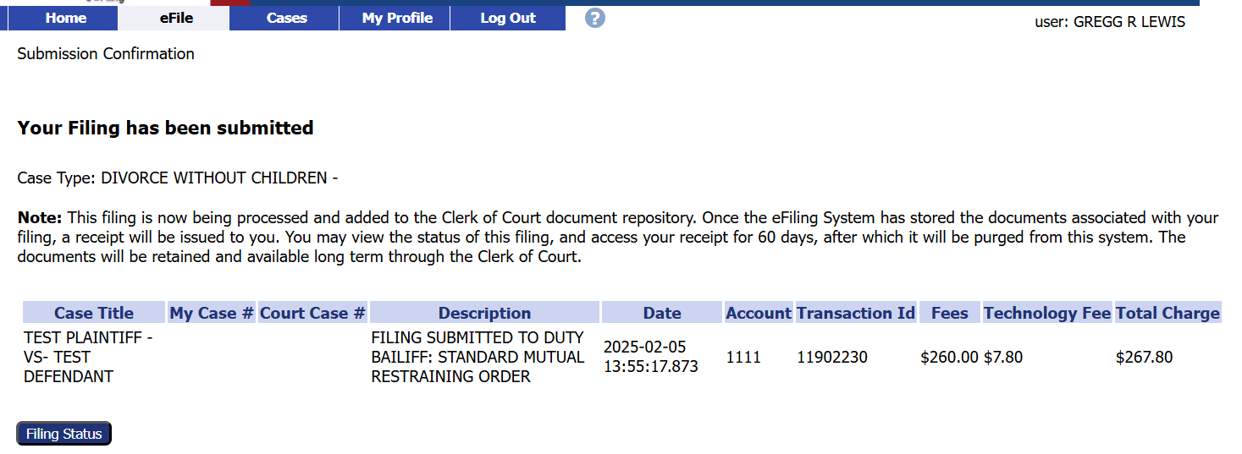
Submission Confirmation
A confirmation of submission will appear.
Click on the Filing Status to check where the filing is in the approval process.
*Note-Approval references that the filing has been accepted.
Notes:
A confirmation of submission will appear. Clicking on the Filing Status button to check on the status of the approval or acceptance of the filing.

Slide 20
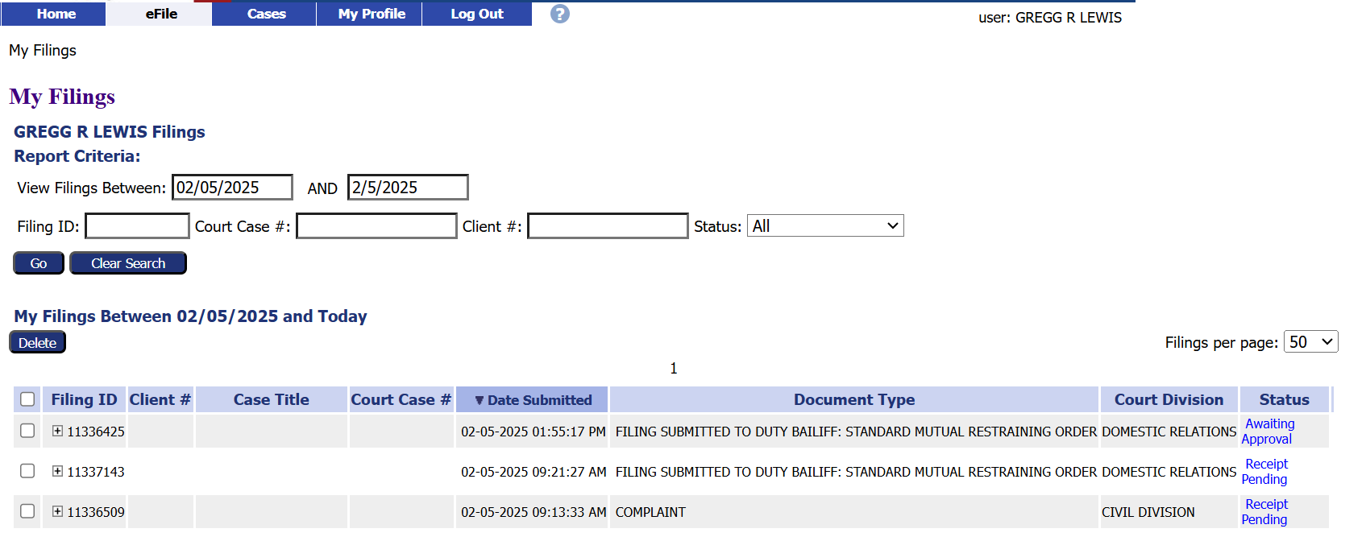
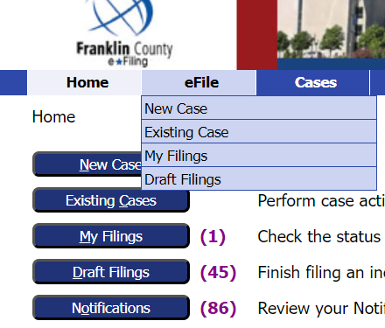
Filing Status
Clicking the Filing Status button brings up a list of all filed cases and their status.
Users can search for a specific case on this page.
This page can be reached by clicking My Filings from the Home page
or by going to the eFile tab and selecting My Filings from the drop-down menu.
Notes:
Clicking the Filing Status button will bring up a list of all cases that have been filed and show their filing status. You can search for a specific case by enter the search parameters and choosing search. The Filing Status list can always be reached by clicking My Filing from the home page or by going to the eFile tab and selecting My Filings from the drop-down menu.

Slide 21
Thank you for using the
Franklin County e-Filing System
For help or questions about e-filing, contact the Clerk of Courts Office by email at franklincountyclerk@franklincountyohio.gov.
Notes:
Thank you for using the Franklin County e-filing System. For help or questions about filing, contact the Clerk of Courts Office at 614.525.3600 or email at franklincountyclerk@franklincountyohio.gov

