Slide 1
Introduction to Appeals e-Filing
Filing to an Existing Case
Franklin County Clerk of Courts
Notes:
Welcome to the Franklin County Ohio Clerk of Courts’ Introduction to Civil e-Filing. This e-filing system will allow cases and documents to be electronically filed for cases in the Common Pleas courts. During this tutorial, you will learn how to file a new case in the Civil court.

Slide 2
Topics for this Presentation
Helpful Technologies
How to File to an Existing Case
How to Check for the Filing Status
Where to Get Help
Notes:
During this presentation, we will cover helpful technologies, how to file a bond hearing request, how to check for notifications on cases, and where to get help

Slide 3
Helpful Technologies
A Scanner - with a recommended setting of 300 dpi
A PDF Converter
Print to PDF
Word or other similar product that allows Save to PDF
Online Adobe Word to PDF Converter
Note – Word documents must be in a .docx format
Notes:
Some helpful technologies are a scanner with the recommended setting of 300dpi. A way to convert documents into a PDF format such as using Print to PDF, embedded PDF Converter in Word or other similar products or an online word to PDF Converter. Word documents must be in a .docx format.

Slide 4
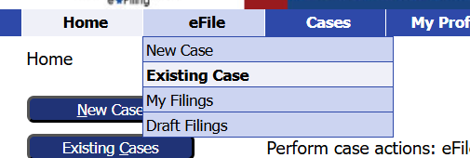
File to an Existing Case
Select Existing Cases from the Home page OR
Go to the eFile tab and select Existing Case from the dropdown menu.
Notes:
Choose the General Division, Court of Common Pleas, then from the Jurisdiction menu, choose Civil Division.

Slide 5
File to an Existing Appeals Case
There are several options to search for a case.
Option 1
Enter the Case Number
Choose the court from the dropdown
Click the eFile button
Example case: 09AP000594
Notes:
Or Option 3 find the case from the list of cases. Click the efile link.

Slide 6
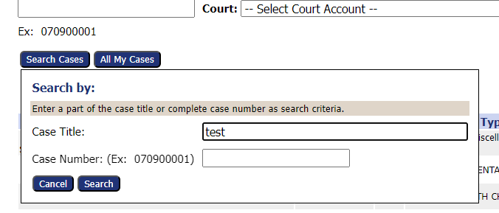
File to an Existing Appeals Case
Option 2
Click the Search Cases button
Enter part of the Case Title or complete Case Number
Click the Search button
Example: 09AP000594
Notes:
Or Option 3 find the case from the list of cases. Click the efile link.

Slide 7
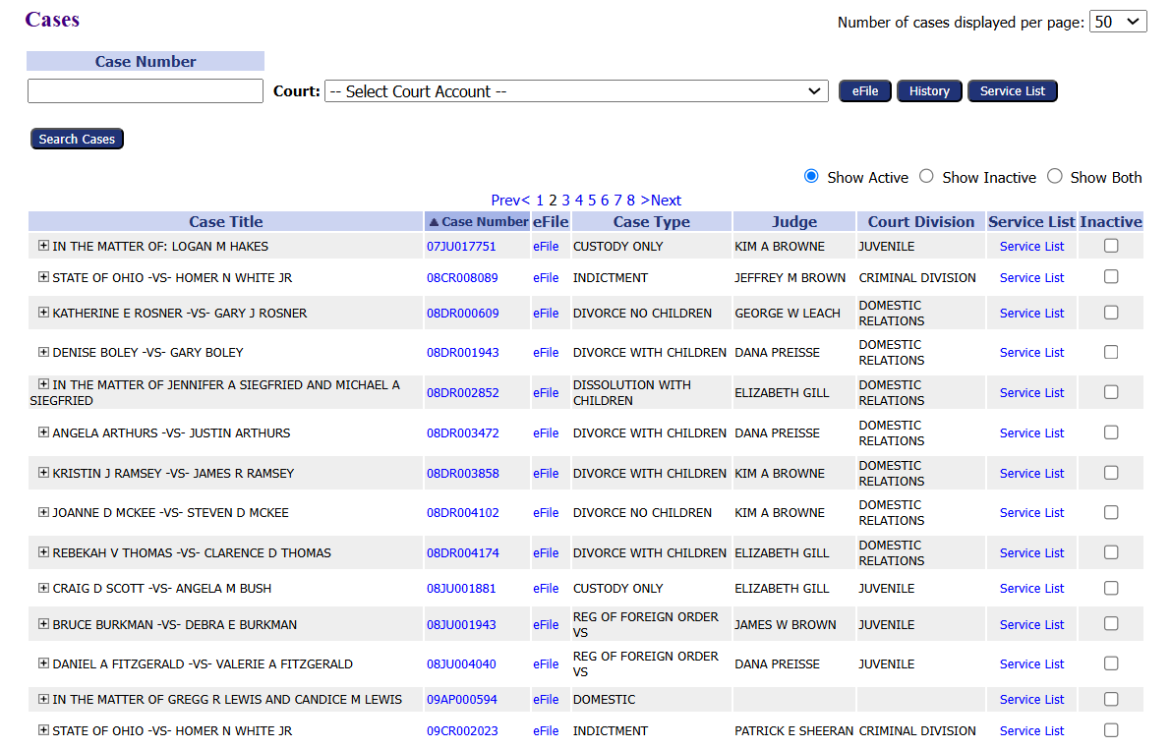
File to an Existing Appeals Case
Option 3
Find the case from the list of cases.
Click the eFile link
Example: 09AP000594
Notes:
Or Option 3 find the case from the list of cases. Click the efile link.

Slide 8
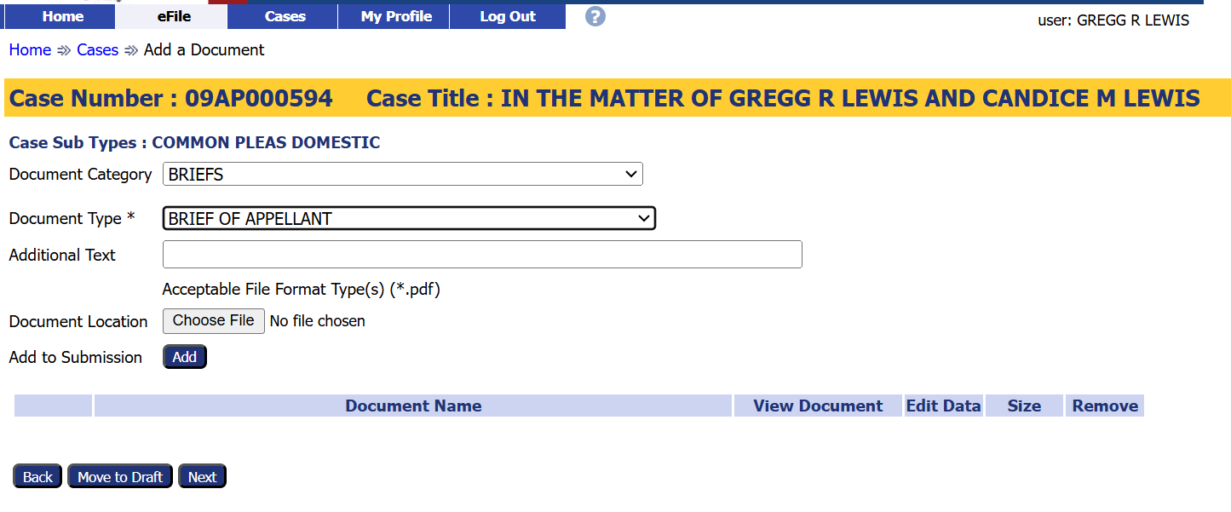
How to File to an Existing Case
1. Choose a Document Category to filter the number of Document Type choices.
2. Choose a Document Type from the drop-down menu. This is a required field.
Notes:
After logging into your efiling account, select File to an existing case by clicking on the Existing Case button on the left or going to the efile tab and selecting Existing case from the dropdown menu.

Slide 9
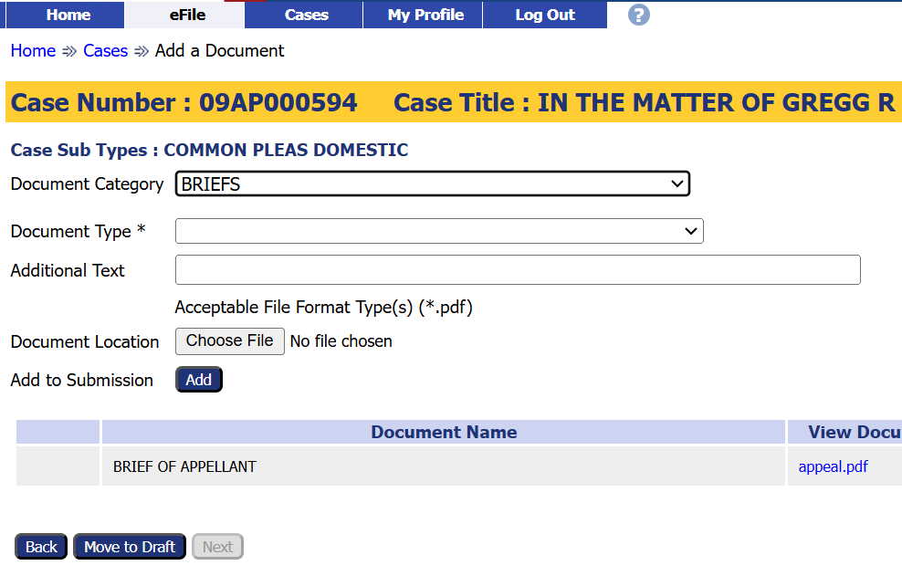
How to File to an Existing Case
Note the required document format.
3. Click the Add button to add
the document to the filing.
2. Click the Choose File button to select and
upload a document.
Notes:
After logging into your efiling account, select File to an existing case by clicking on the Existing Case button on the left or going to the efile tab and selecting Existing case from the dropdown menu.

Slide 10
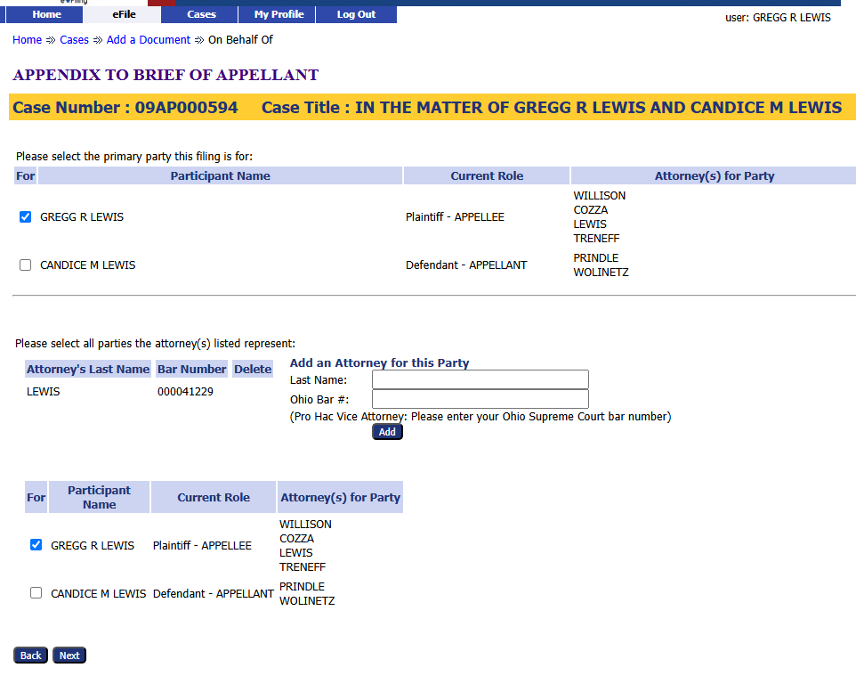
How to File to an Existing Case
1. Confirm the Participant’s name is already checked. In the top and bottom sections.
2. Confirm the attorney’s [yours] is in the middle section.
3. Add additional attorneys for the party, if needed.
4. Click the Next button.
Notes:
After logging into your efiling account, select File to an existing case by clicking on the Existing Case button on the left or going to the efile tab and selecting Existing case from the dropdown menu.

Slide 11
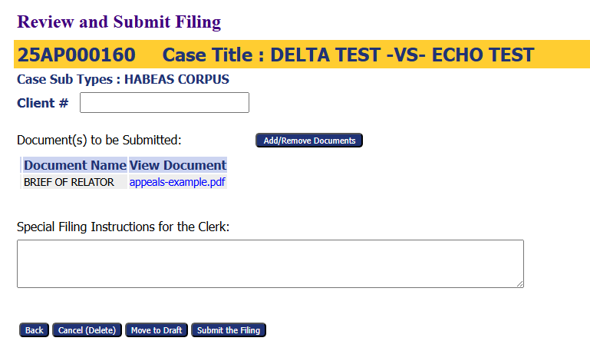
Submit the Filing
Use the optional Client # field to enter an office case reference number.
Add or Remove additional documents, if needed.
Add any filing notes
Other options
Cancel (Delete) the filing
Move to Draft – Save the filing to be completed later.
Submit the Filing – completes the filing process.
Notes:
Review the filing before submitting. There is an optional Client # field so an office reference number can be added. Review the documents to be submitted and add or remove as needed. To request a bond hearing the Motion Bond Hearing and Request for Bond Hearing are needed. Add any filing notes. At this point, if the filing is not ready, it can be cancelled (deleted), Moved to draft filings for completion later, or submitted to complete the filing process.

Slide 12
Submission Confirmation
A confirmation of submission will appear.
Click on the Filing Status to check where the filing is in the approval process.
*Note-Approval references that the filing has been accepted.
Notes:
A confirmation of submission will appear. Clicking on the Filing Status button to check on the status of the approval or acceptance of the filing.

Slide 13
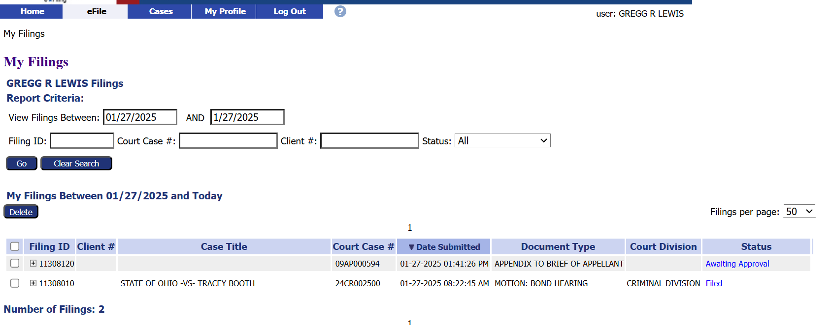
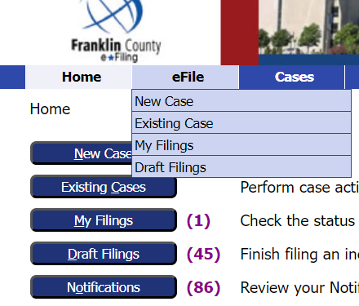
Filing Status
Clicking the Filing Status button brings up a list of all filed cases and their status.
Users can search for a specific case on this page.
This page can be reached by clicking My Filings from the Home page
or by going to the eFile tab and selecting My Filings from the drop-down menu.
Notes:
Clicking the Filing Status button will bring up a list of all cases that have been filed and show their filing status. You can search for a specific case by enter the search parameters and choosing search. The Filing Status list can always be reached by clicking My Filing from the home page or by going to the eFile tab and selecting My Filings from the drop-down menu.

Slide 14
Thank you for using the
Franklin County e-Filing System
For help or questions about e-filing, contact the Clerk of Courts Office by email at franklincountyclerk@franklincountyohio.gov.
Notes:
Thank you for using the Franklin County e-filing System. For help or questions about filing, contact the Clerk of Courts Office at 614.525.3600 or email at franklincountyclerk@franklincountyohio.gov

