Slide 1
Introduction to e-Filing in the Appeals Division

Slide 2
Welcome to e-Filing
We hope this guide will assist you in becoming familiar with our County’s e-Filing system. Please view this presentation as a slide show to get the best user experience.
For information regarding registering for an account, navigating our home page, you can watch our “Introduction to e-Filing” video series here:
Clerk's e-Filing Videos

Slide 3
What to Expect From This Presentation
What you need to e-File in the Appeals Division
Online resources and helpful links
How to:
Filing an Original Action
Filing a case on appeal from the Common Pleas Court, Civil Division
Filing pleadings to an existing case
Checking Notifications

Slide 4
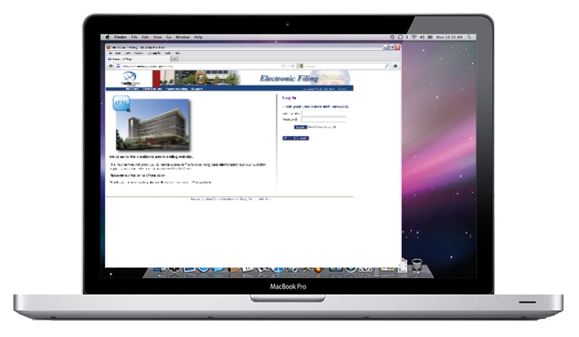
What do you need to e-File?
Computer with Internet browsing capabilities
Scanner
Ability to create .PDF files
Recommended setting: 300 DPI
Word Processer capable of exporting to MS Word 97-2003 format or later
The system will only accept .DOC or .DOCX
Other documents types (e.g. Corel Word Perfect or Apple Pages) must be re-formatted to .DOC or .DOCX

Slide 5
Online Resources & Helpful Links
Adobe Acrobat:
http://www.adobe.com/products/acrobat.html
Adobe Acrobat is the recommended software for creating .PDF files.
PDF Conversion Plug-In for Microsoft Office 2007: http://www.microsoft.com/download/en/details.aspx?id=7
This plug-in will give you the ability to save your files in .PDF format if you are running Office 2007.
Corel WordPerfect:
http://apps.corel.com/lp/wpo/
Corel WordPerfect will allow you to convert your files to .DOC or .PDF.
Newer versions will also allow you to convert your files to .DOCX.

Slide 6
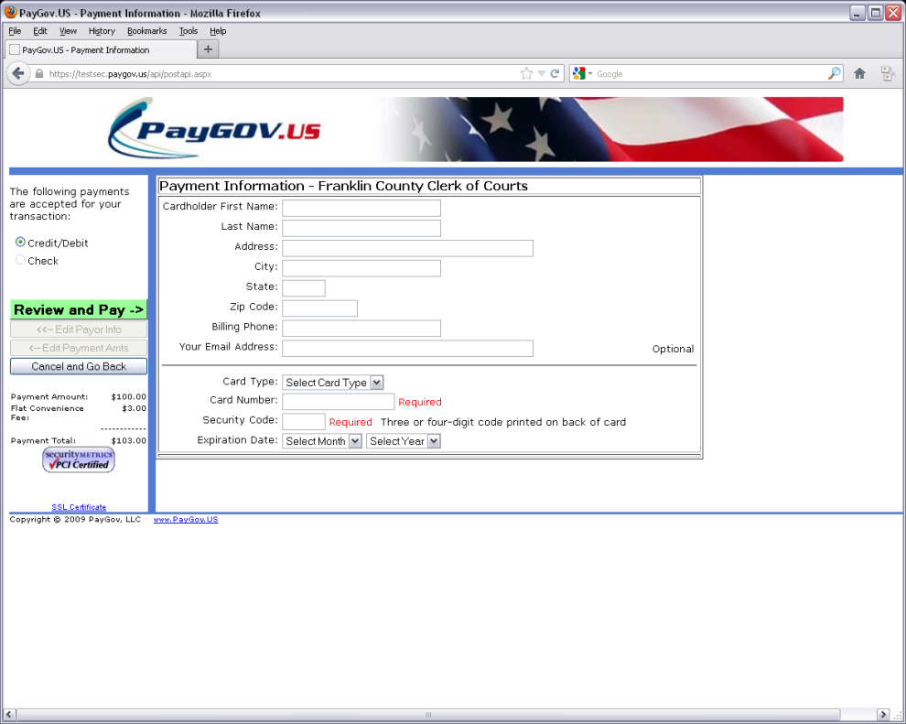
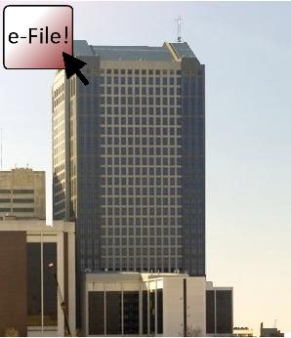
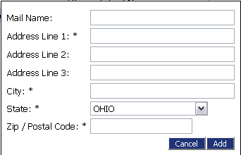
How To: Filing an Original Action

Slide 7
JWOODARD
********

Slide 8
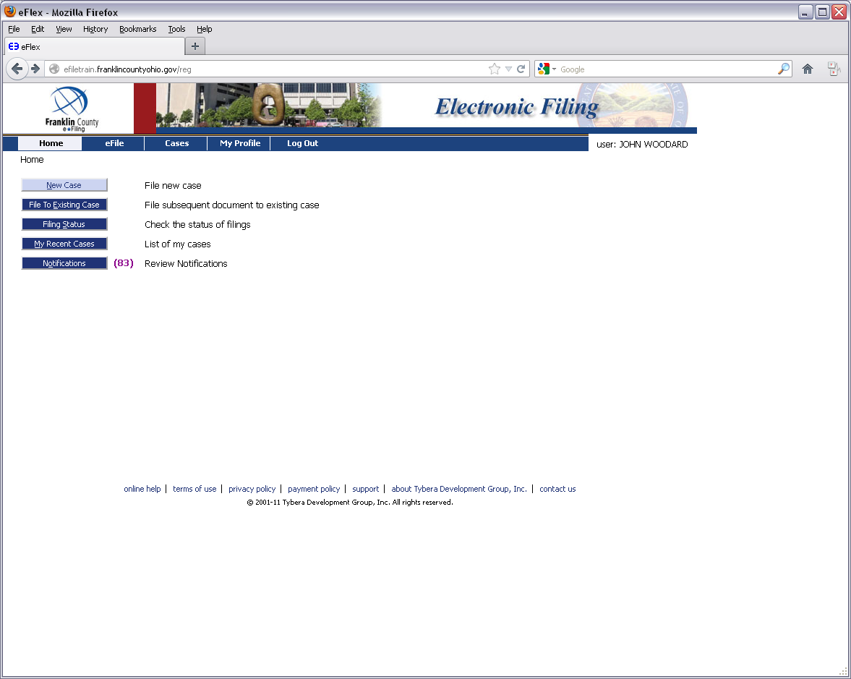

Slide 9
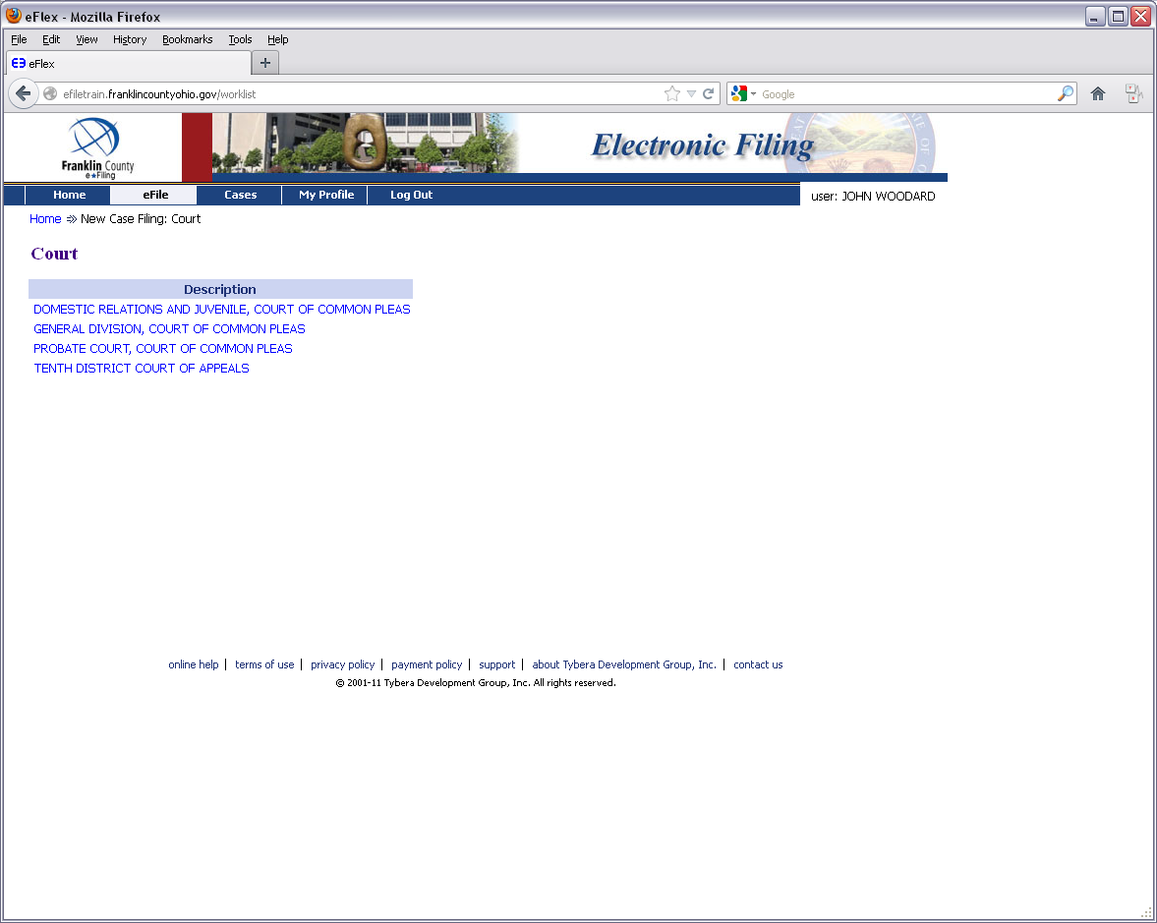

Slide 11
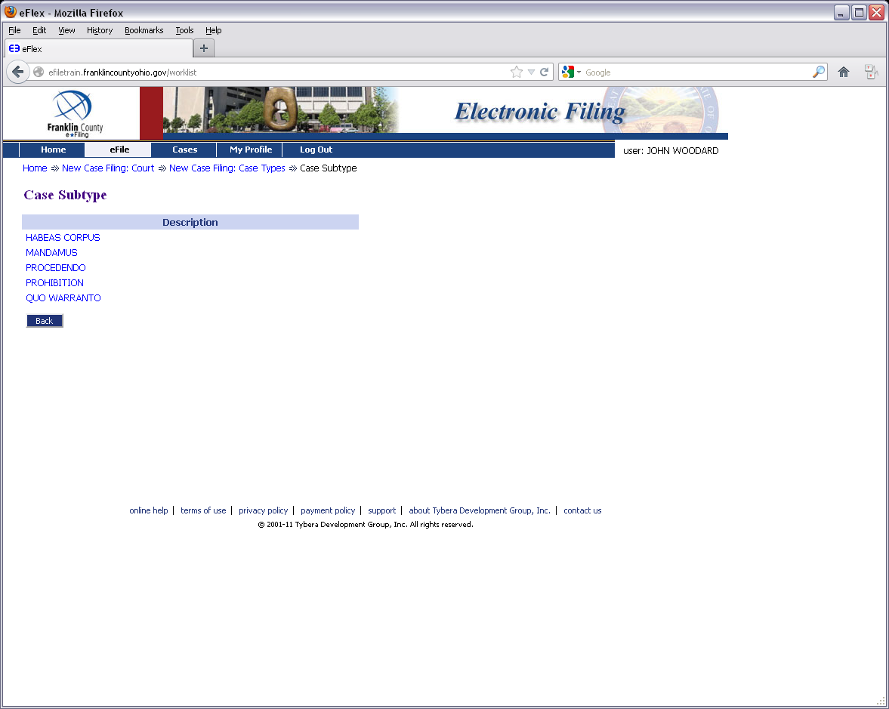

Slide 12
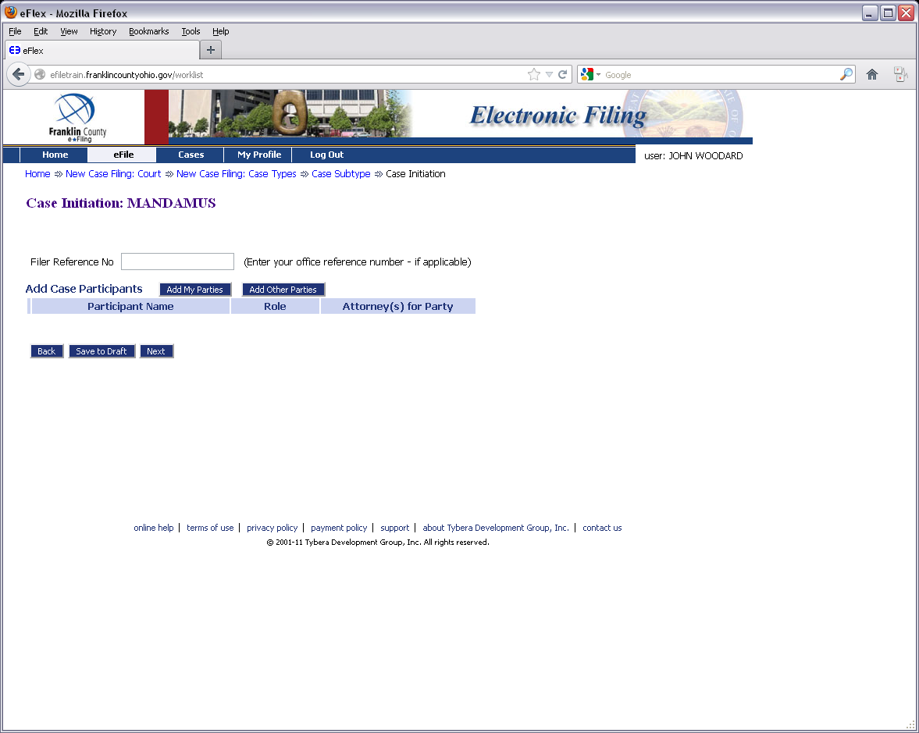

Slide 13
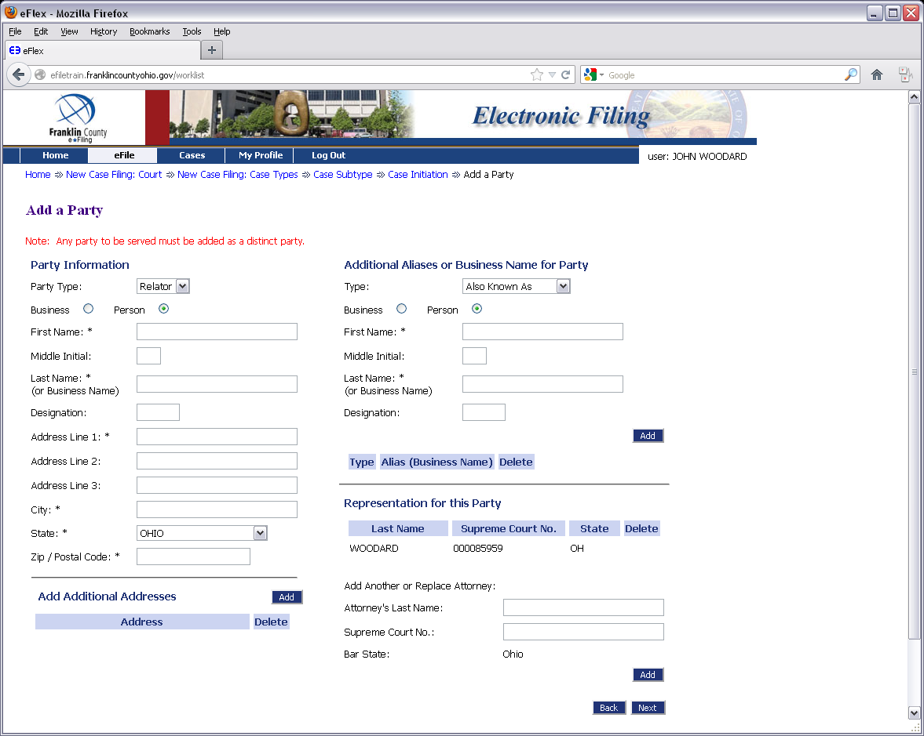

Slide 15
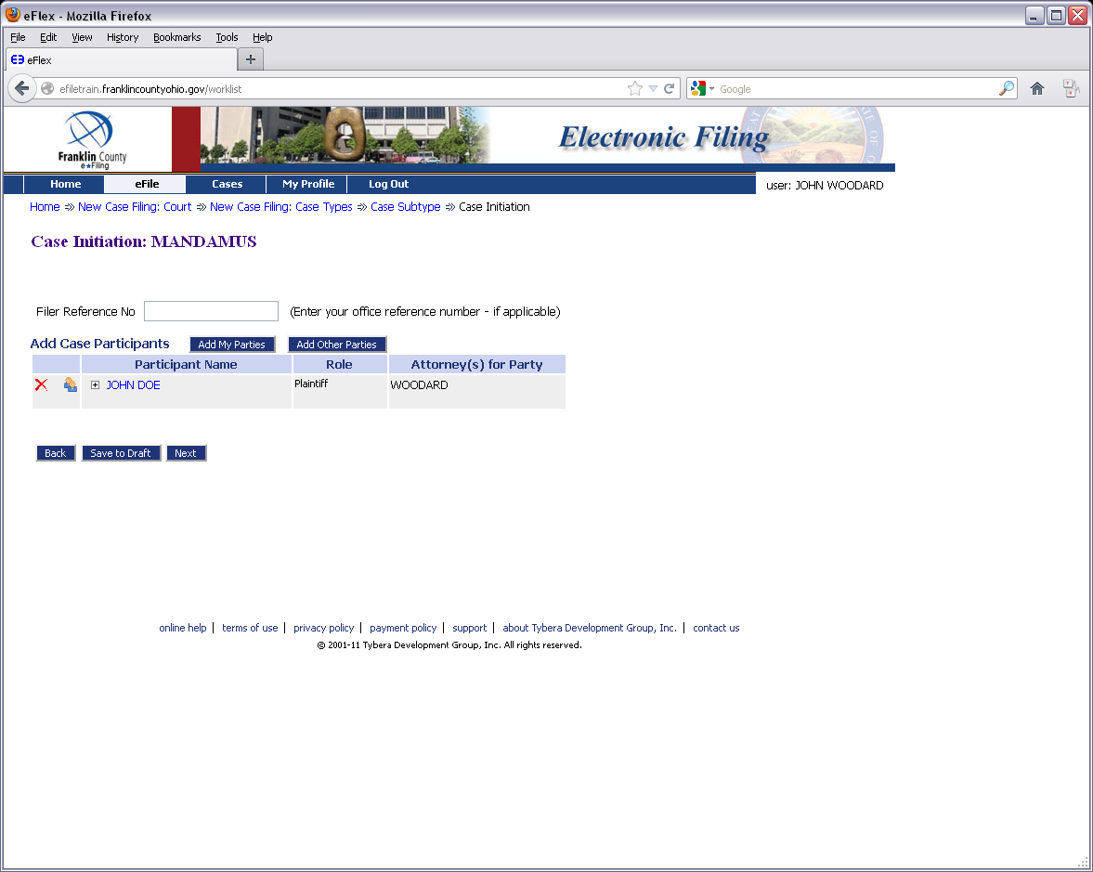

Slide 16
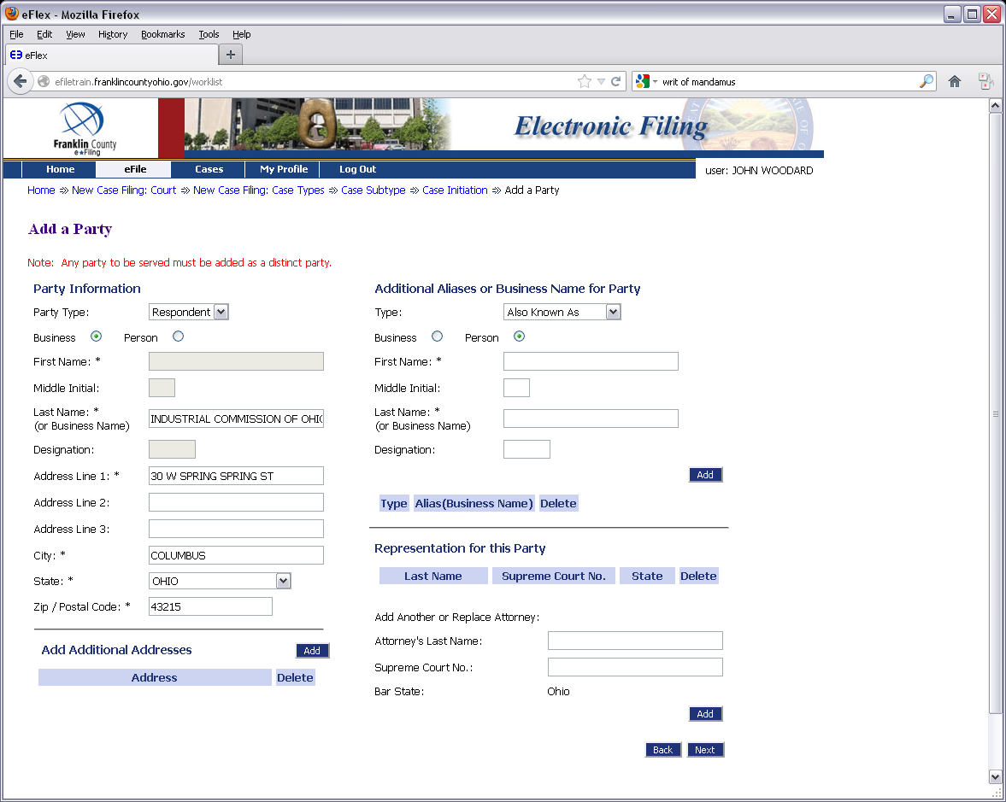

Slide 17
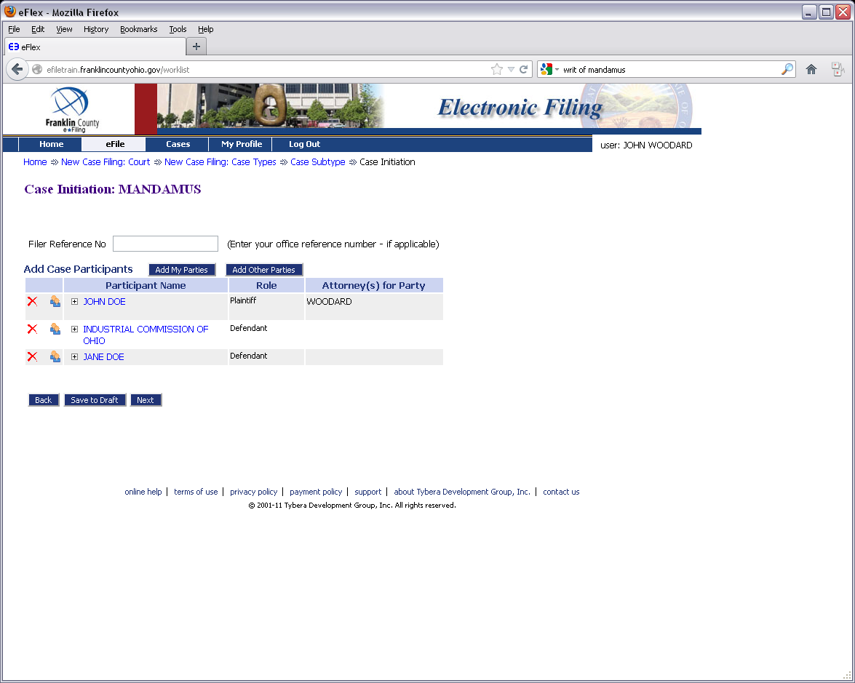

Slide 18
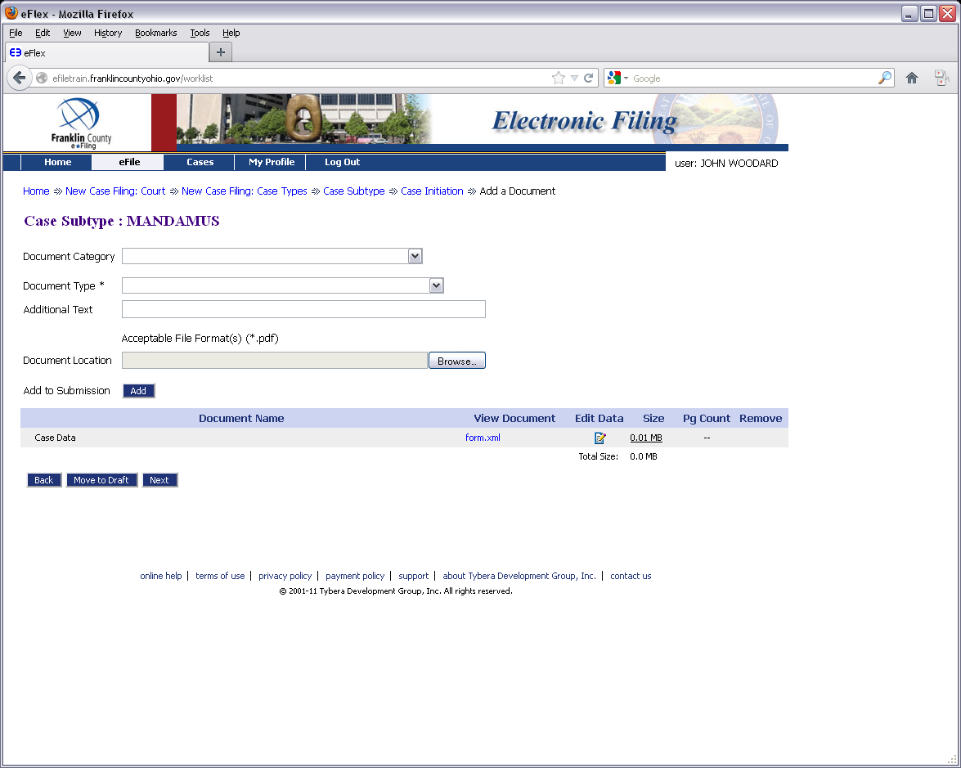

Slide 19
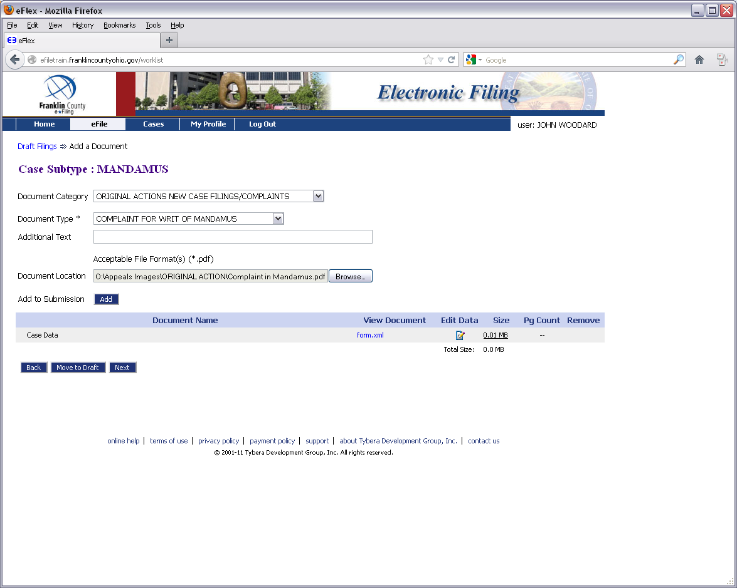

Slide 20
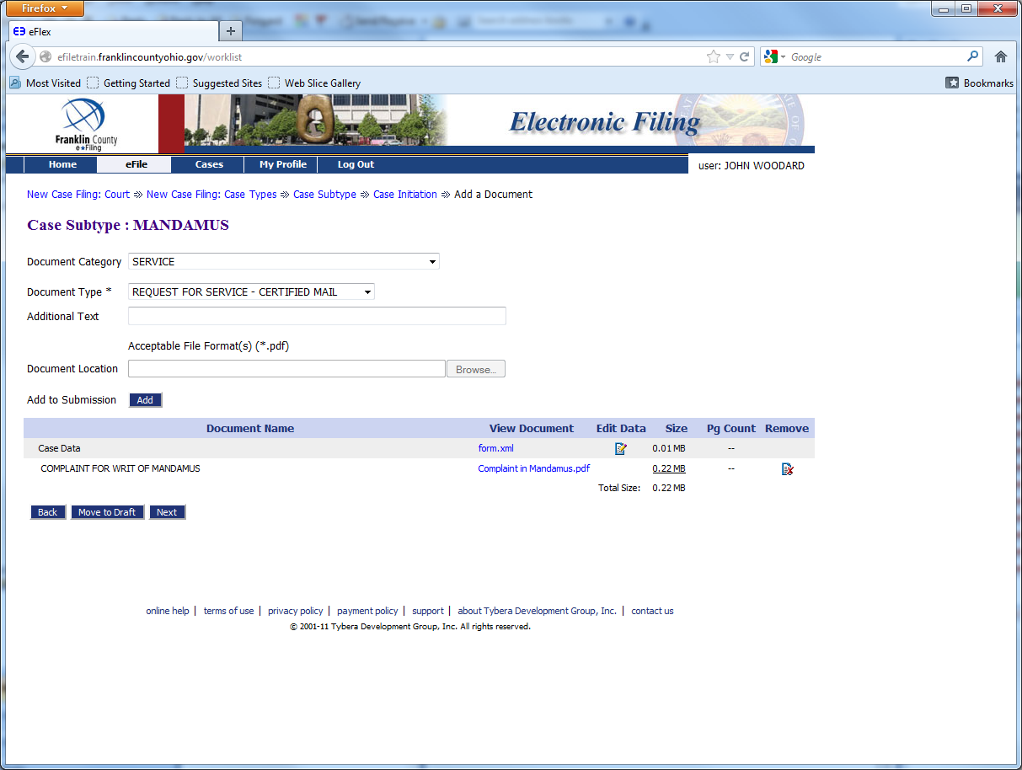

Slide 21
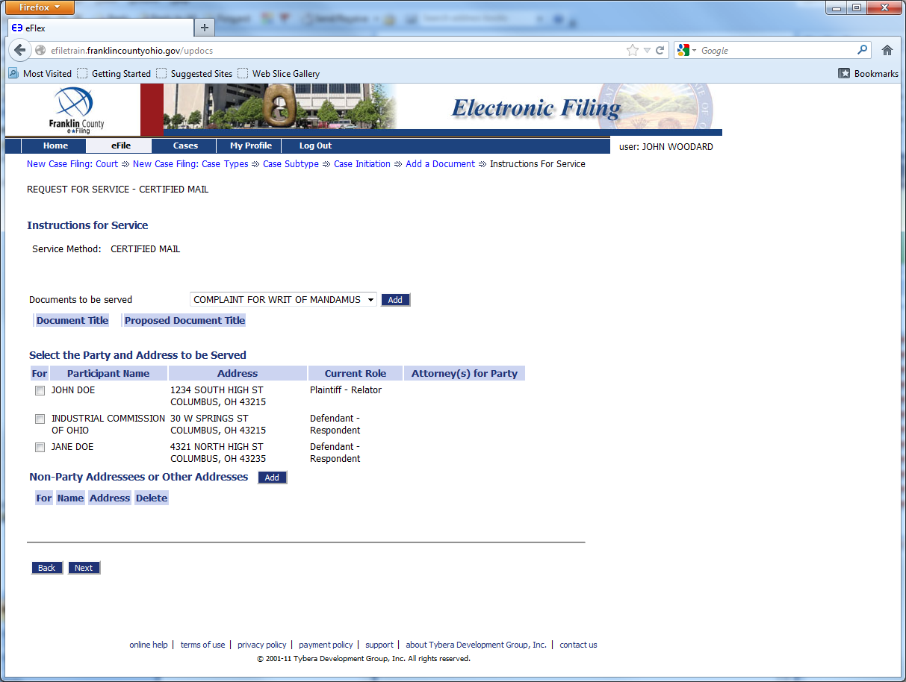

Slide 22
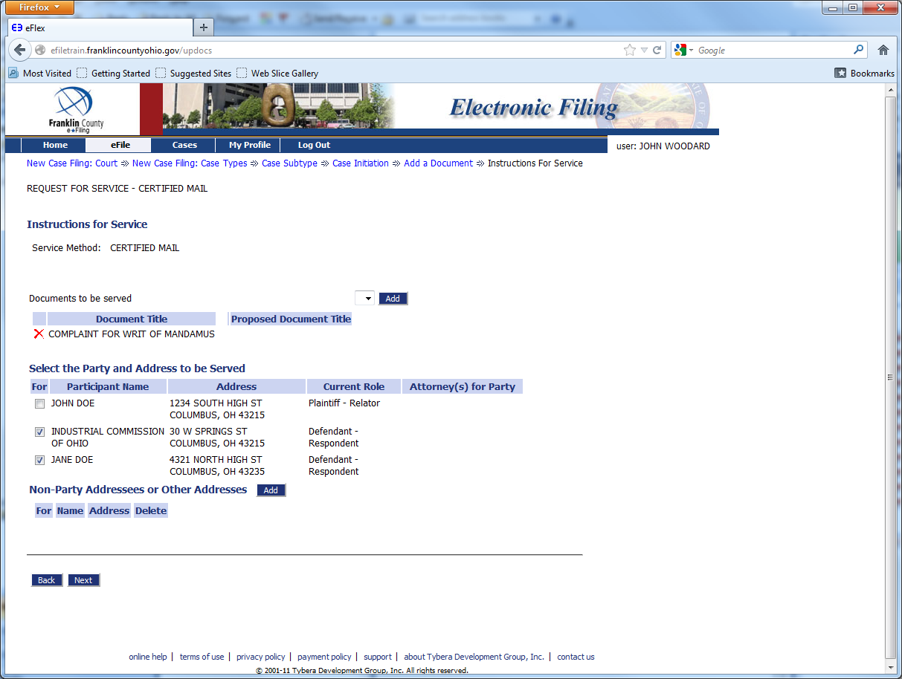

Slide 23
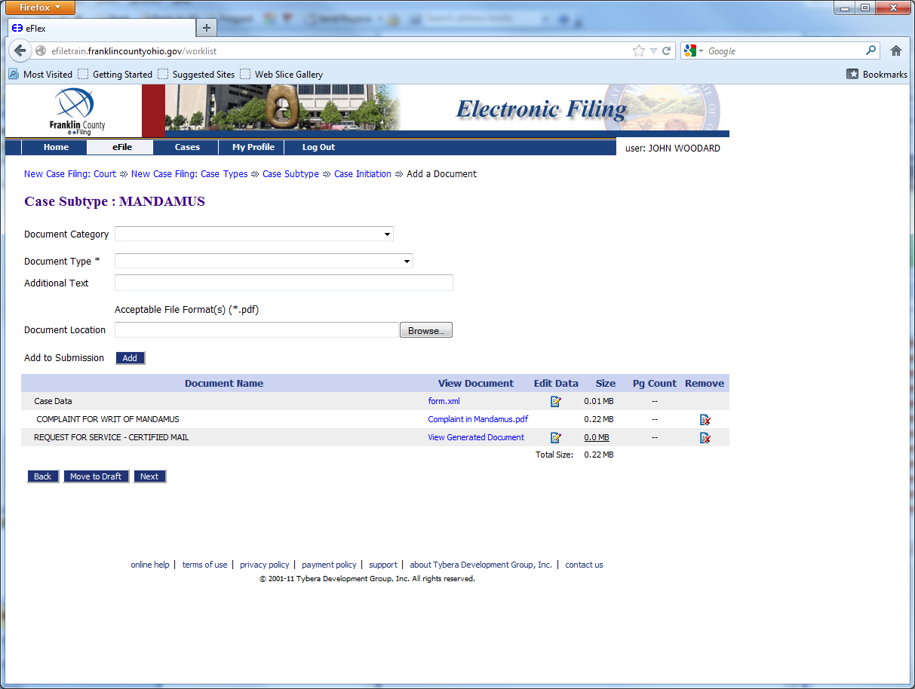

Slide 24
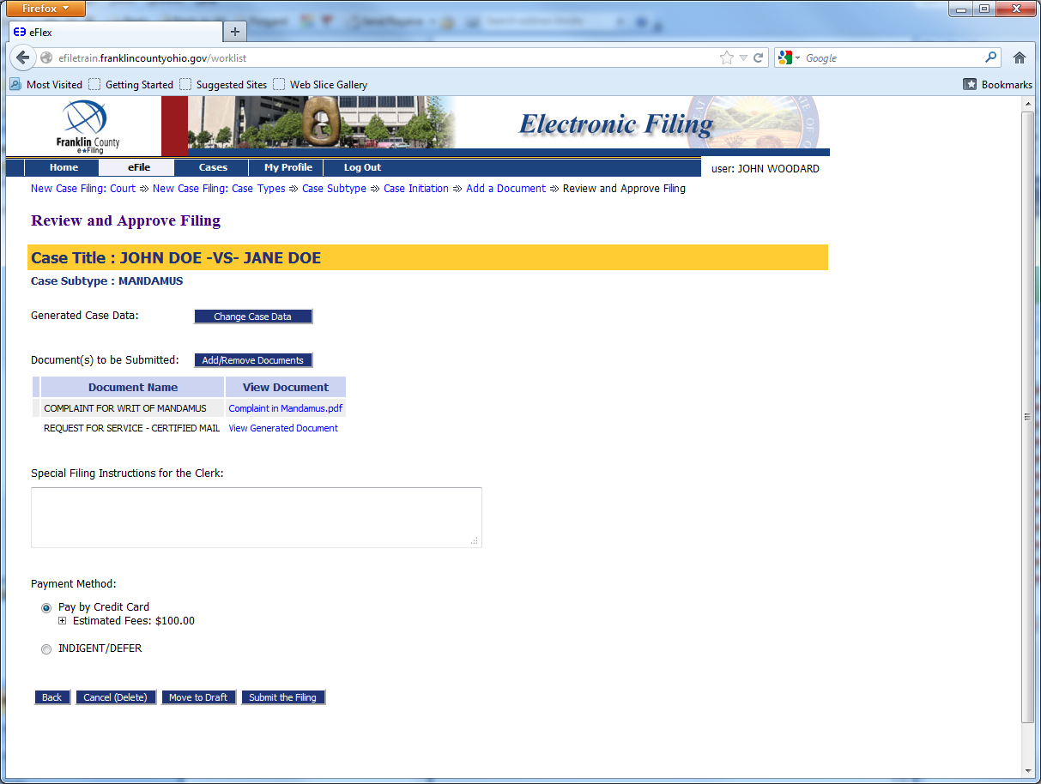

Slide 26
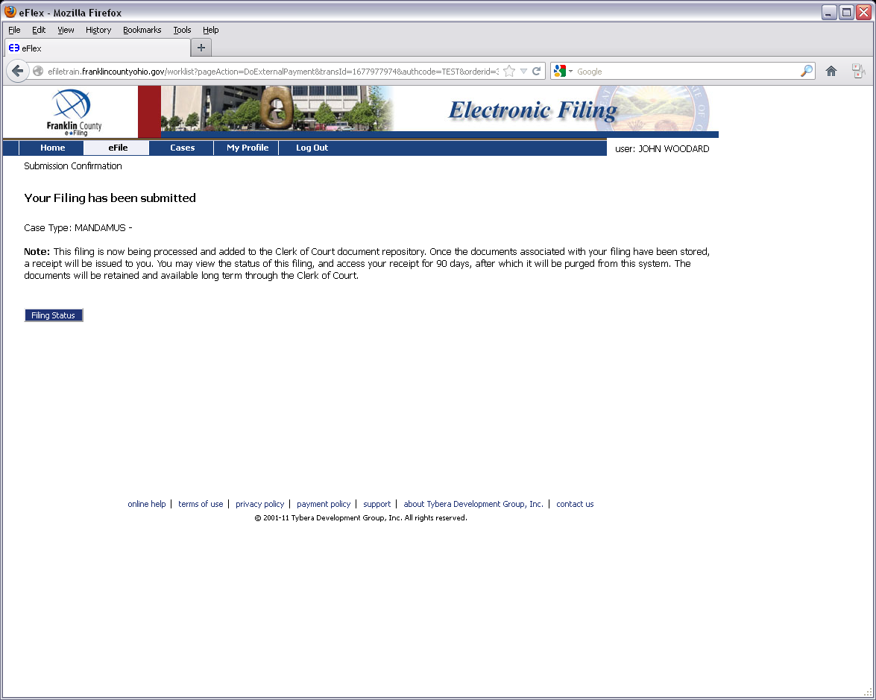

Slide 27
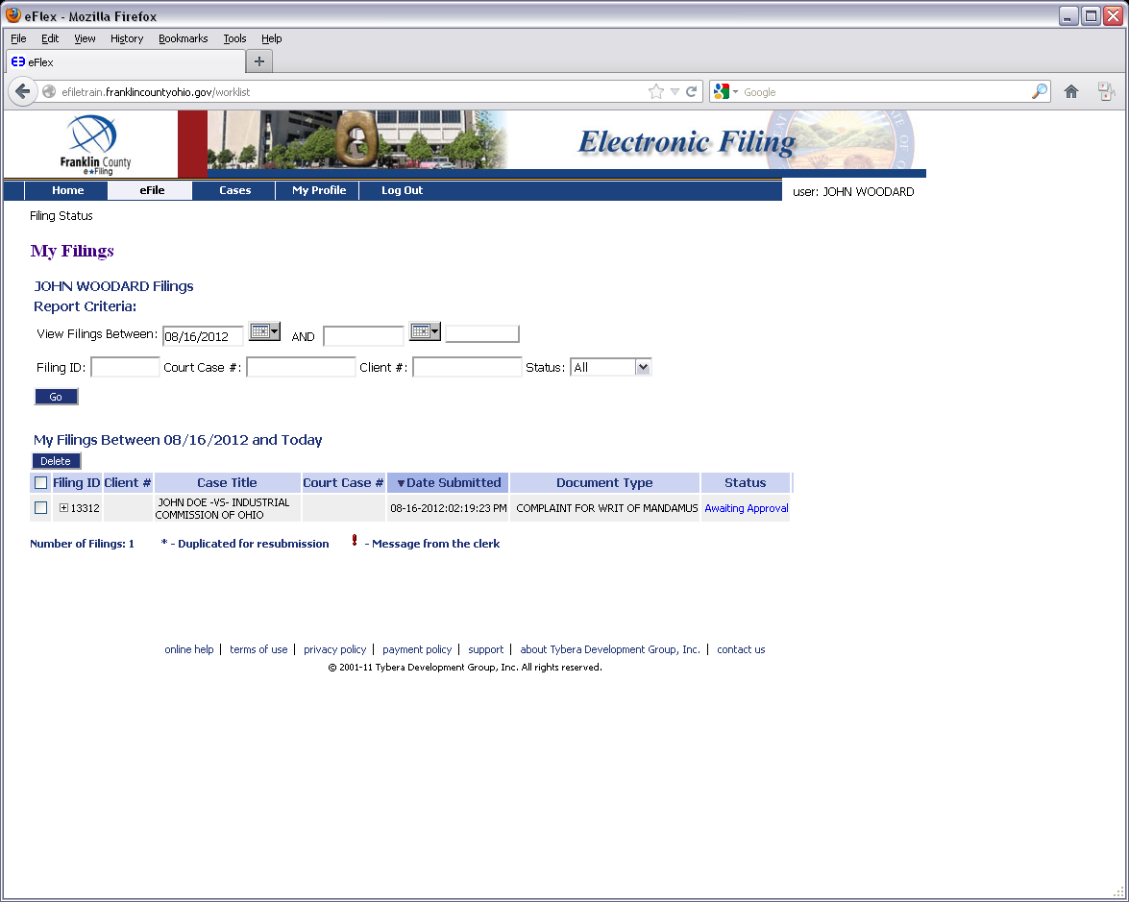

Slide 28
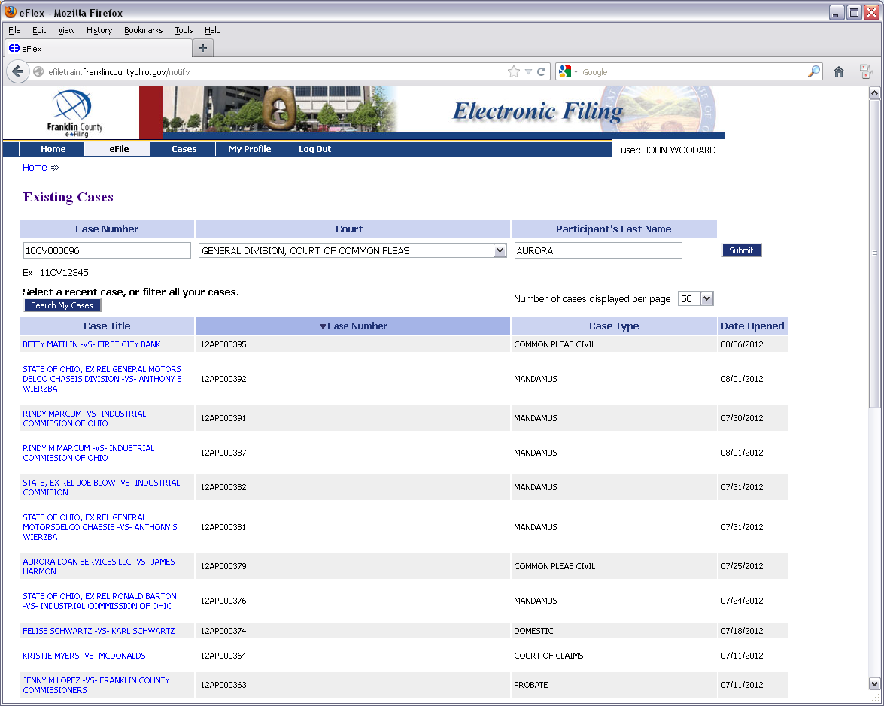
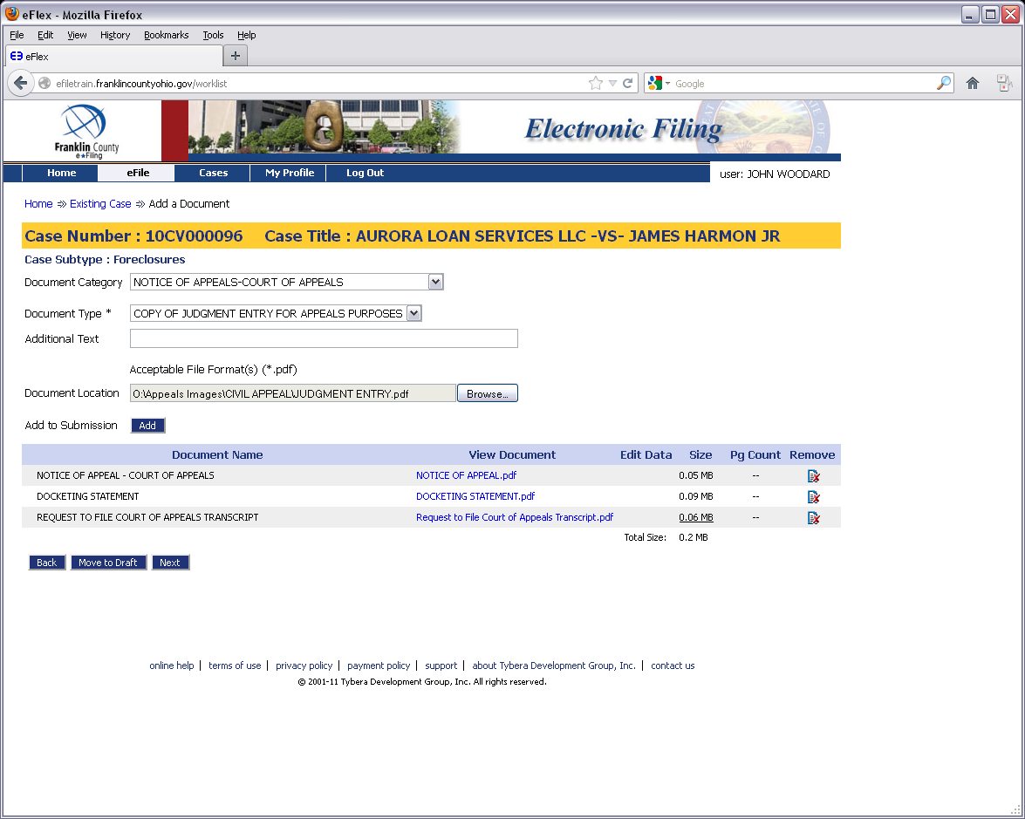
How To: Filing a Case on Appeal (Civil Division)

Slide 31
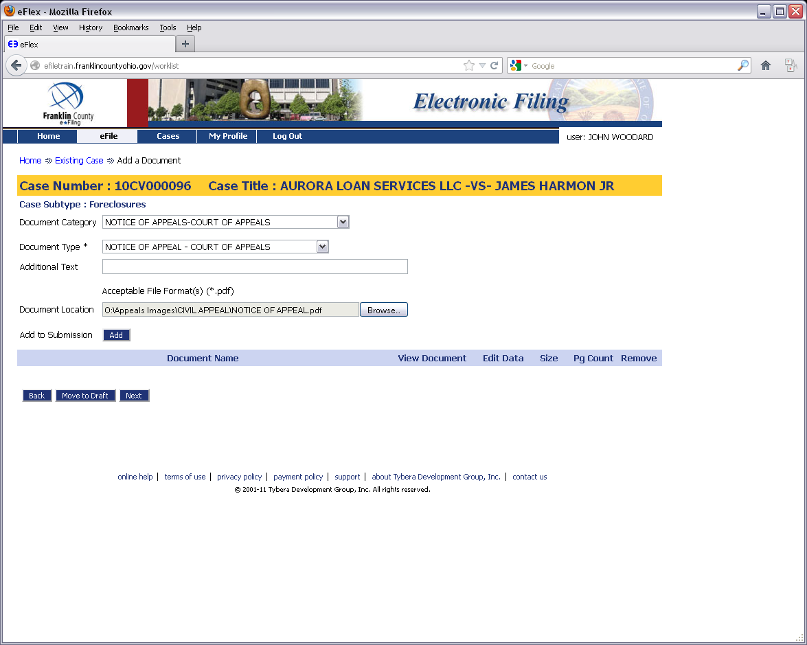

Slide 32
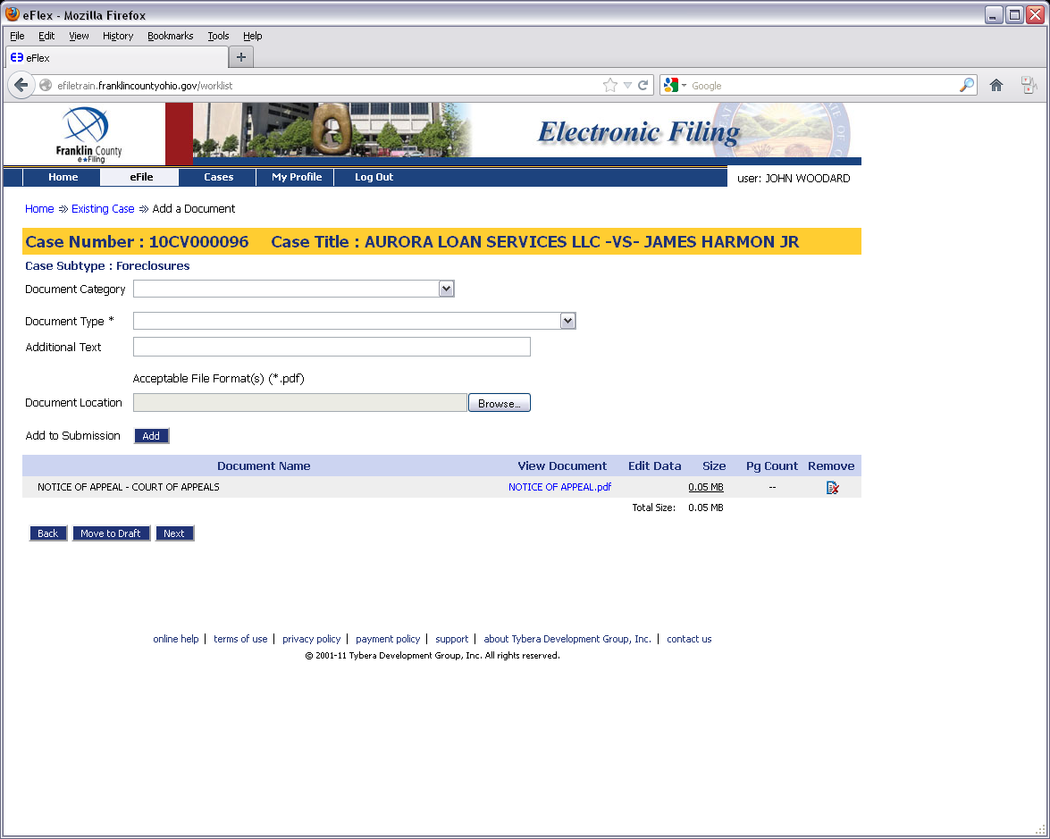

Slide 34
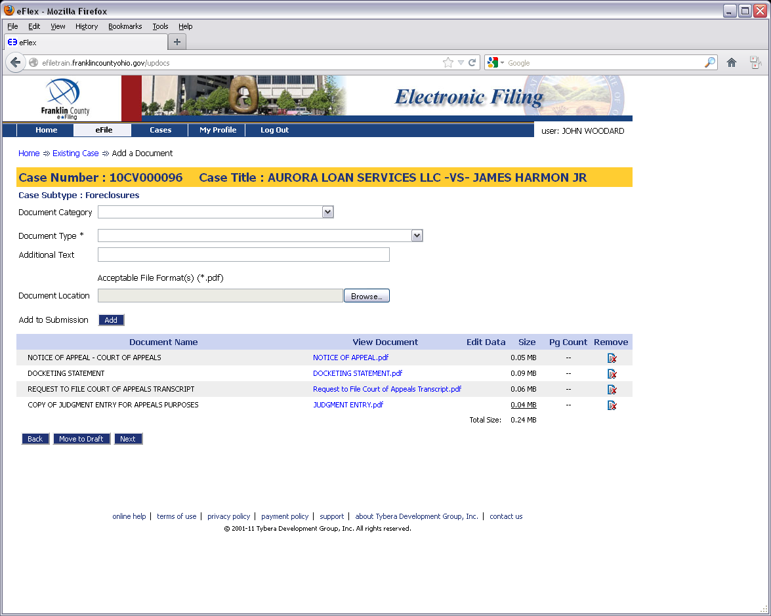

Slide 35
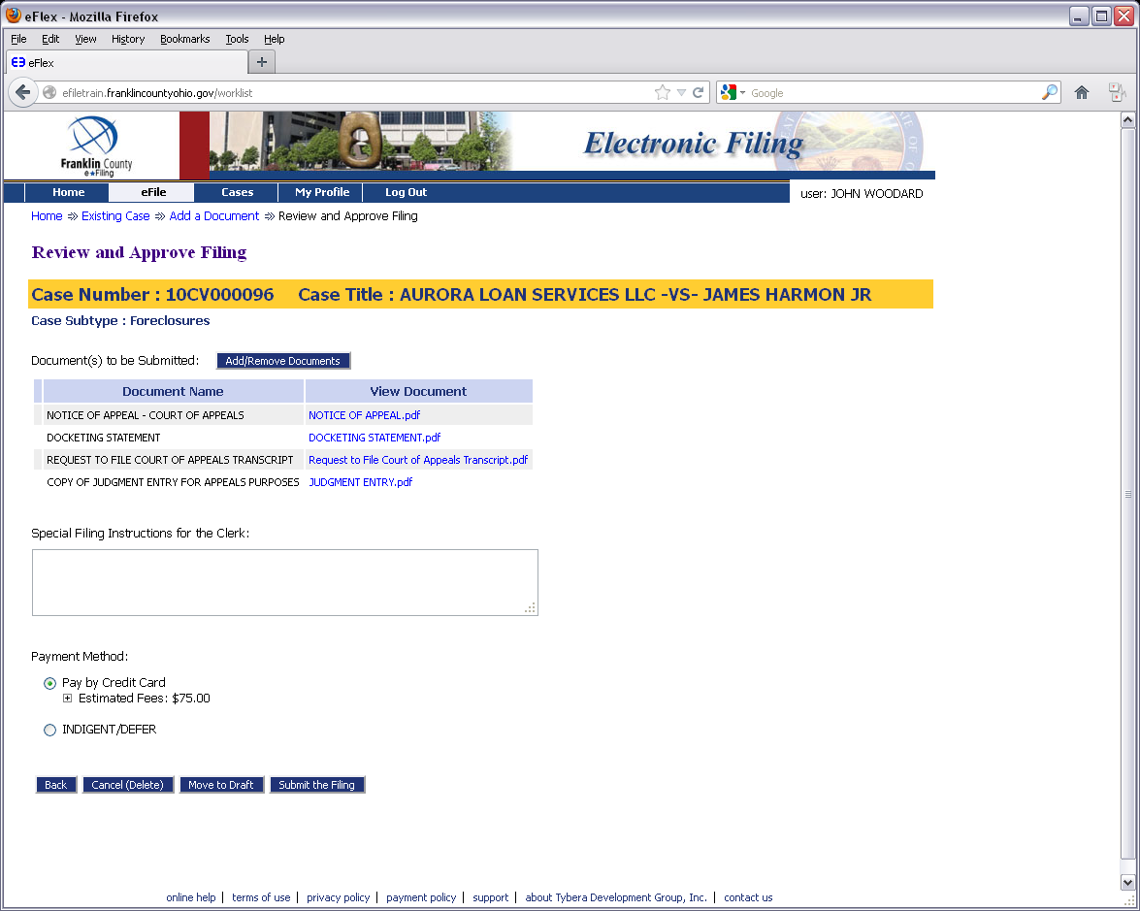

Slide 37
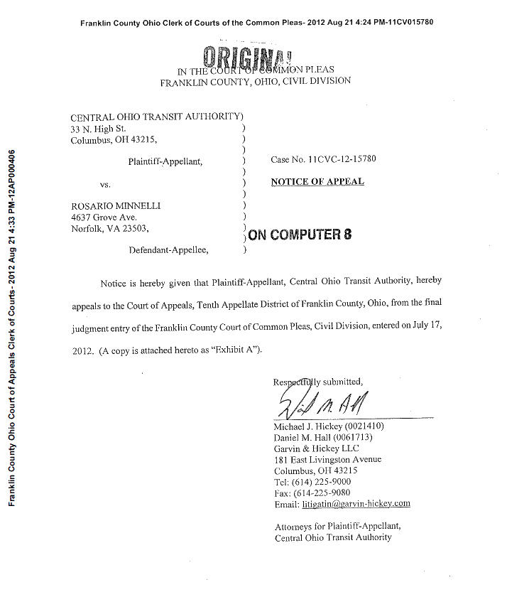
The NEW Appeals Time-stamp

Slide 38
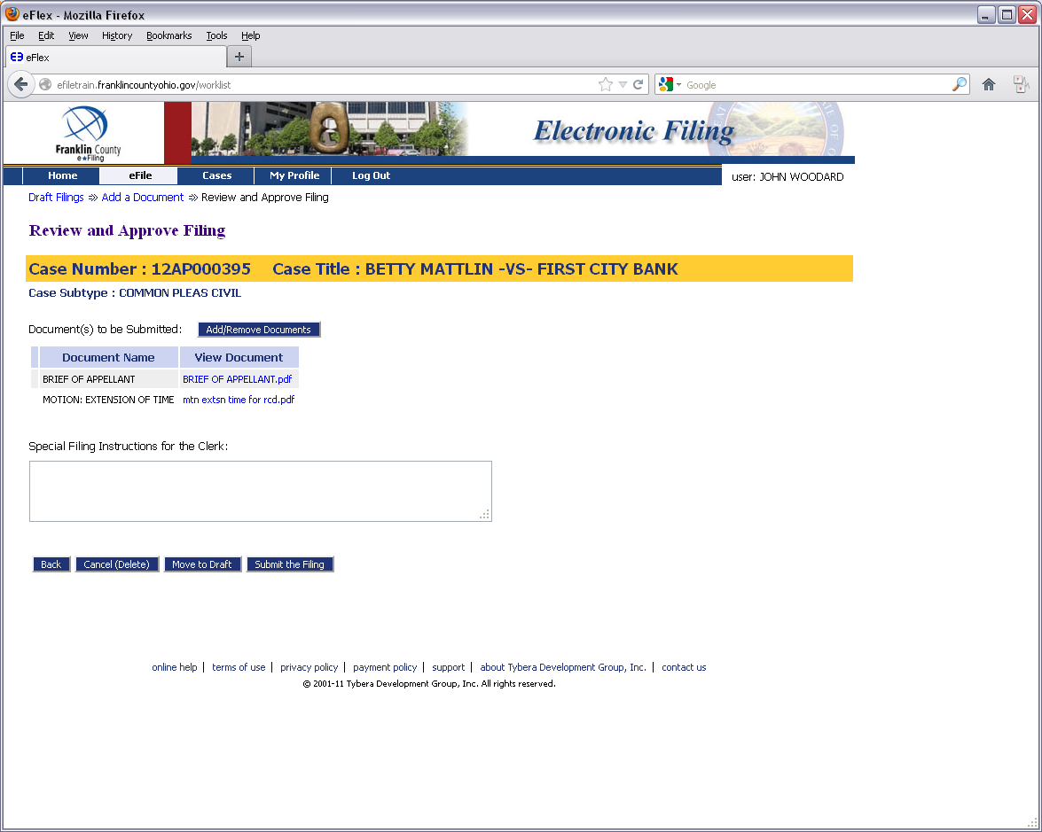
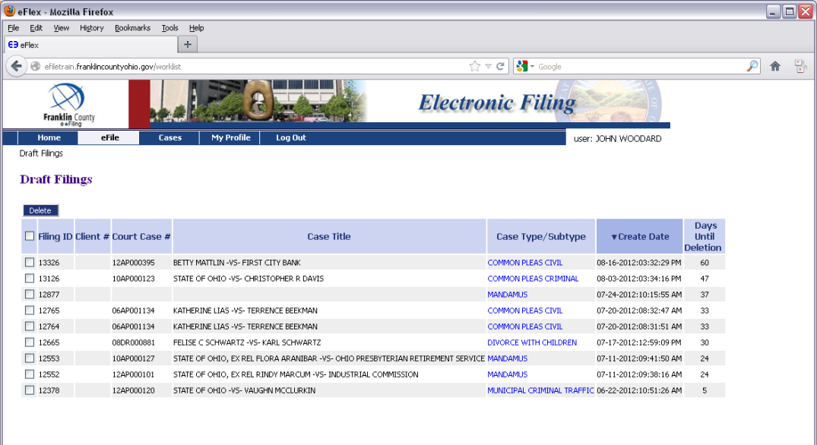
How To: Filing to an Existing Appeals Case

Slide 41
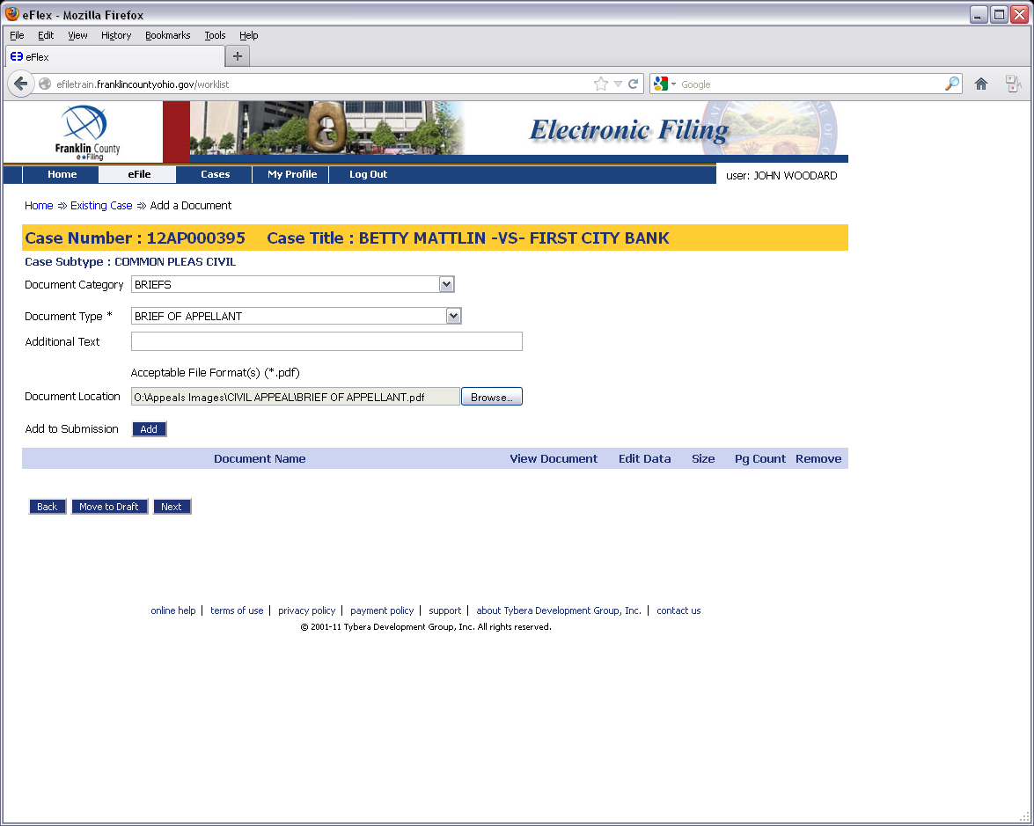

Slide 42
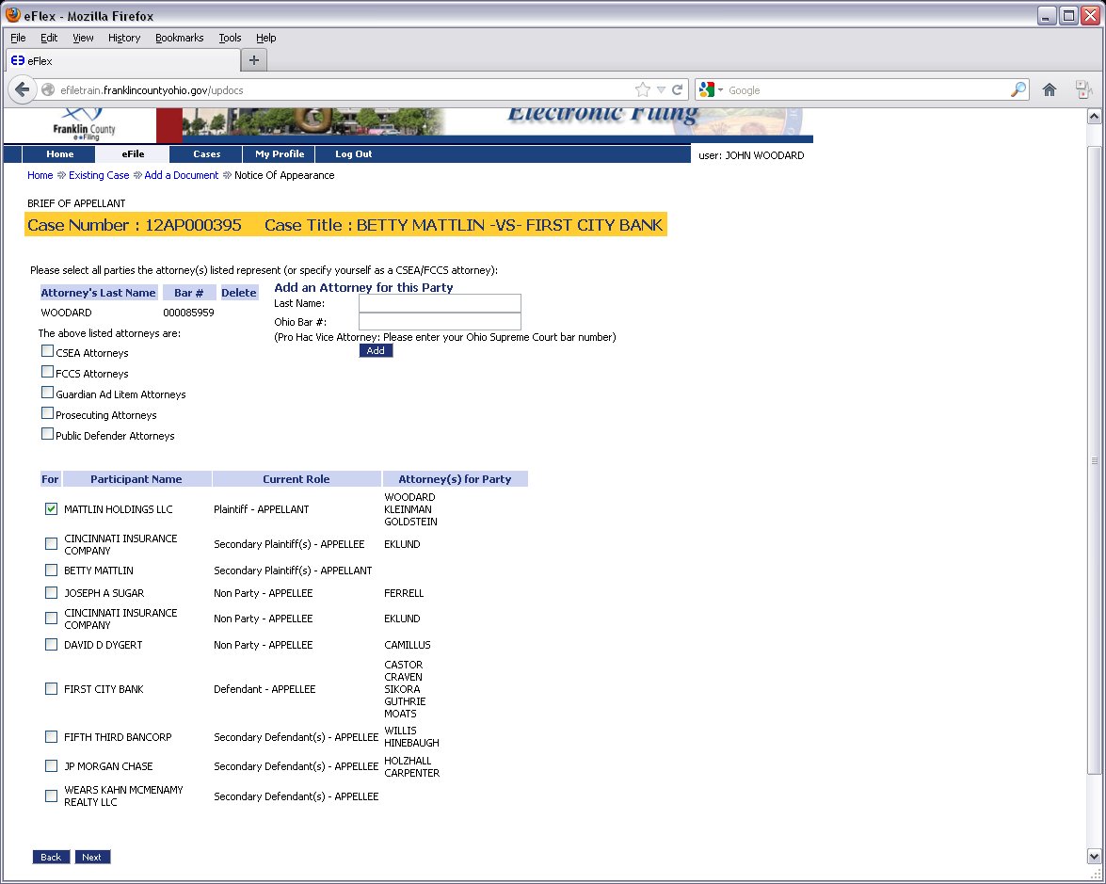

Slide 43
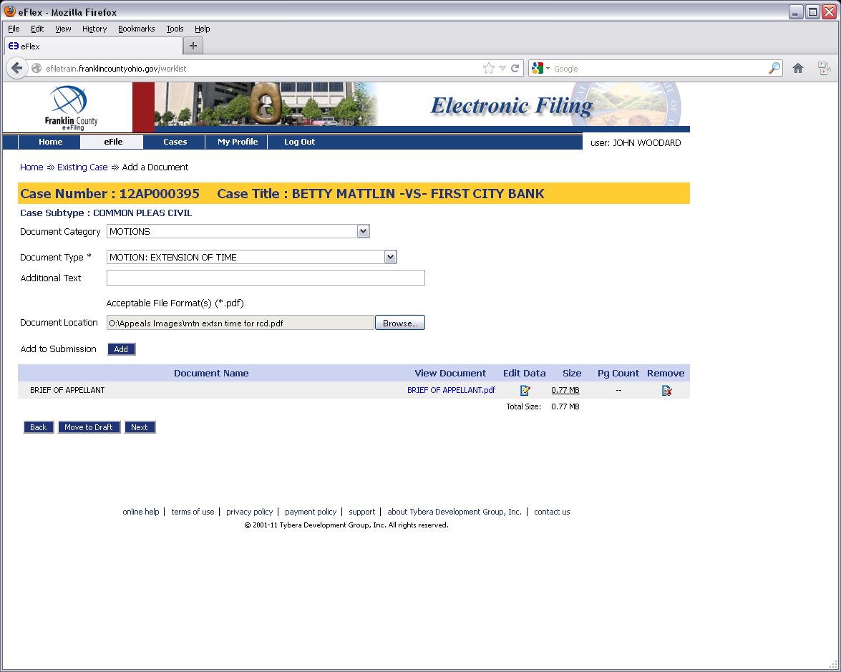

Slide 44
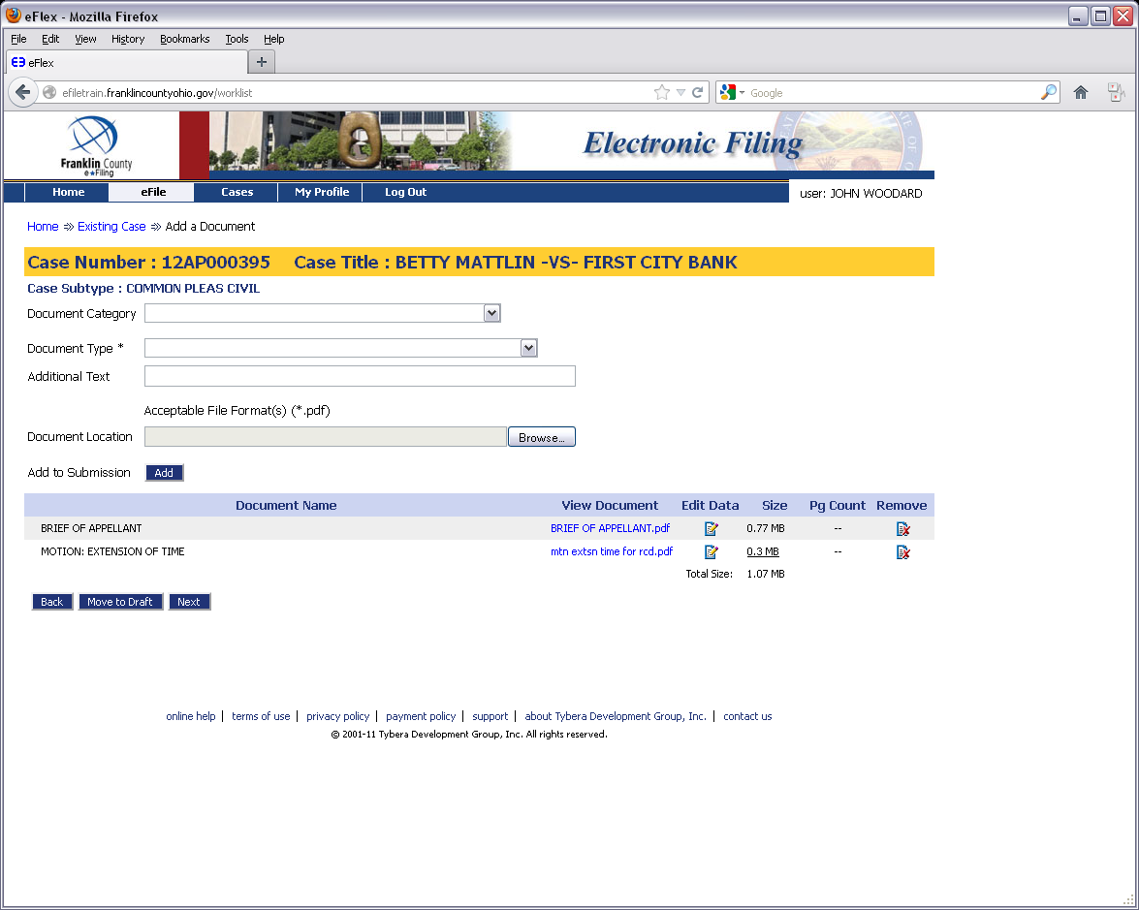

Slide 48
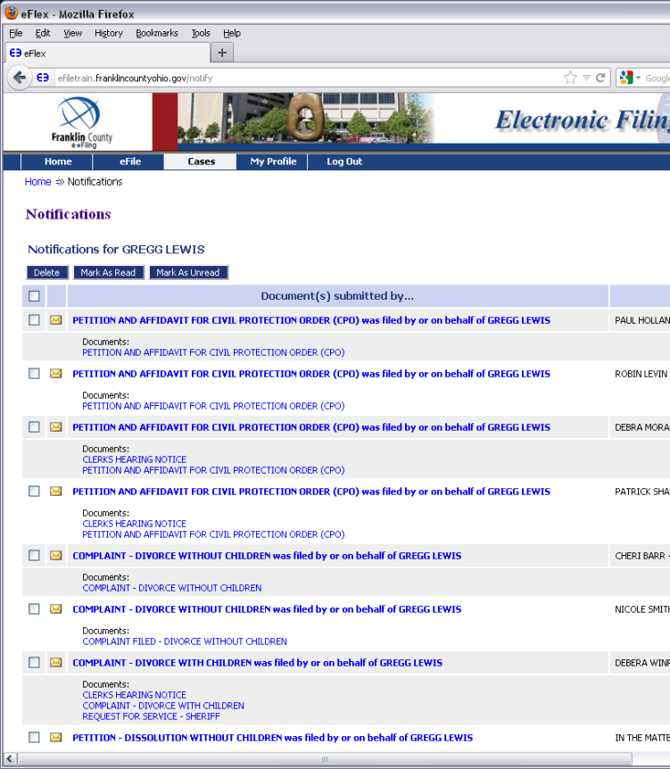
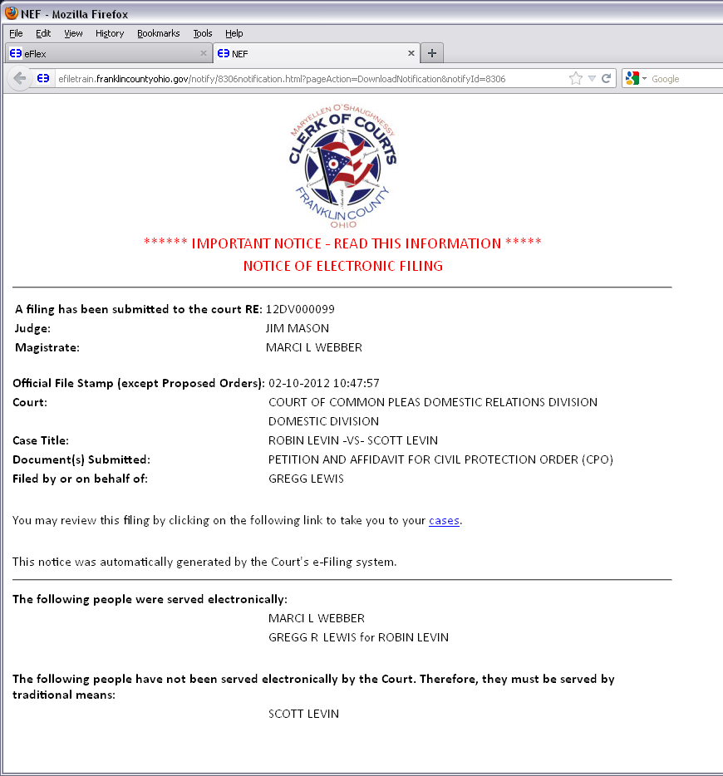
How To: Checking Notifications

Slide 49
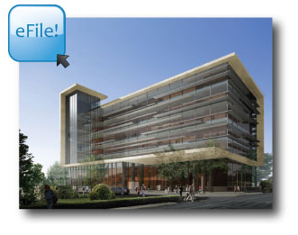
When YOU e-File…YOU are Notified!
Via email…
…And our system

Slide 51
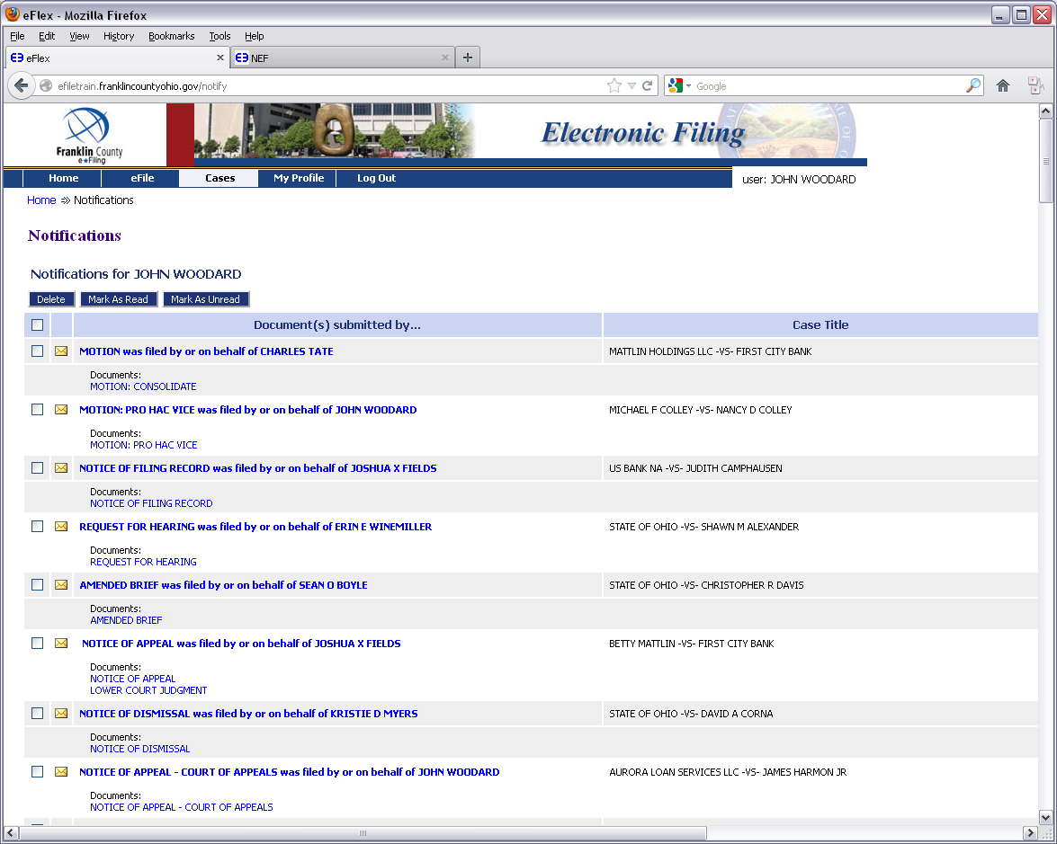

Slide 52
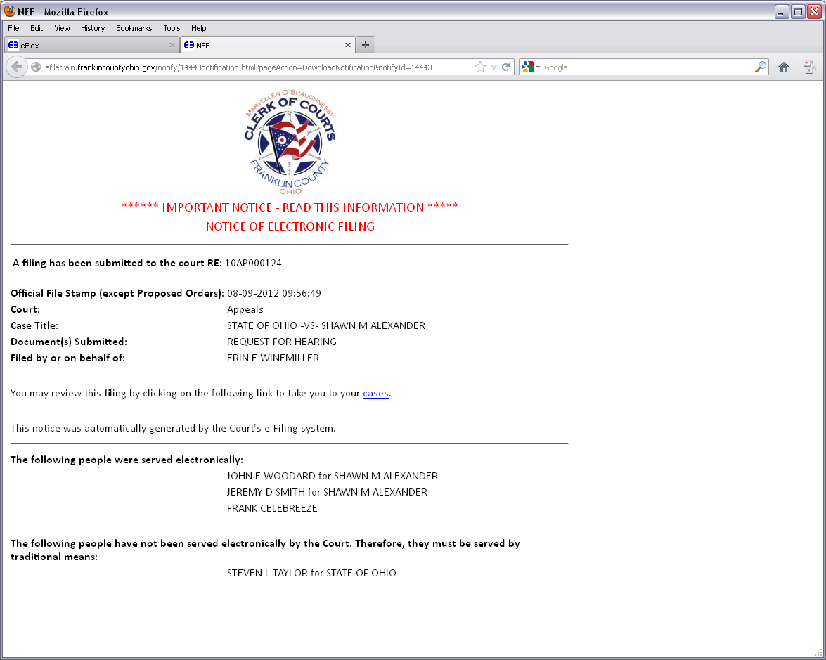

Slide 53
For More Information…
Online Help Through the System
https://efiling.franklincountyohio.gov/onlineHelp/fiDefault.htm
Clerk of Courts YouTube Channel
Youtube.com/clerkfranklincounty
For Procedural & Technical Issues
Appeals Division Number:
614.525.3624
*Available Monday-Friday, 8am-5pm*
http://clerk.franklincountyohio.gov/e-File.cfm

Slide 54
This Presentation Was Produced by:
Franklin County Clerk of Courts
Communications and Operations Staff

