Slide 1
Introduction to e-Filing in the Domestic Relations Division

Slide 2
Welcome to e-Filing
We hope this guide will assist you in becoming familiar with our County’s e-Filing system. Please view this presentation as a slide show to get the best user experience.
For information regarding registering for an account, navigating our home page, you can watch our “Introduction to e-Filing” video series here:
Clerk's e-Filing Videos

Slide 3
What to Expect From This Presentation
What technology you need to e-File in the Domestic Division
Online resources and helpful links
How to:
File a new Domestic case
File to an existing Domestic case
Check Notifications

Slide 4
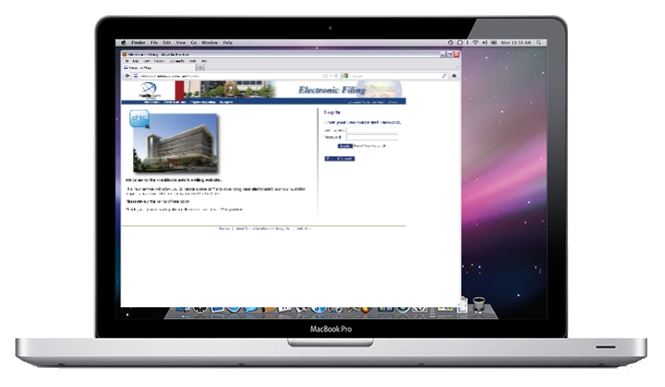
What do you need to e-File?
Computer with Internet browsing capabilities
Scanner
Ability to create .PDF files
Recommended setting: 300 DPI
Word Processer capable of exporting to MS Word 97-2003 format or later
The system will only accept .DOC or .DOCX
Other documents types (e.g. Corel Word Perfect or Apple Pages) must be re-formatted to .DOC or .DOCX

Slide 5
Online Resources & Helpful Links
Adobe Acrobat:
http://www.adobe.com/products/acrobat.html
Adobe Acrobat is the recommended software for creating .PDF files.
PDF Conversion Plug-In for Microsoft Office 2007: http://www.microsoft.com/download/en/details.aspx?id=7
This plug-in will give you the ability to save your files in .PDF format if you are running Office 2007.
Corel WordPerfect:
http://apps.corel.com/lp/wpo/
Corel WordPerfect will allow you to convert your files to .DOC or .PDF.
Newer versions will also allow you to convert your files to .DOCX.

Slide 6
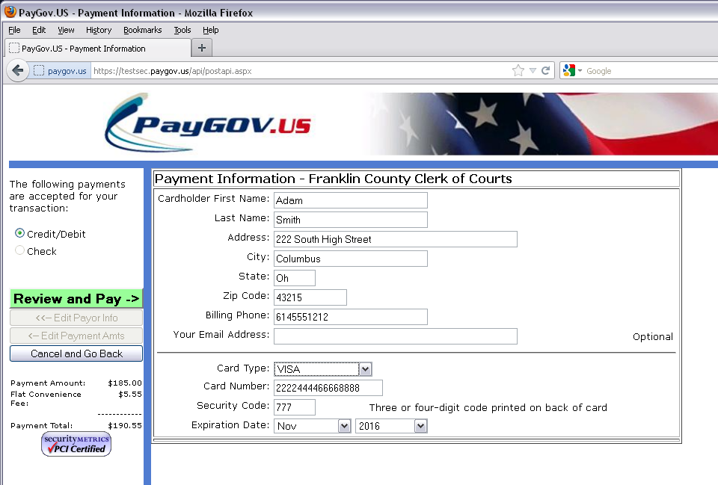
How to: Filing a New Case

Slide 7
GREGGLEWIS
********

Slide 8
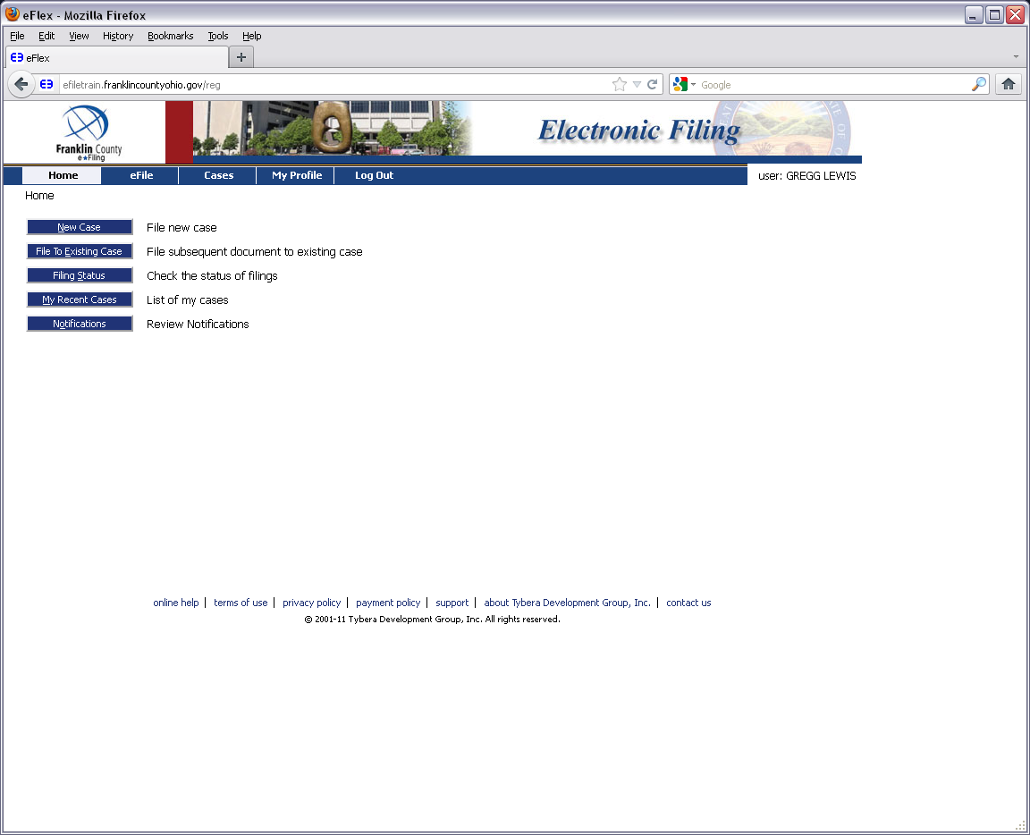

Slide 9
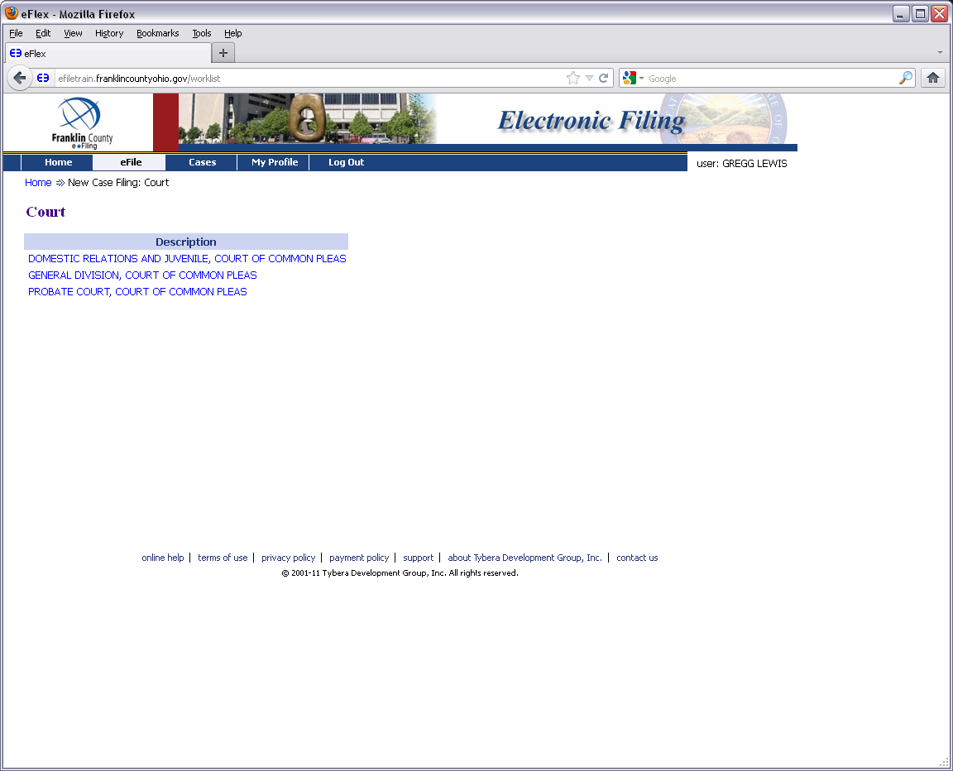

Slide 10
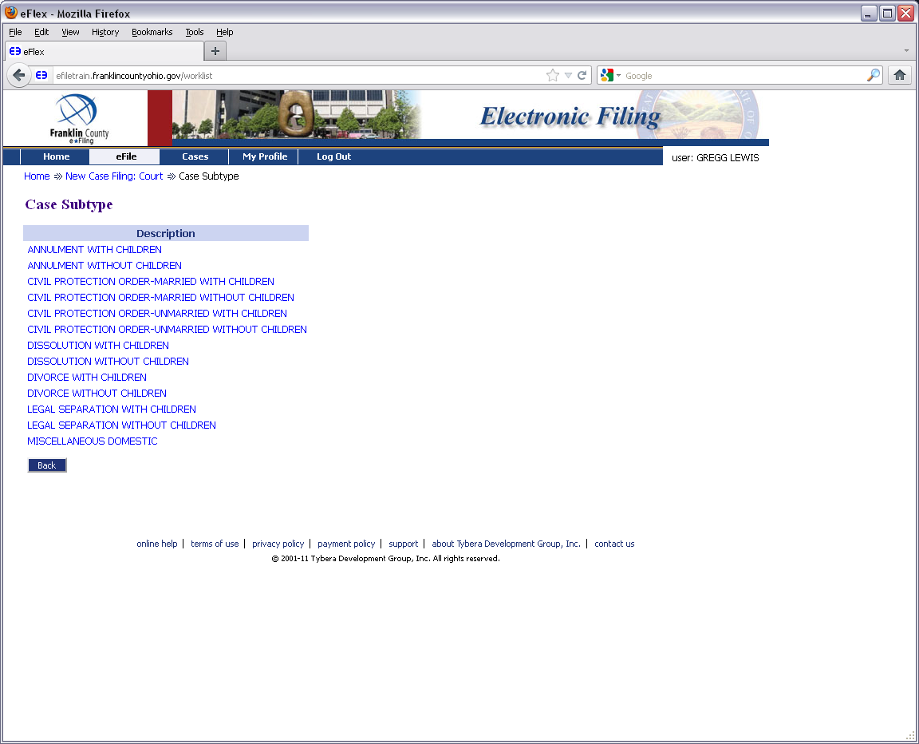

Slide 11
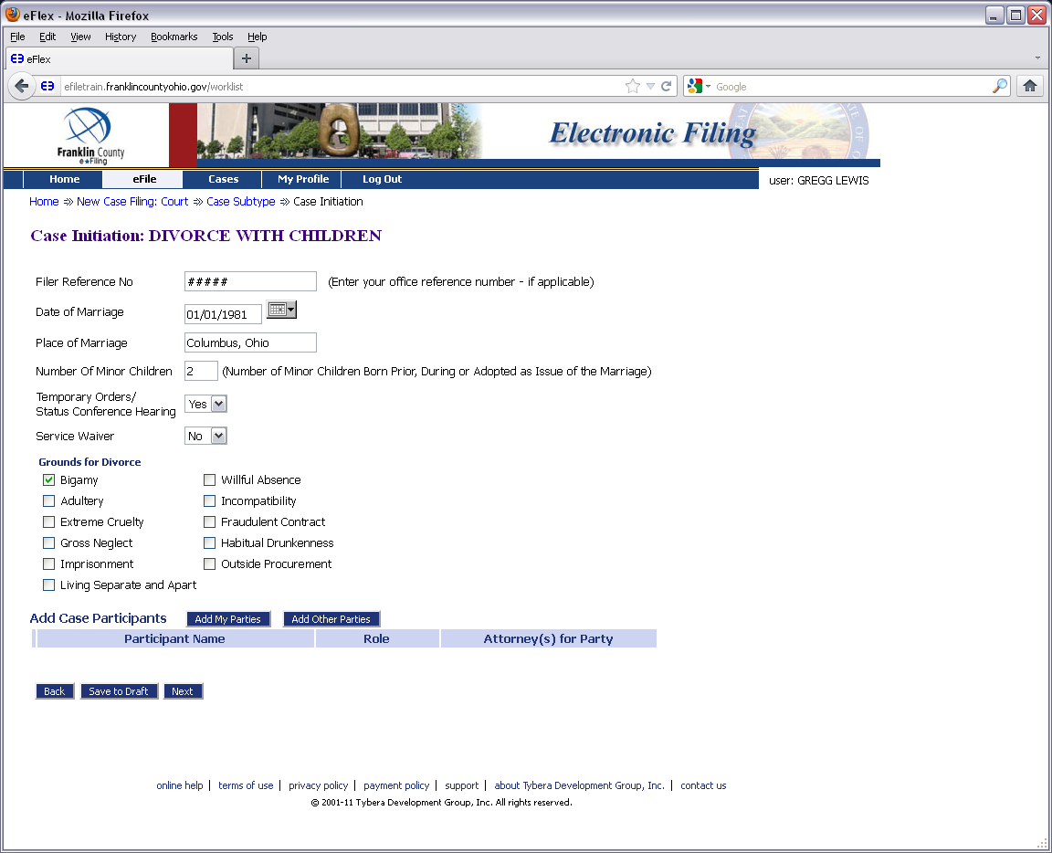

Slide 12
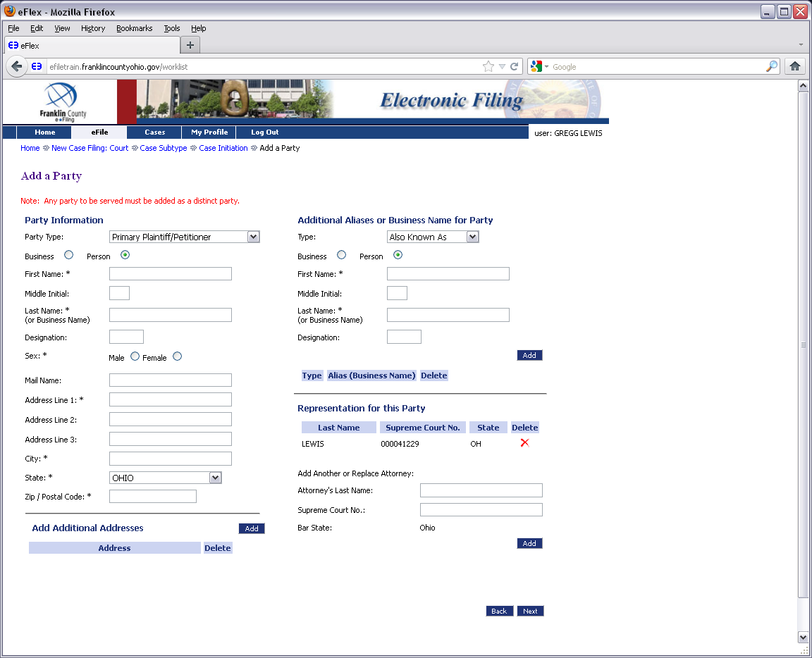

Slide 13
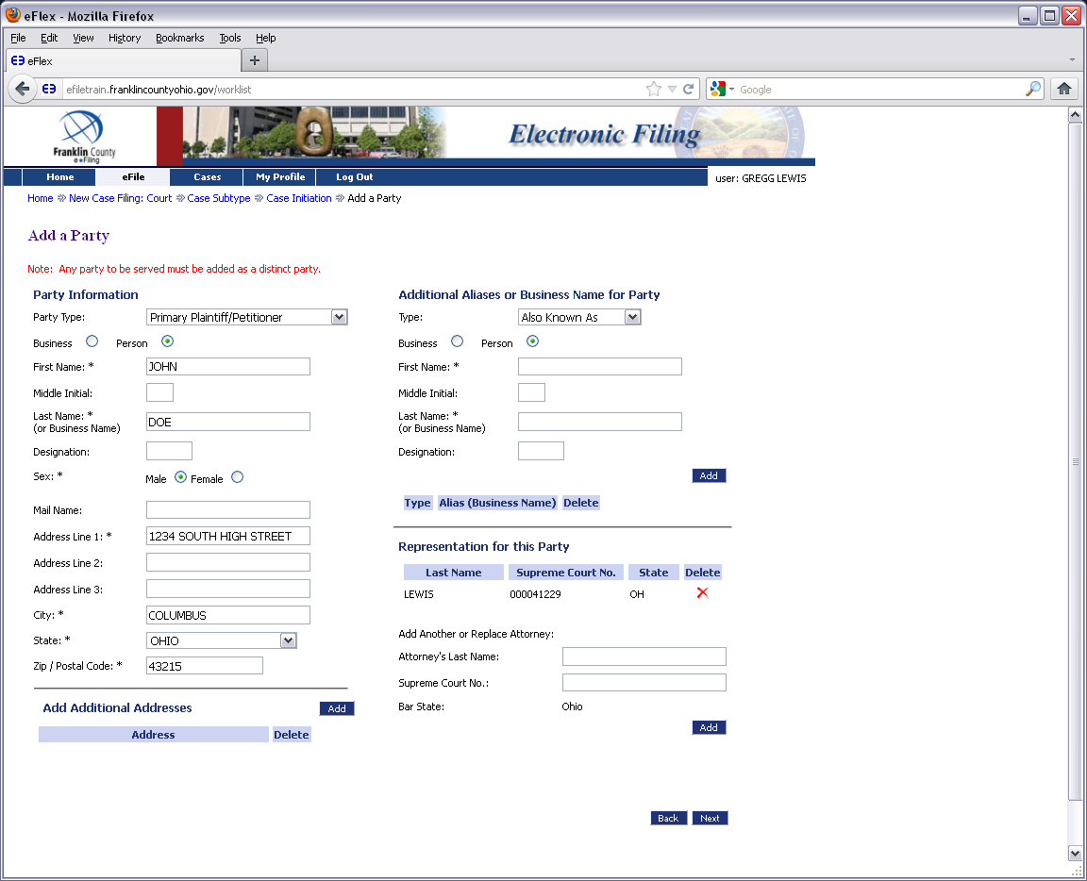

Slide 14
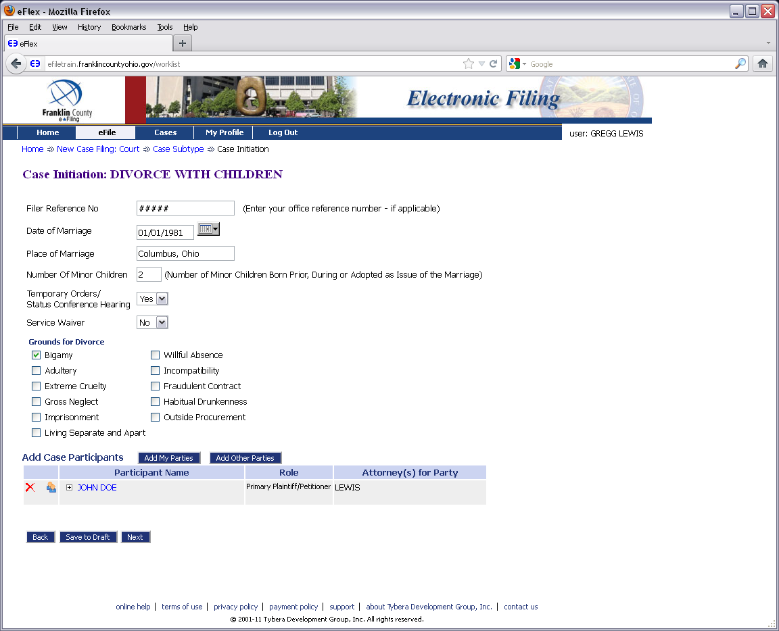

Slide 15
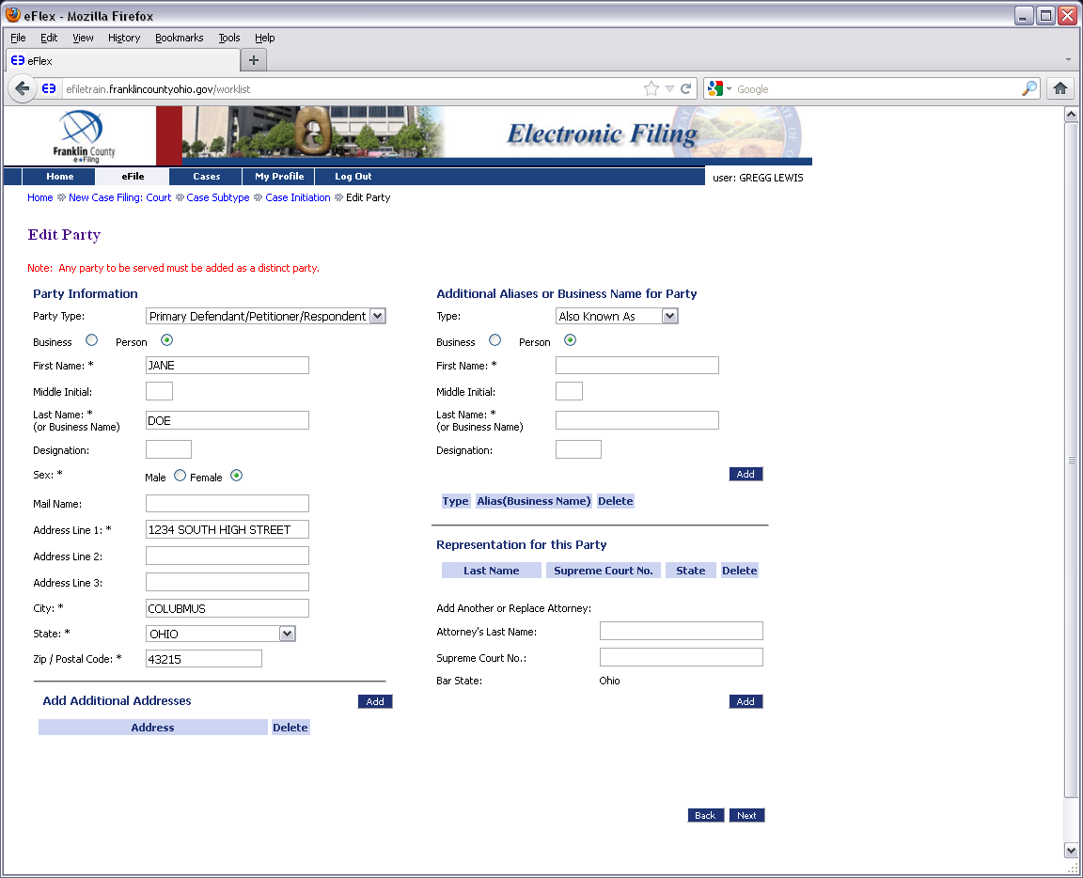

Slide 16
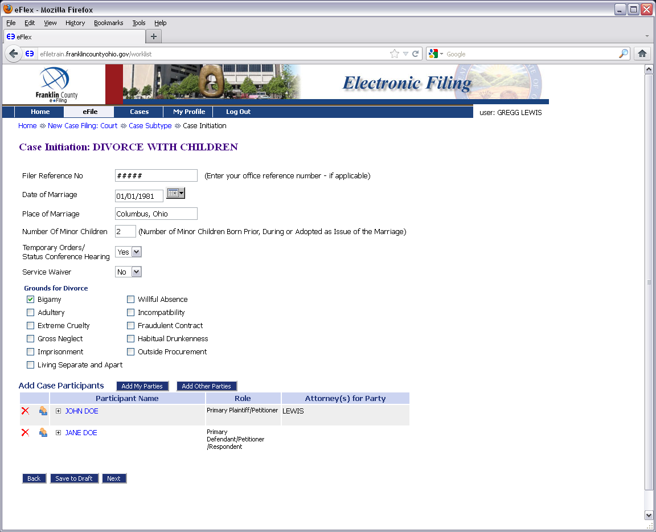

Slide 17
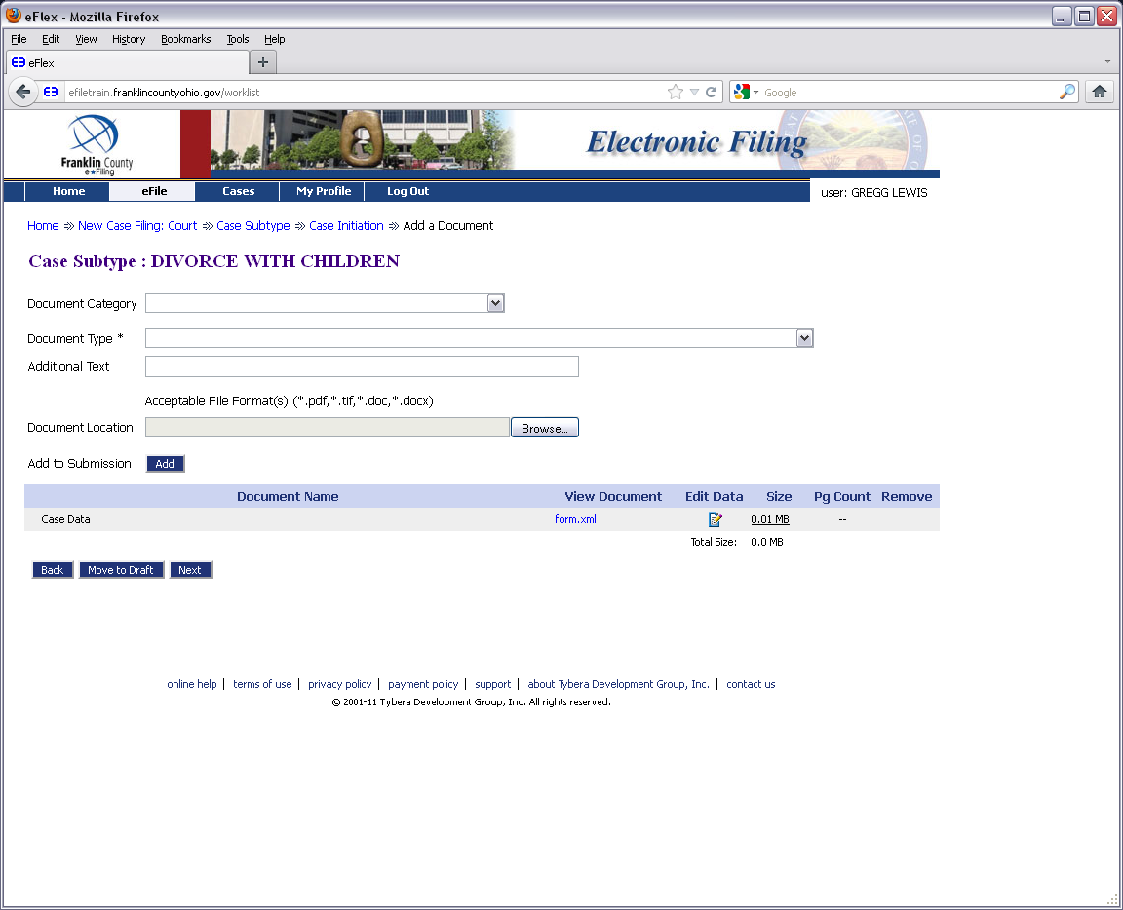

Slide 18
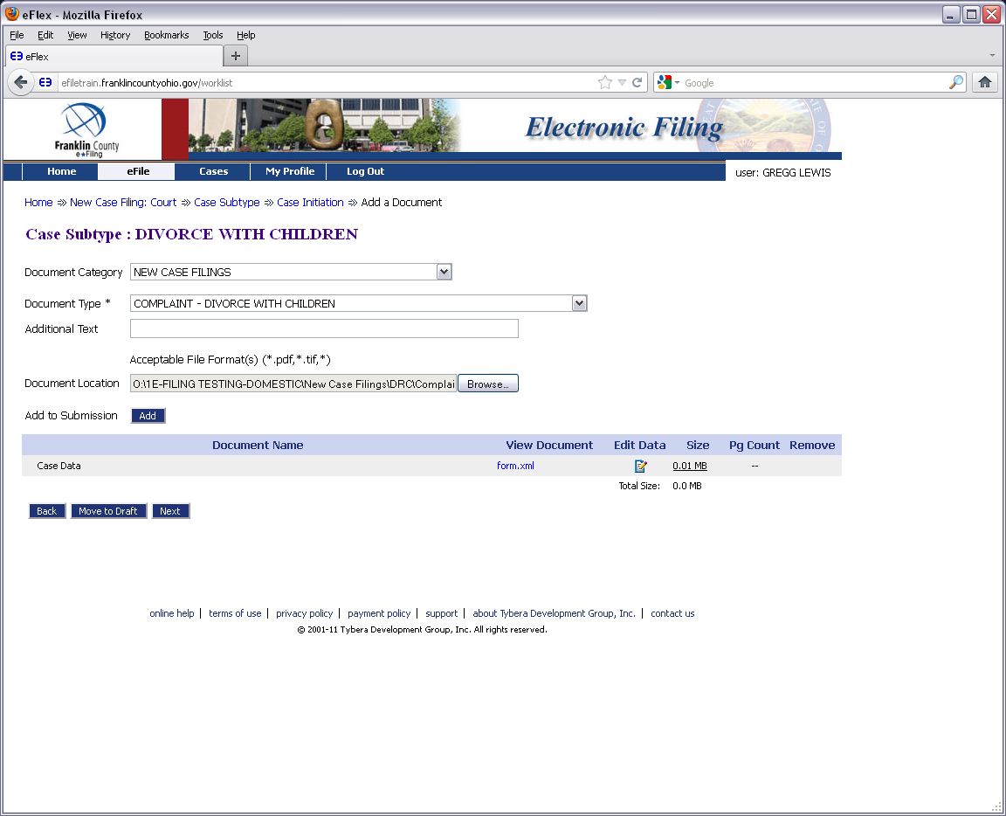

Slide 20
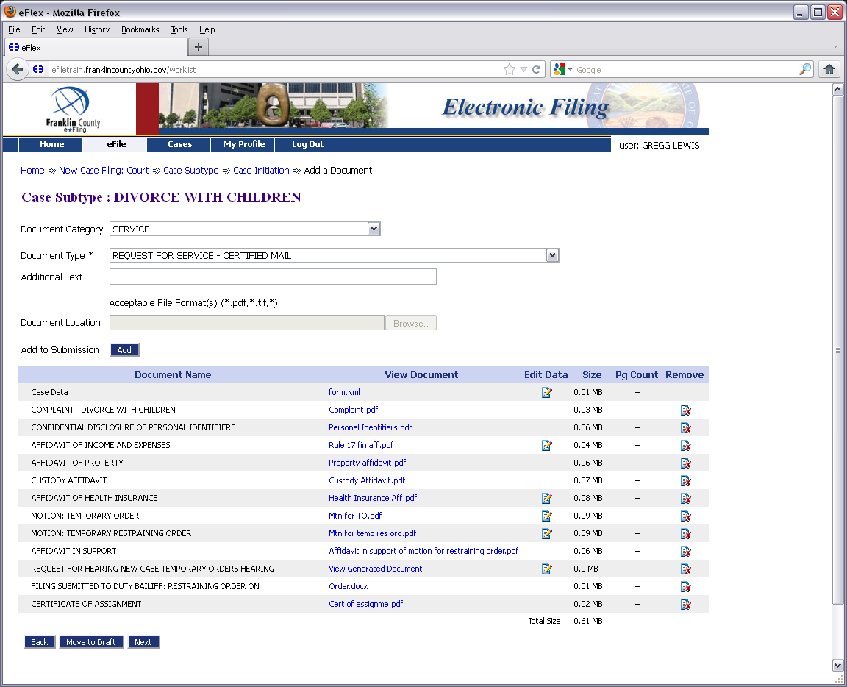

Slide 21
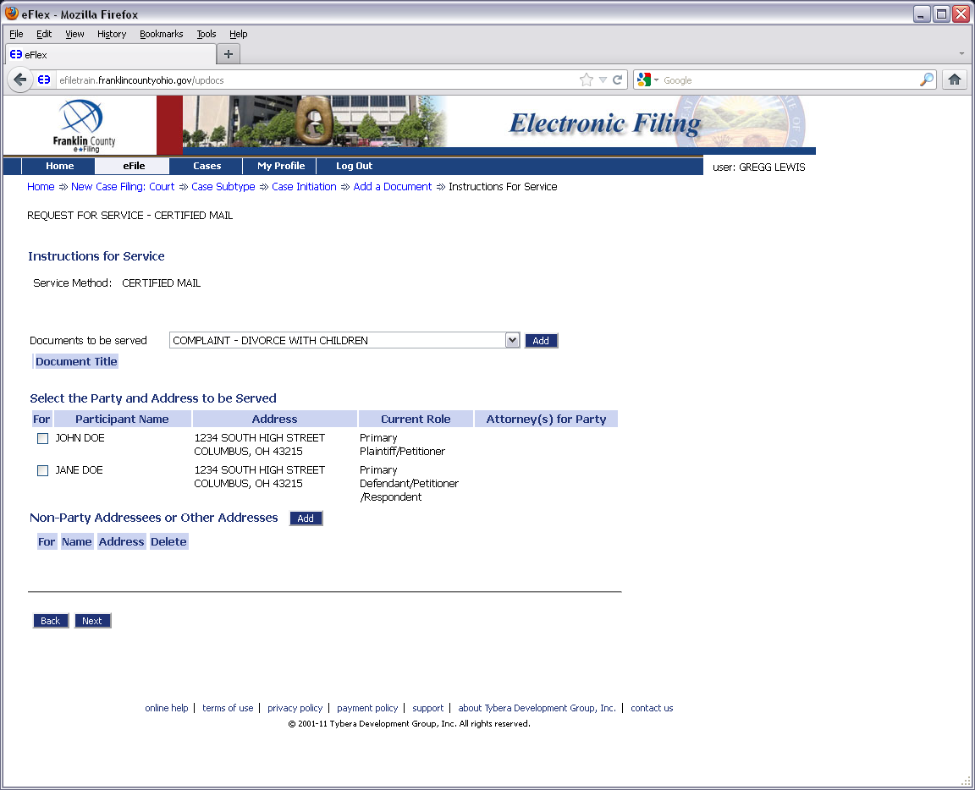

Slide 22
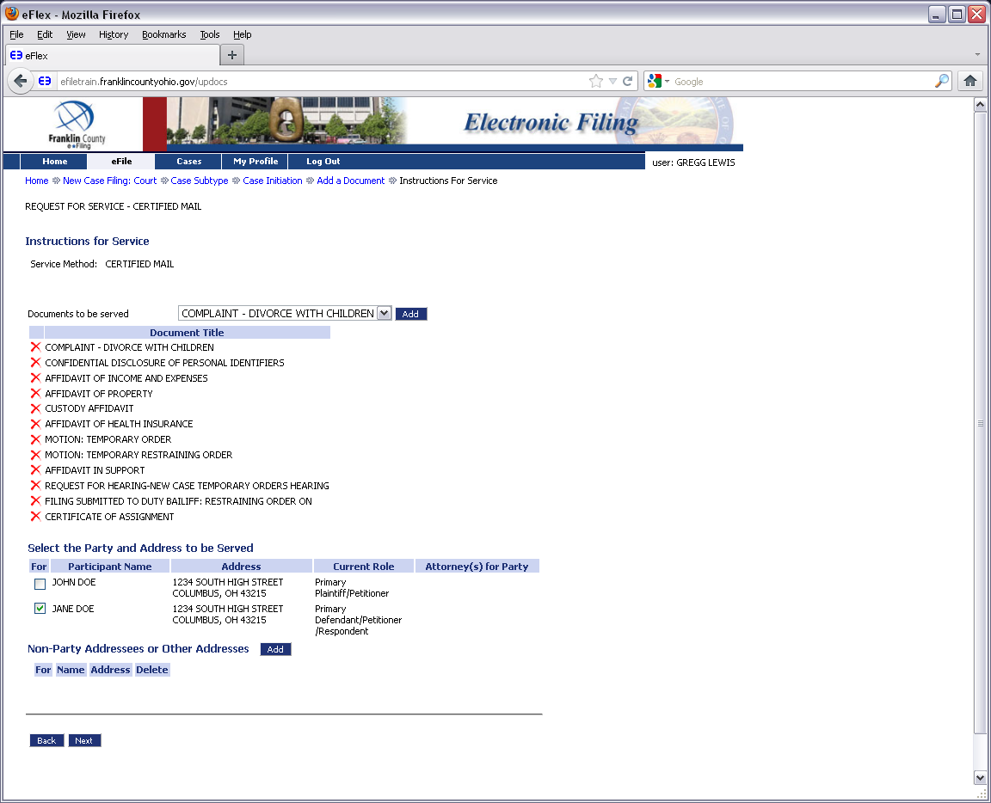

Slide 23
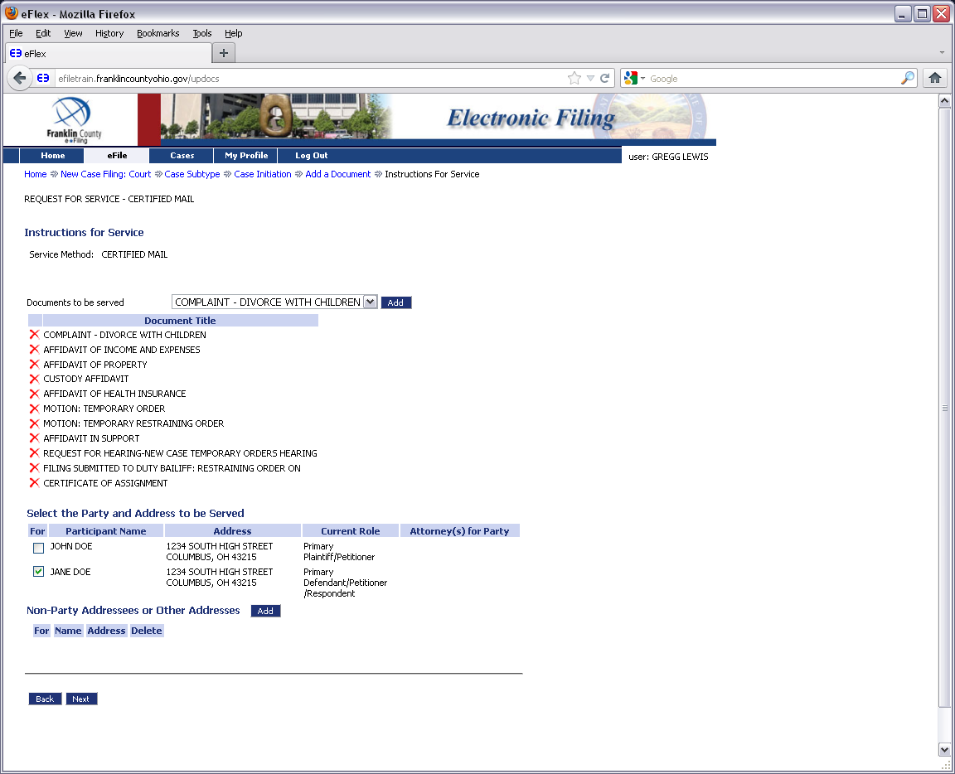

Slide 24
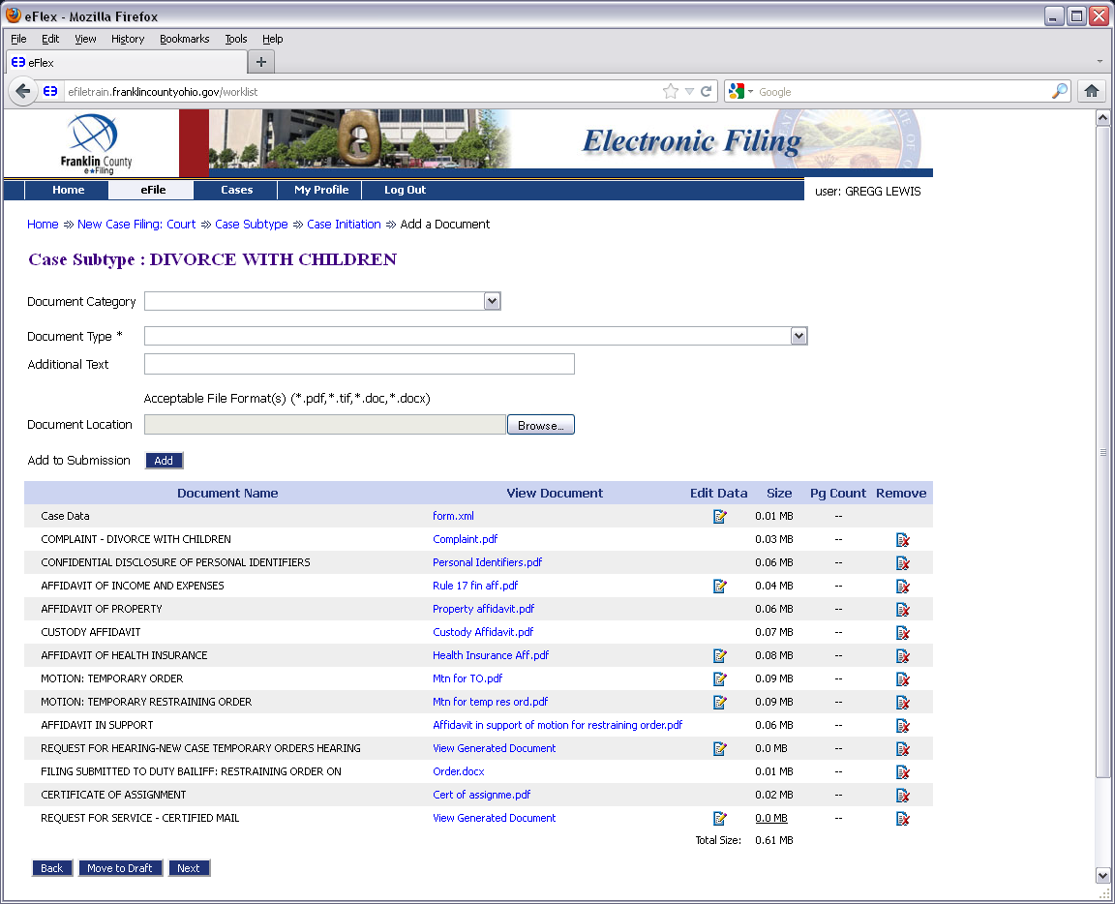

Slide 25
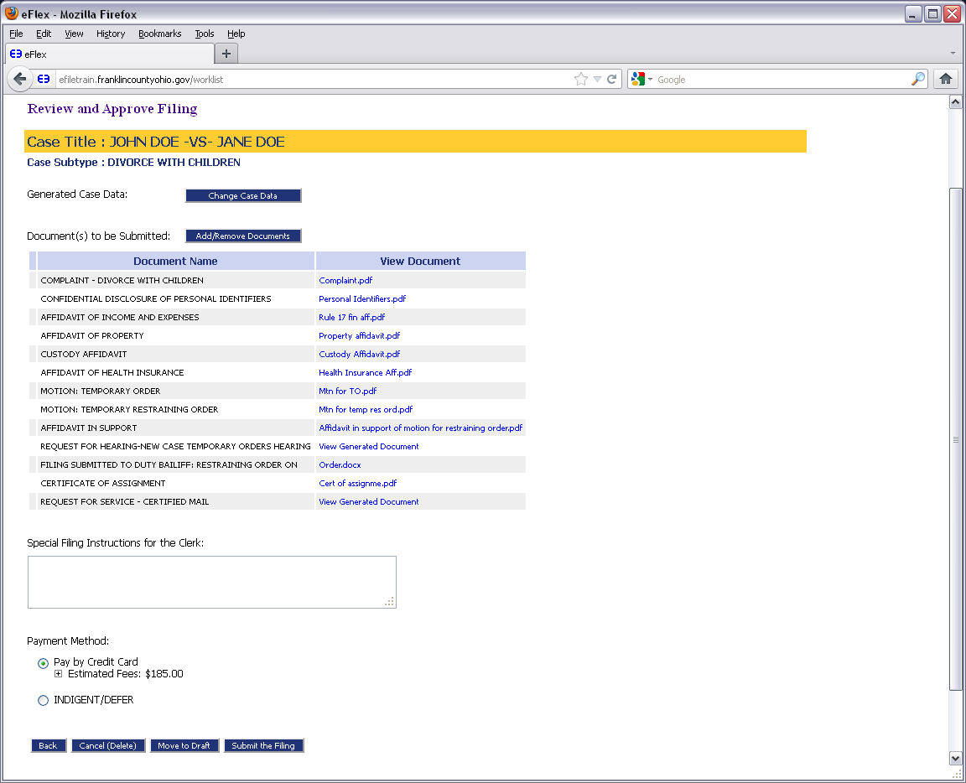

Slide 28
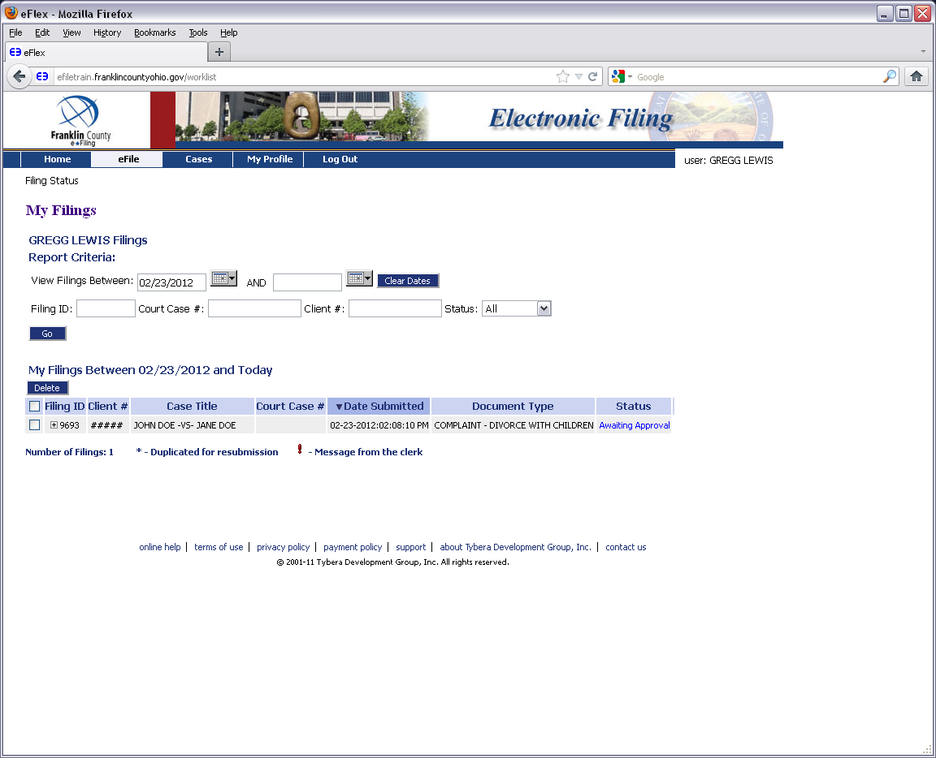

Slide 29
How to: Filing to an Existing Case

Slide 31
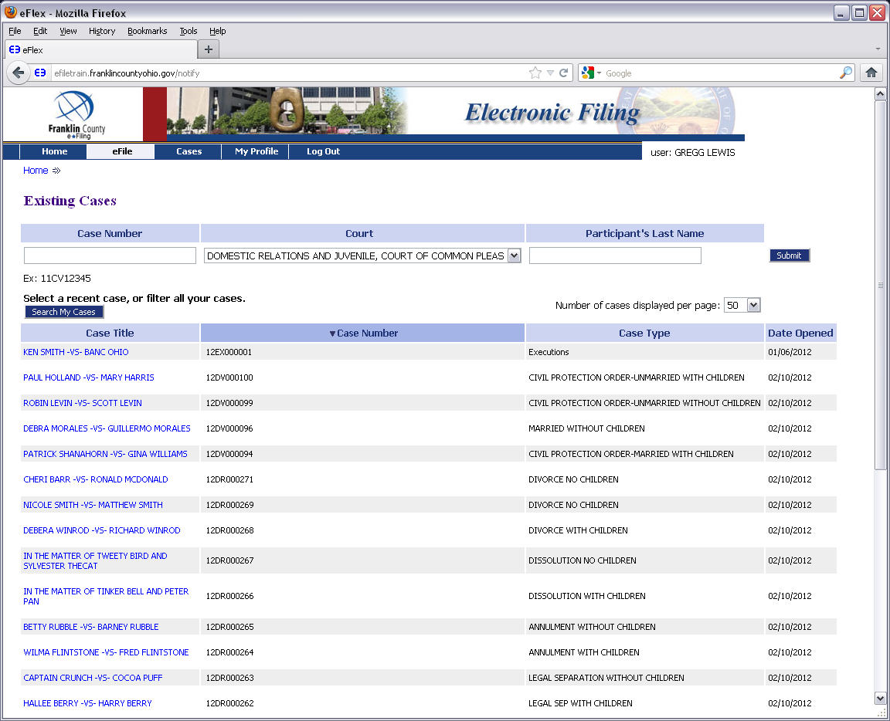

Slide 32
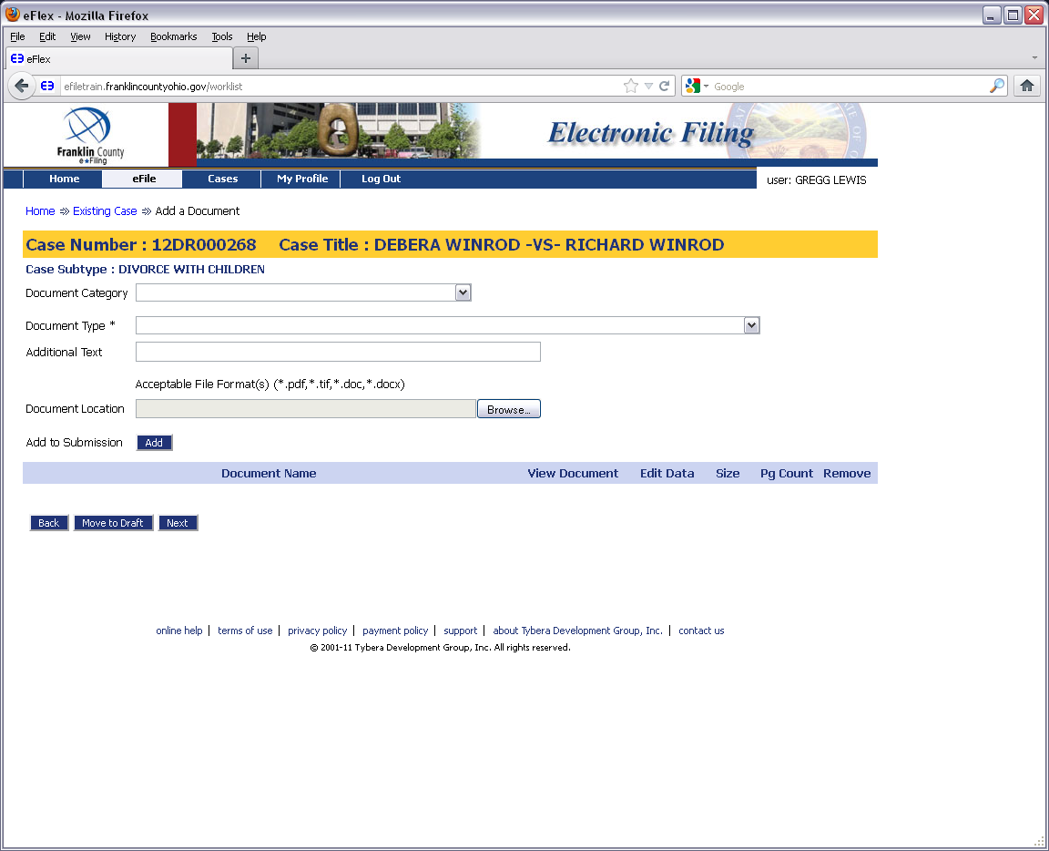

Slide 34
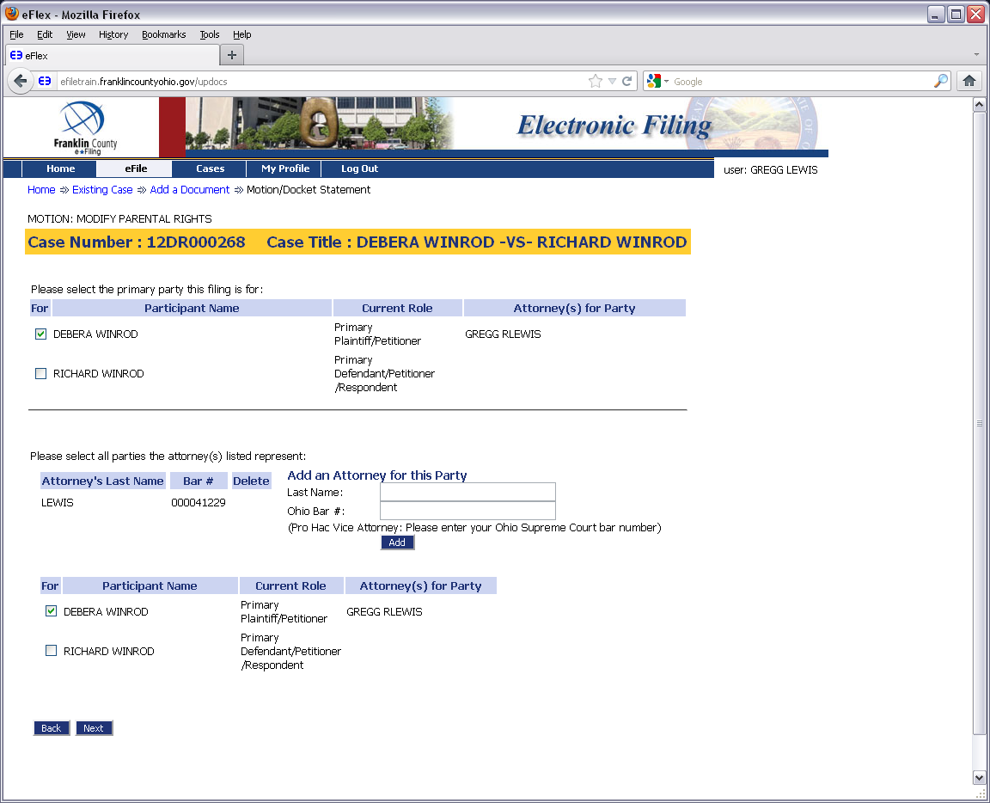

Slide 35
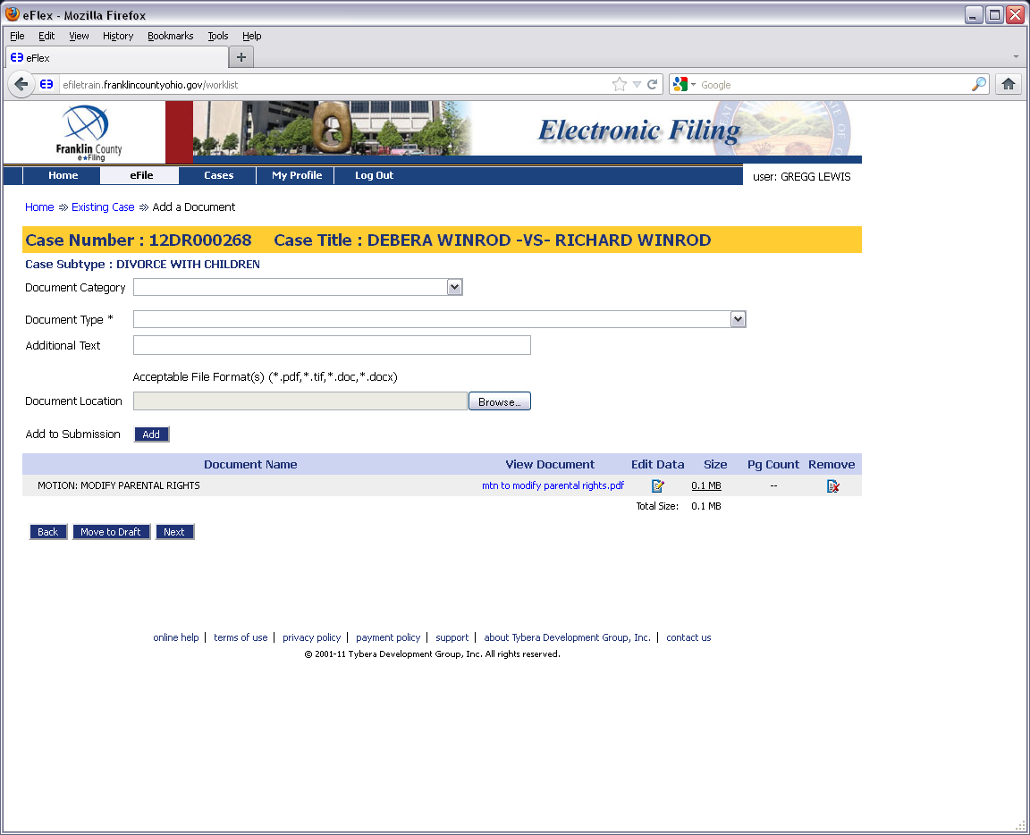

Slide 36
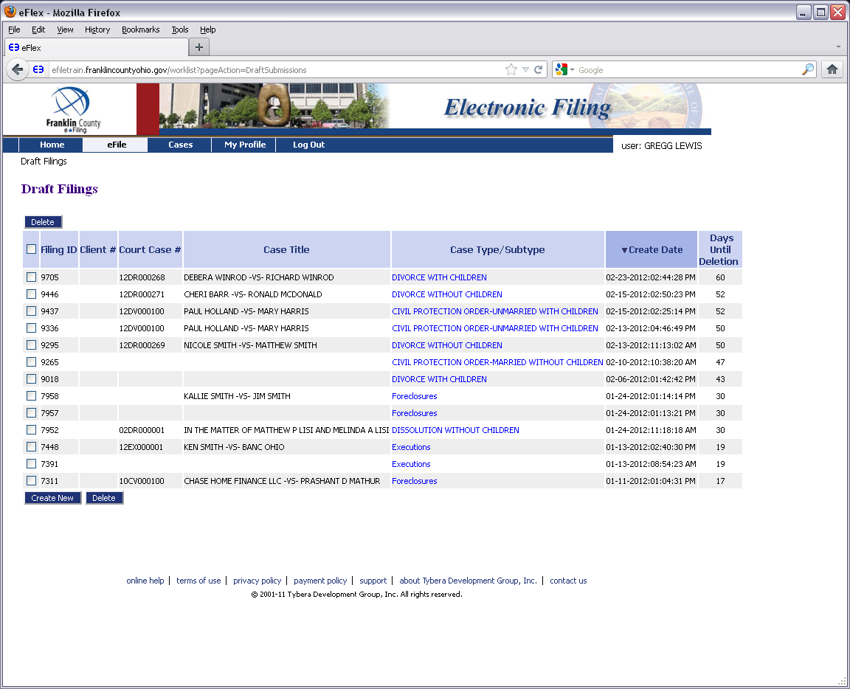

Slide 38
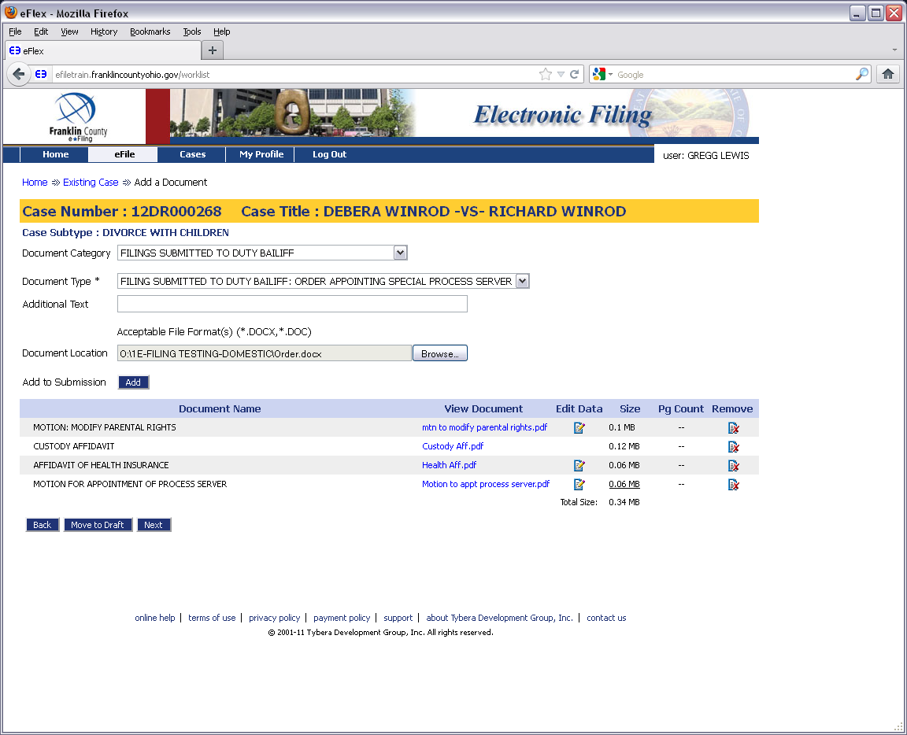

Slide 39
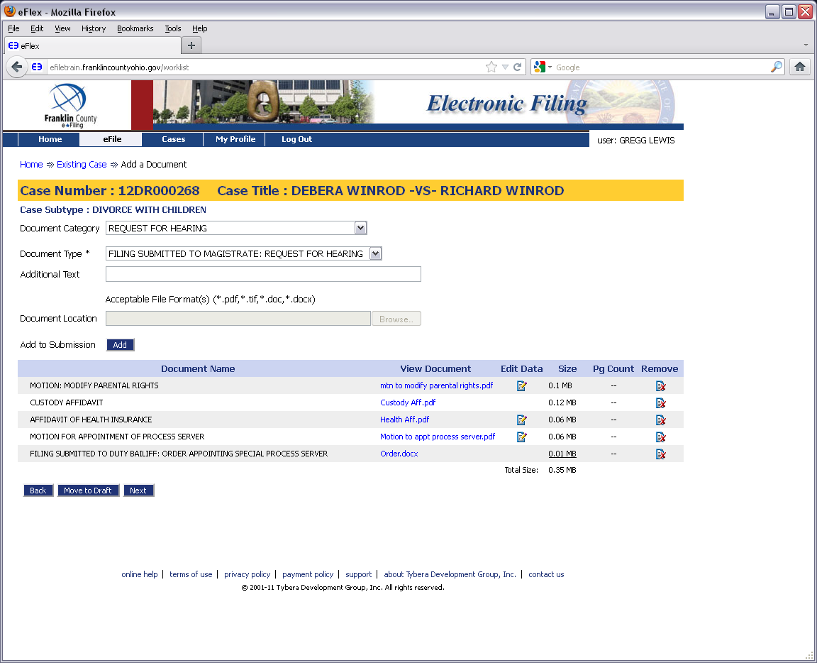

Slide 40
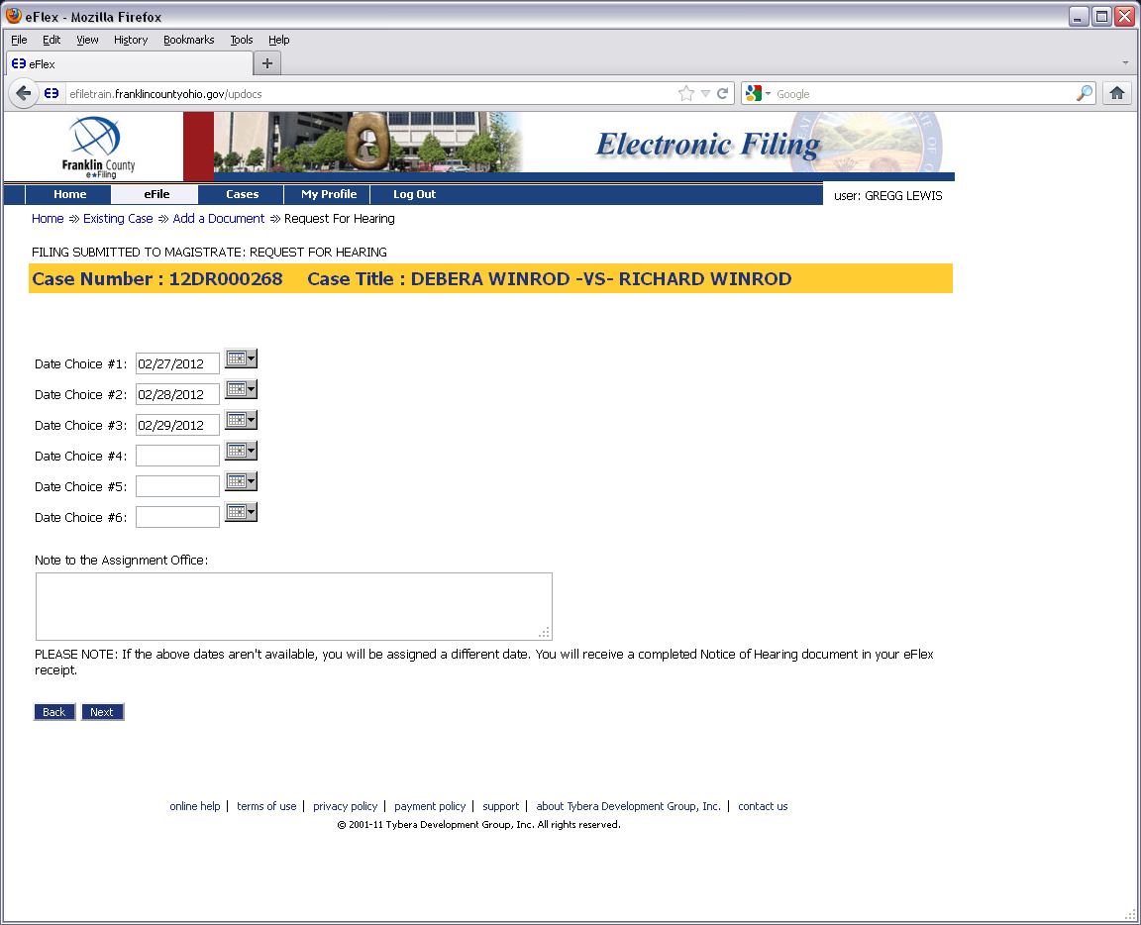

Slide 42
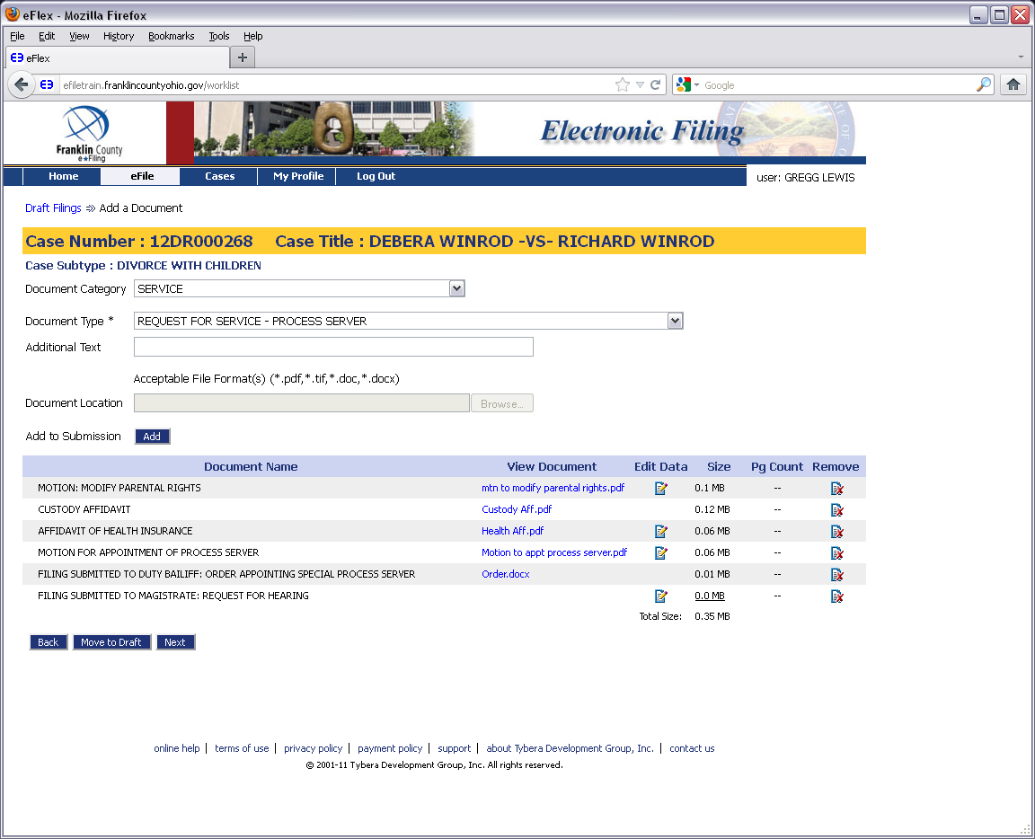

Slide 43
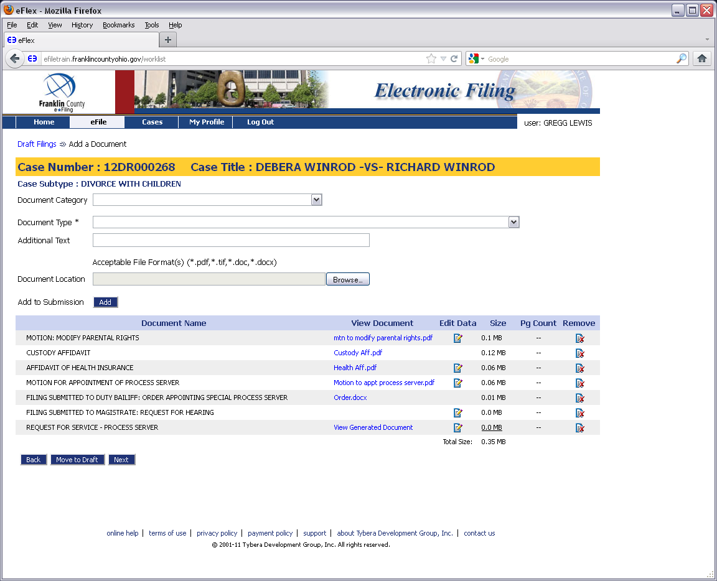

Slide 44
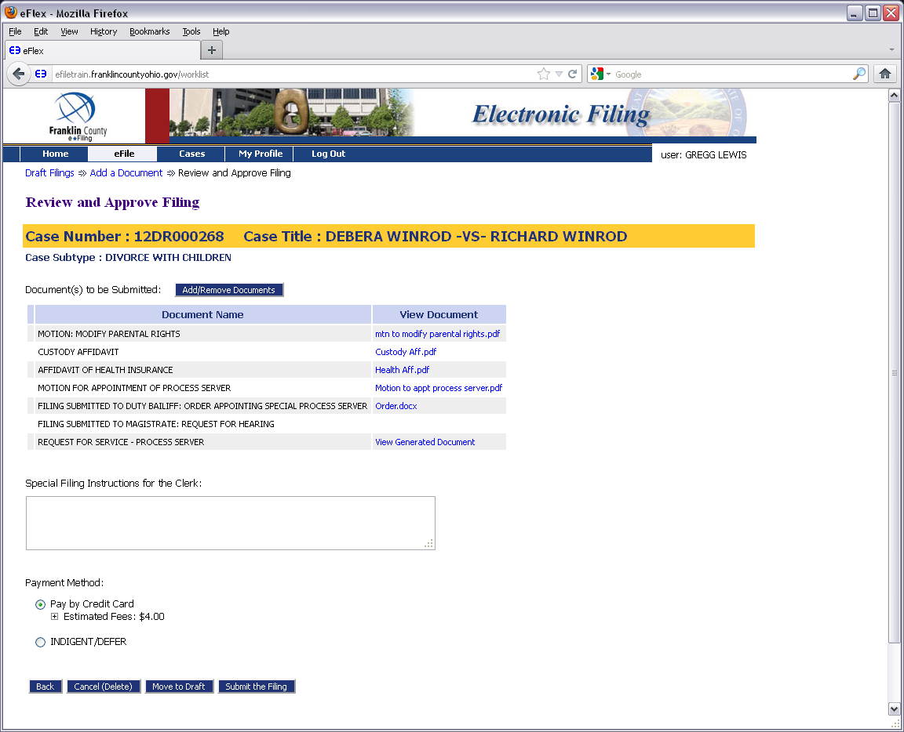

Slide 46
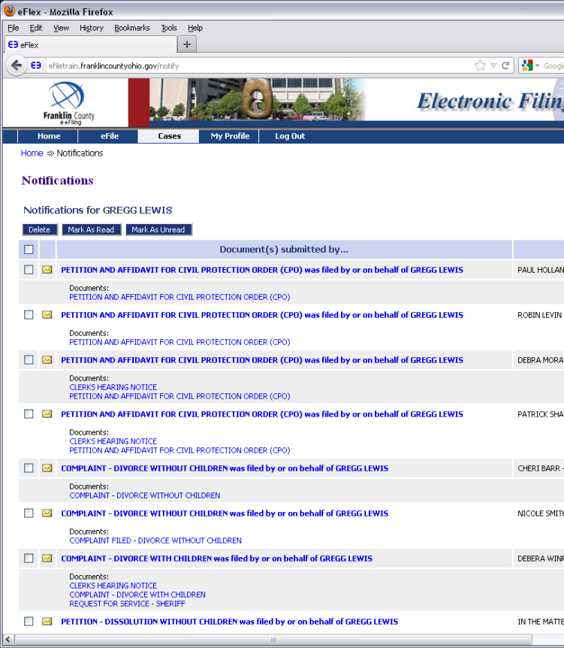
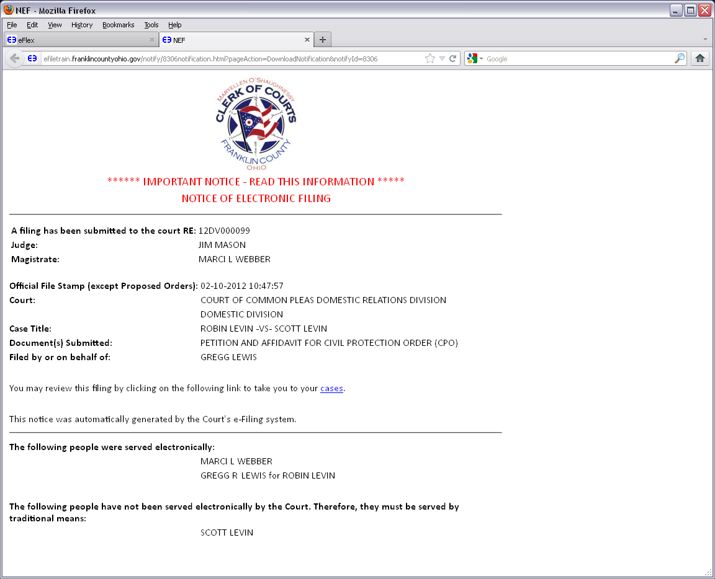
How To: Checking Notifications

Slide 47
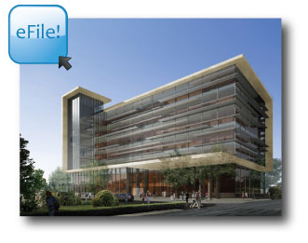
When YOU e-File…YOU are Notified!
Via email…
…And our system

Slide 51
For More Information…
Online Help Through the System
https://efiling.franklincountyohio.gov/onlineHelp/fiDefault.htm
Clerk of Courts YouTube Channel
Youtube.com/clerkfranklincounty
For Procedural & Technical Issues
Domestic Relations Division Number:
614.525.4410
*Available Monday-Friday, 8am-5pm*
http://clerk.franklincountyohio.gov/e-File.cfm

Slide 52
This Presentation Was Produced by:
Franklin County Clerk of Courts
Communications and Operations Staff

