Slide 1
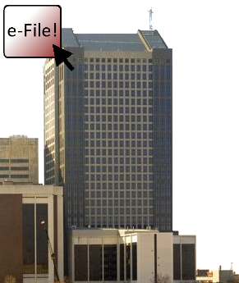

Introduction e-Filing
Juvenile Division

Slide 2
Welcome to e-Filing
We hope this guide will assist you in becoming familiar with our County’s e-Filing system. Please view this presentation as a slide show to get the best user experience.
For information regarding registering for an account, navigating our home page, you can watch our “Introduction to e-Filing” video series here:
Clerk's e-Filing Videos

Slide 3
What to Expect From This Presentation
What technology you need to e-File in the Juvenile Division
Online resources and helpful links
How to:
  File to an existing Juvenile Case: Orders and Service
  File to an existing Juvenile Case: Motions and Hearings
  Check Notifications

Slide 4
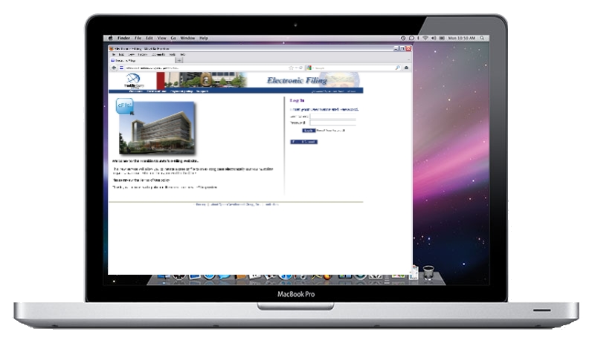
What do you need to e-File?
Computer with Internet browsing capabilities
Scanner
Ability to create .PDF files
  Recommended setting: 300 DPI
Word Processer capable of exporting to MS Word 97-2003 format or later
  The system will only accept .DOC or .DOCX
  Other documents types (e.g. Corel Word Perfect or Apple Pages) must be re-formatted to .DOC or .DOCX

Slide 5
Online Resources & Helpful Links
Adobe Acrobat:
  http://www.adobe.com/products/acrobat.html
Adobe Acrobat is the recommended software for creating .PDF files.
PDF Conversion Plug-In for Microsoft Office 2007: http://www.microsoft.com/download/en/details.aspx?id=7
This plug-in will give you the ability to save your files in .PDF format if you are running Office 2007.
Corel WordPerfect:
  http://apps.corel.com/lp/wpo/
Corel WordPerfect will allow you to convert your files to .DOC or .PDF.
Newer versions will also allow you to convert your files to .DOCX.

Slide 6
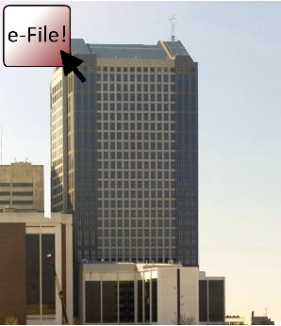
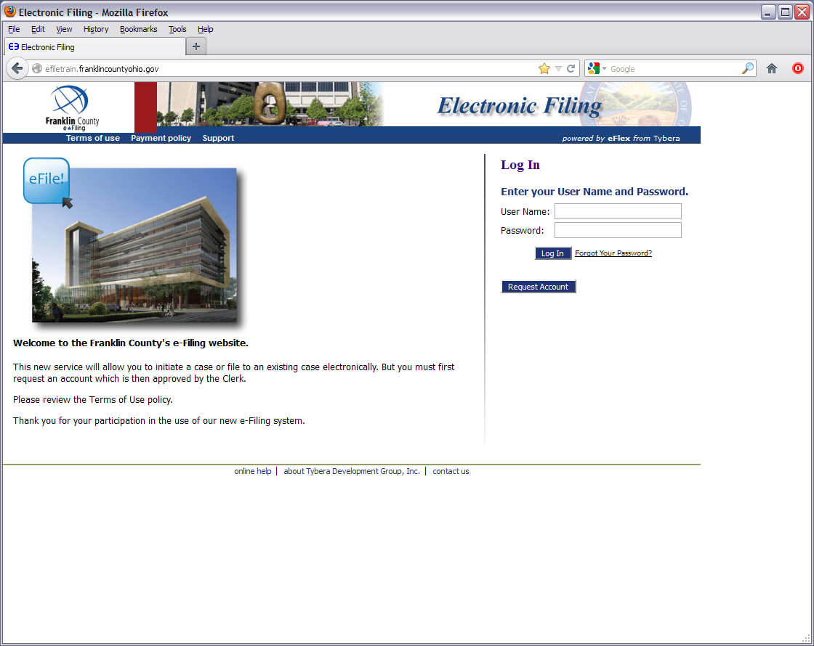
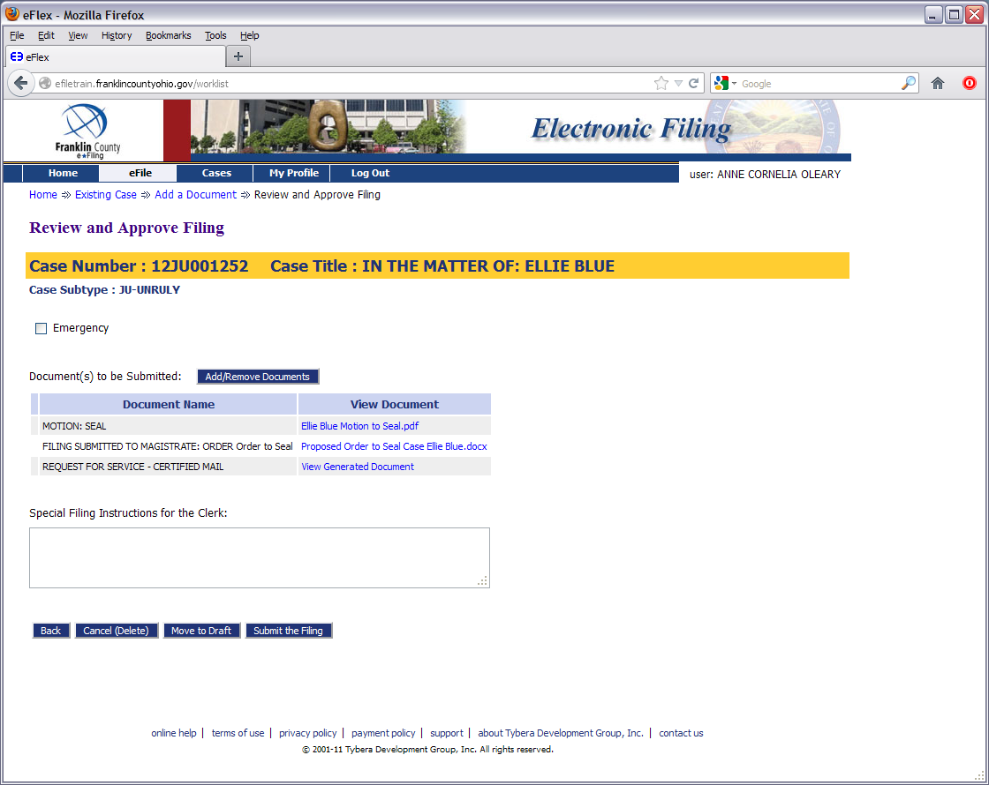
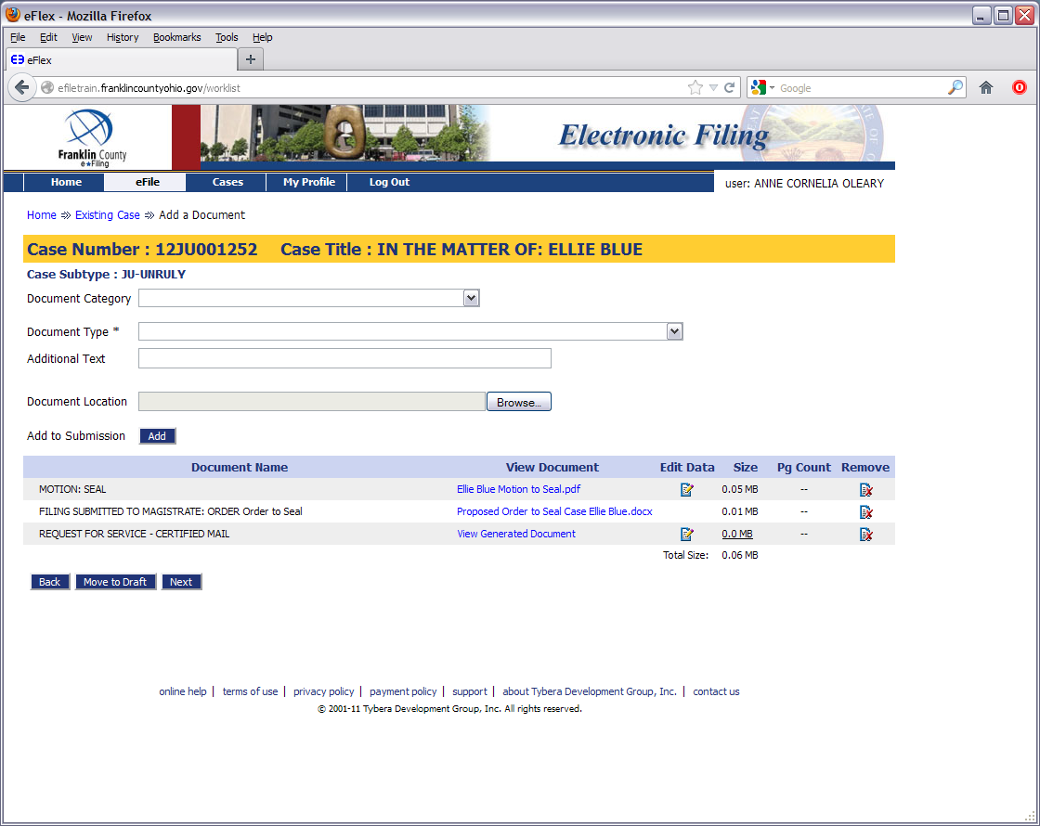
Filing to Existing Cases
Proposed Orders & Service

Slide 7
ACOLEARY
********

Slide 8
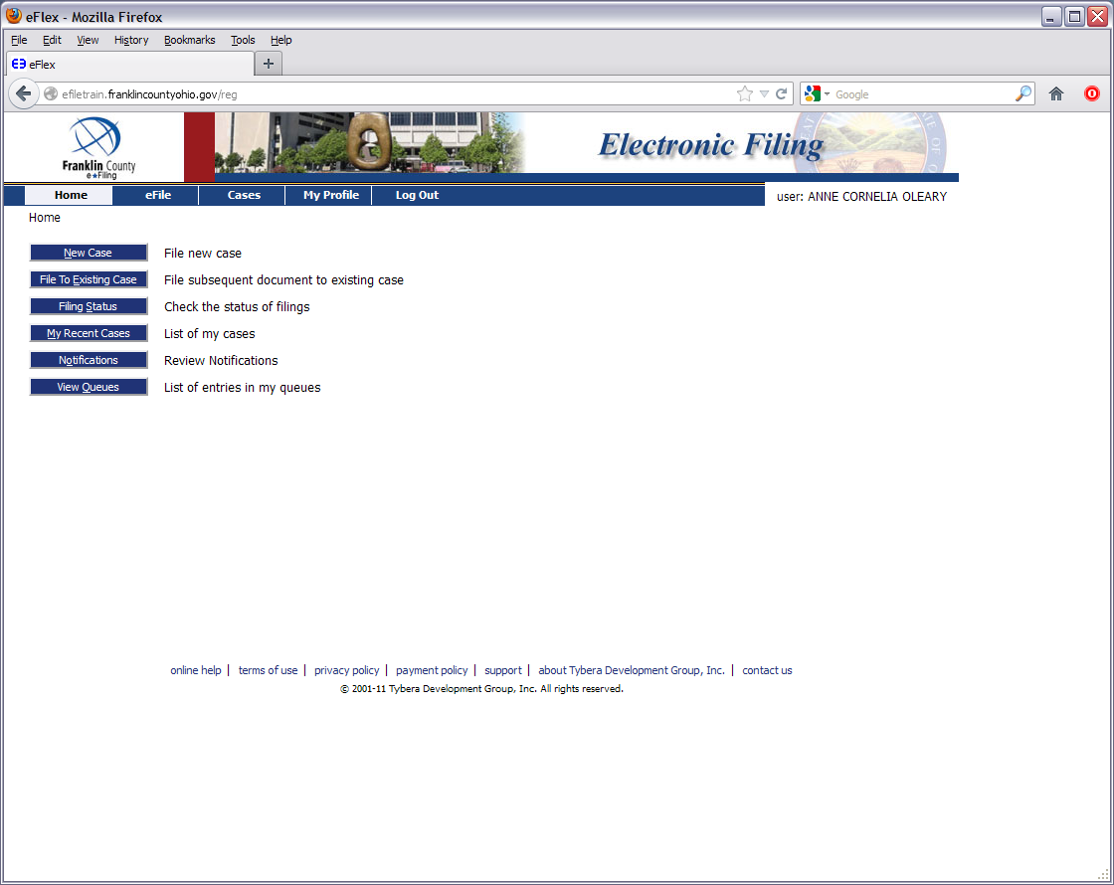

Slide 9
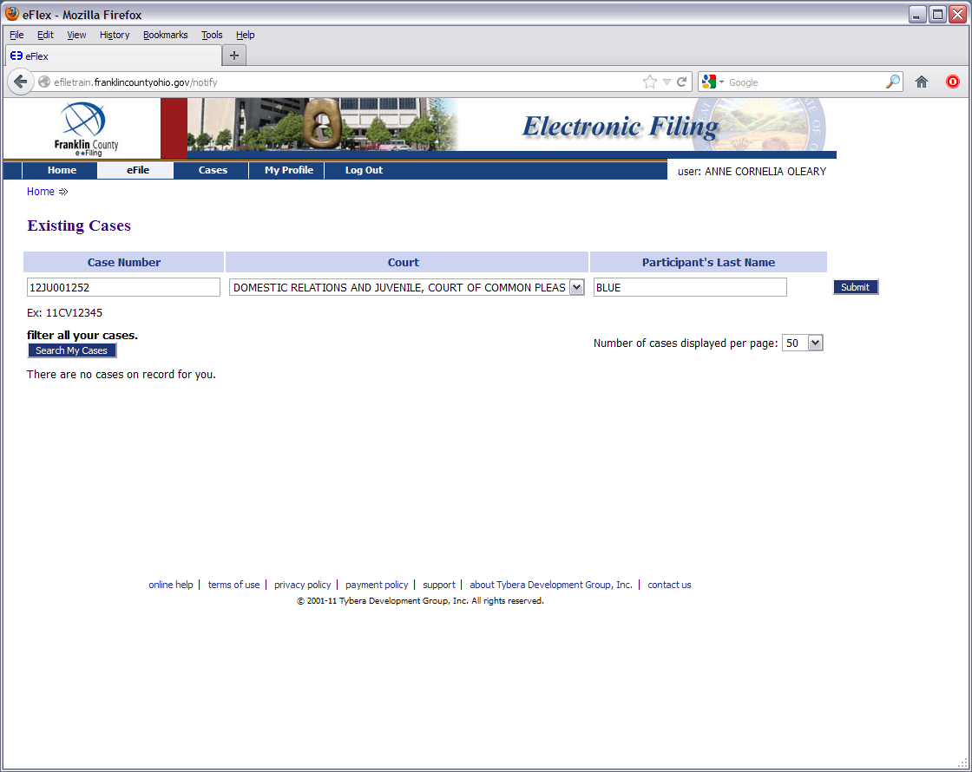

Slide 10
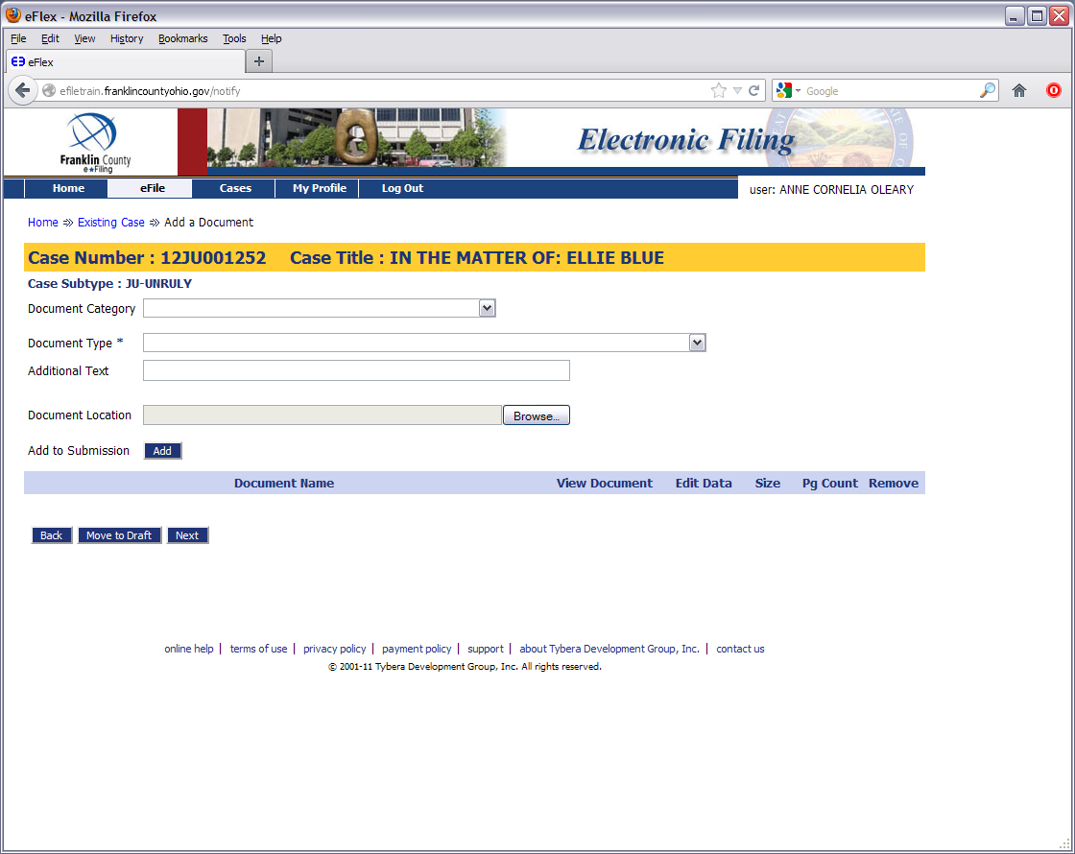

Slide 11
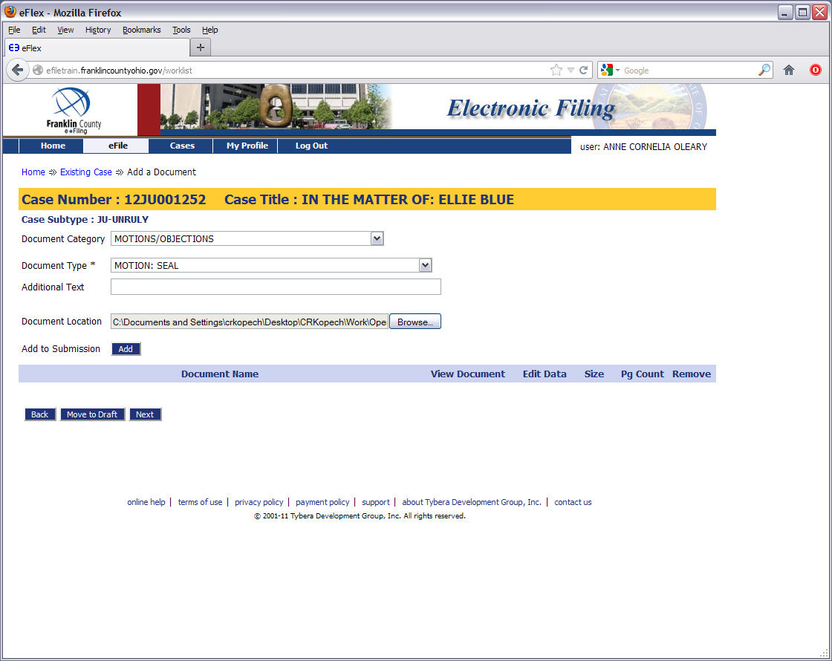

Slide 12
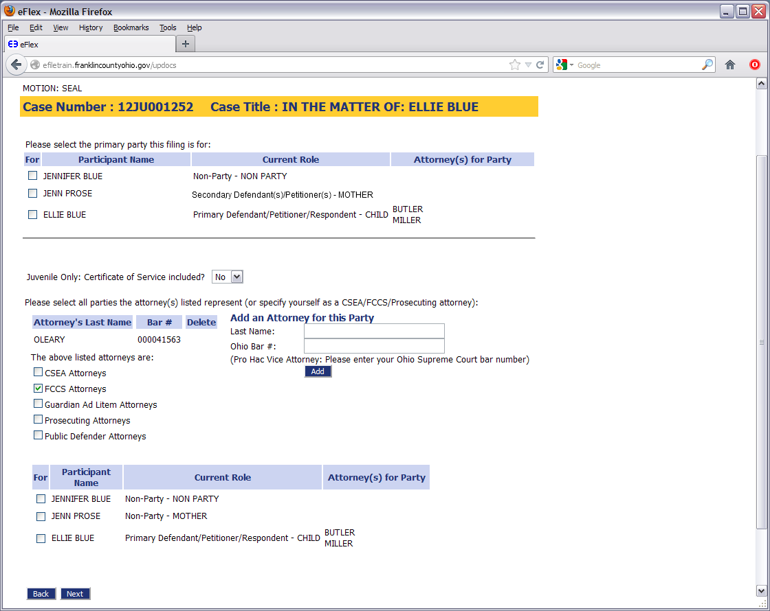

Slide 13
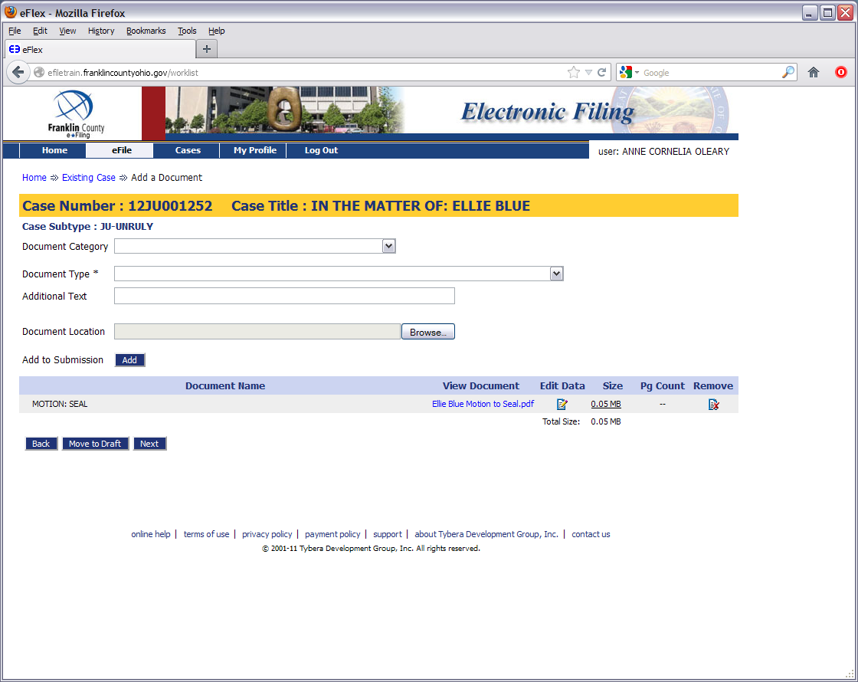

Slide 14
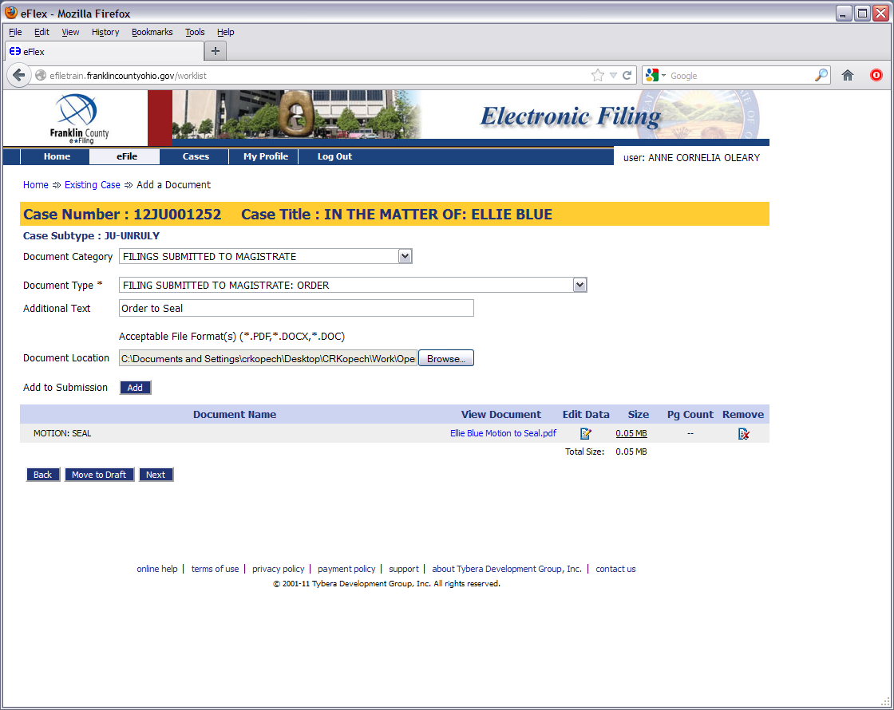

Slide 15
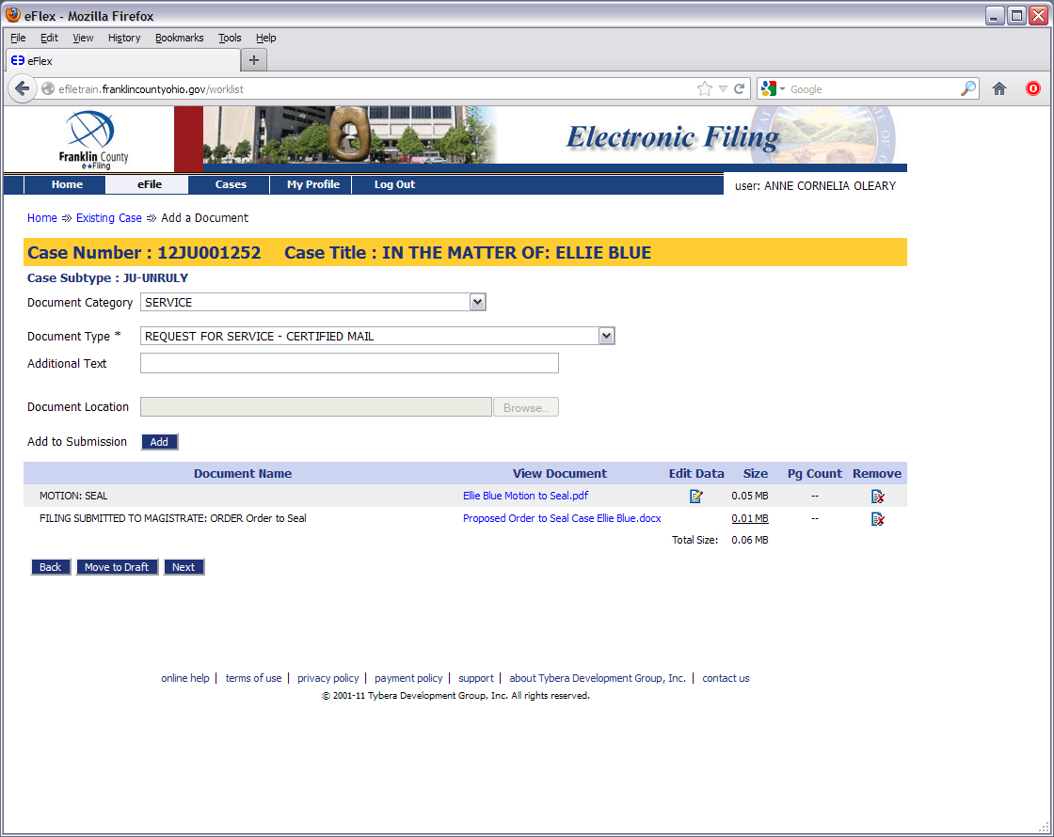

Slide 16
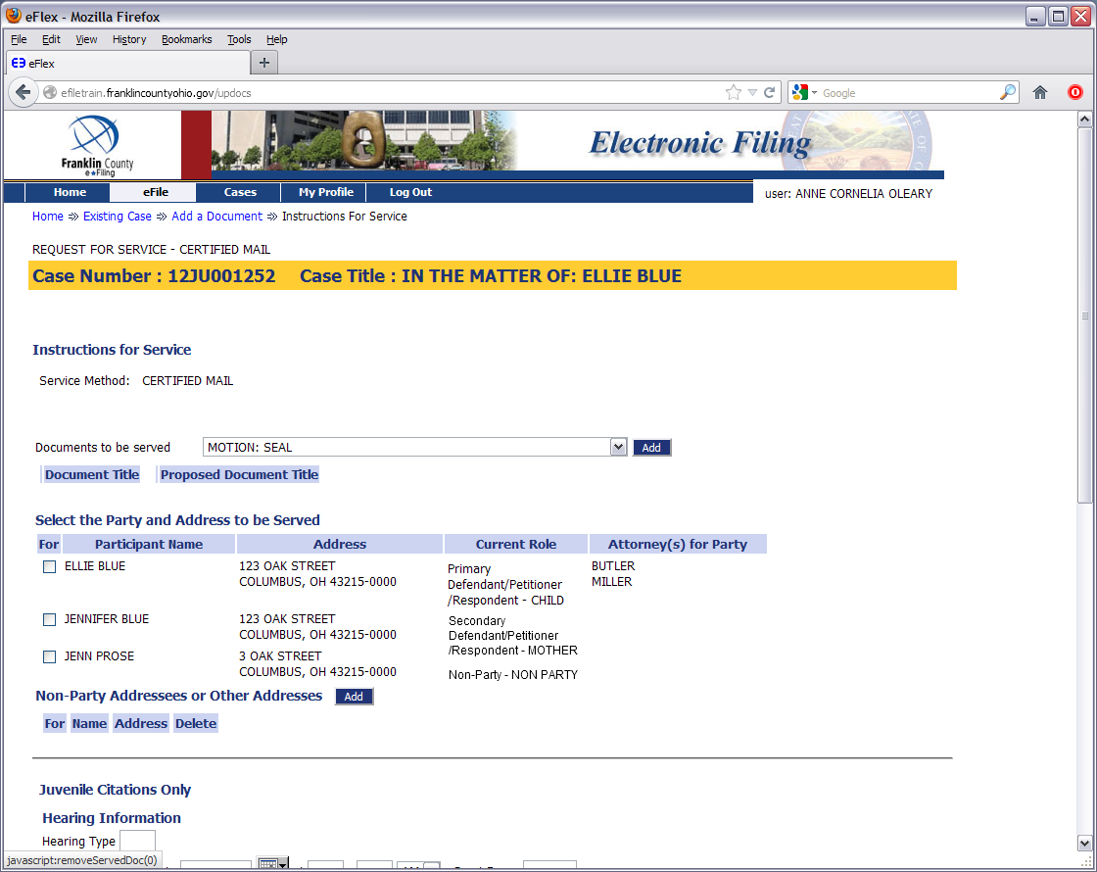

Slide 17
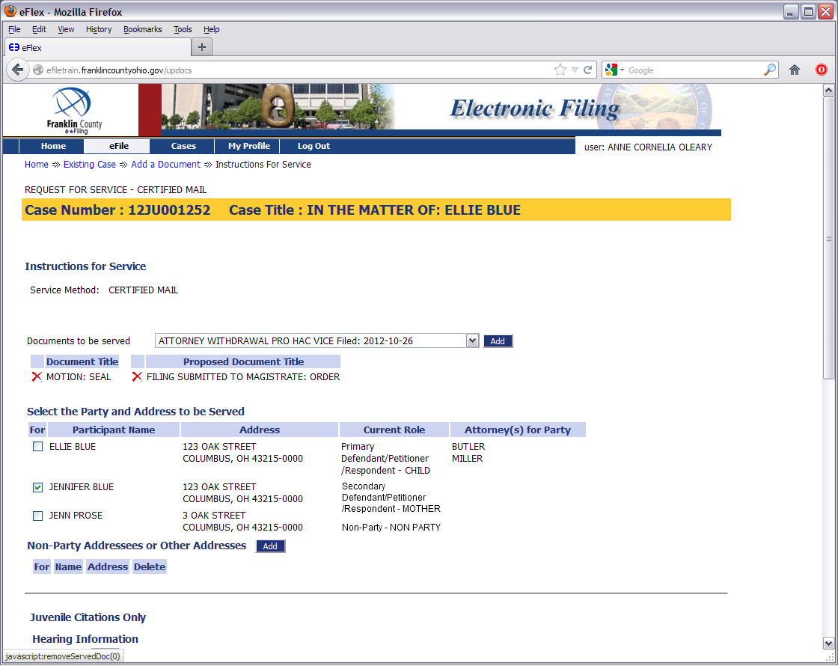

Slide 18
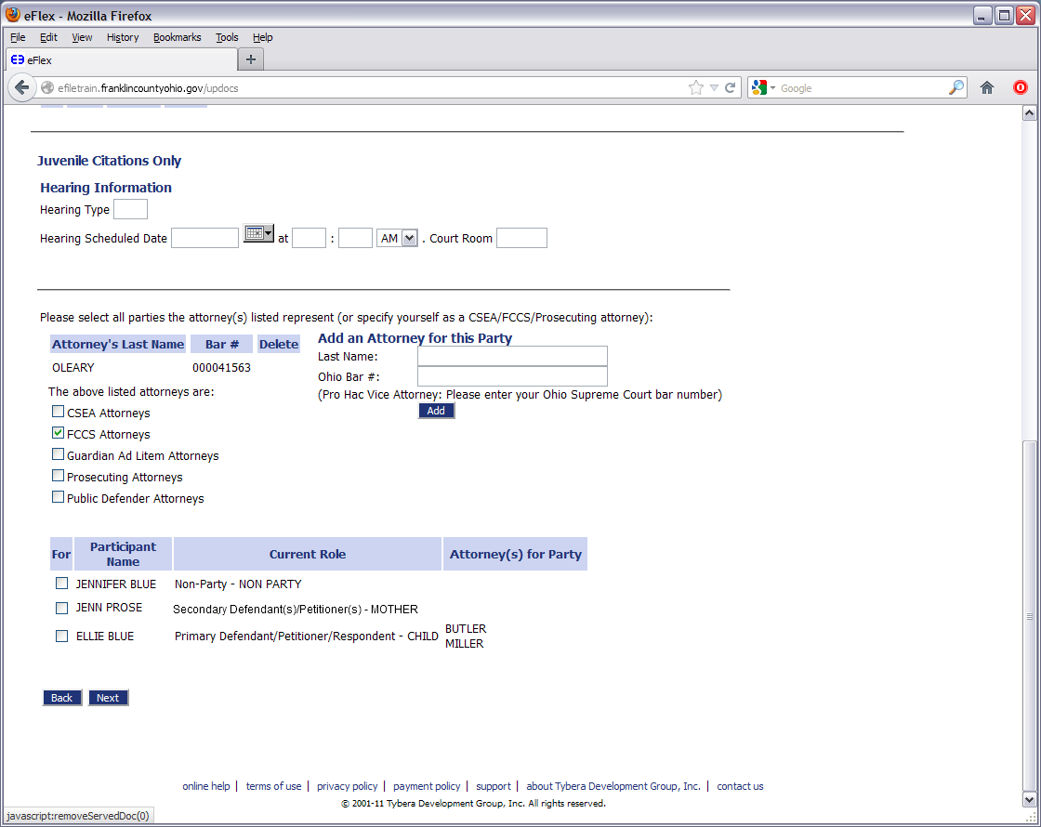

Slide 21
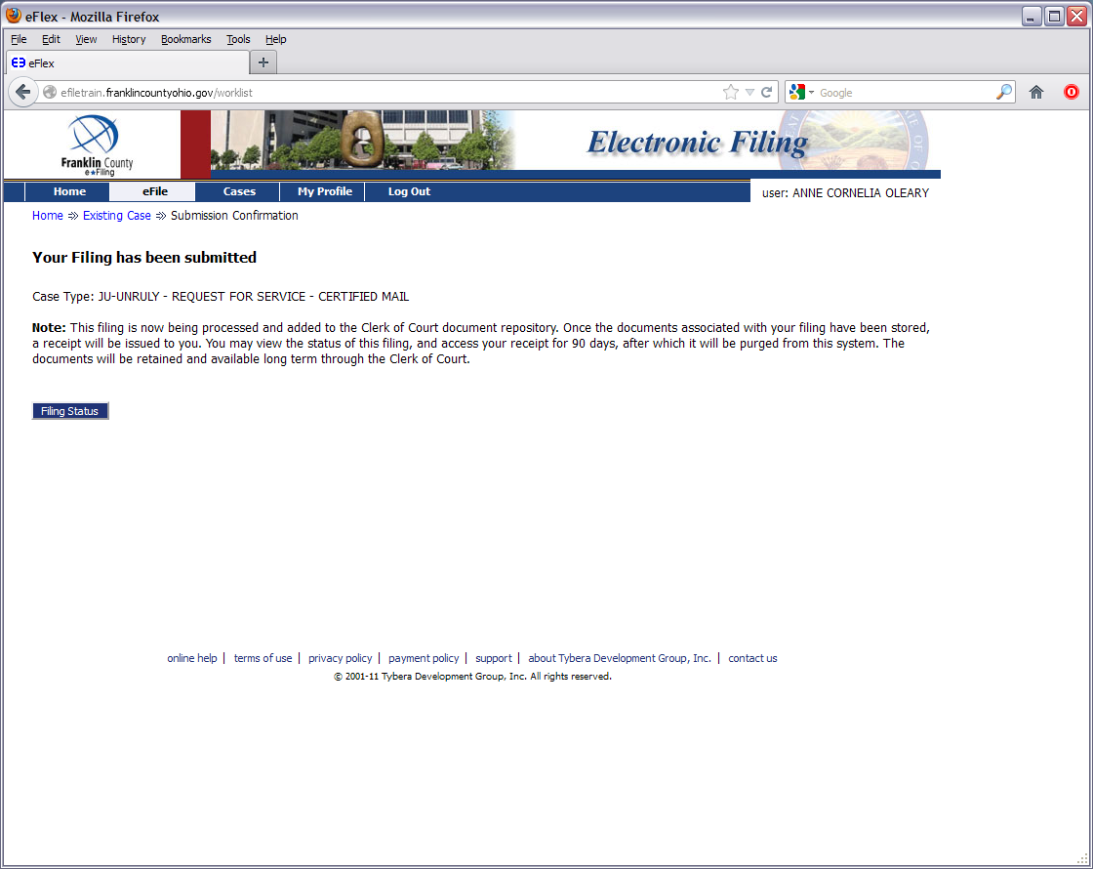

Slide 22
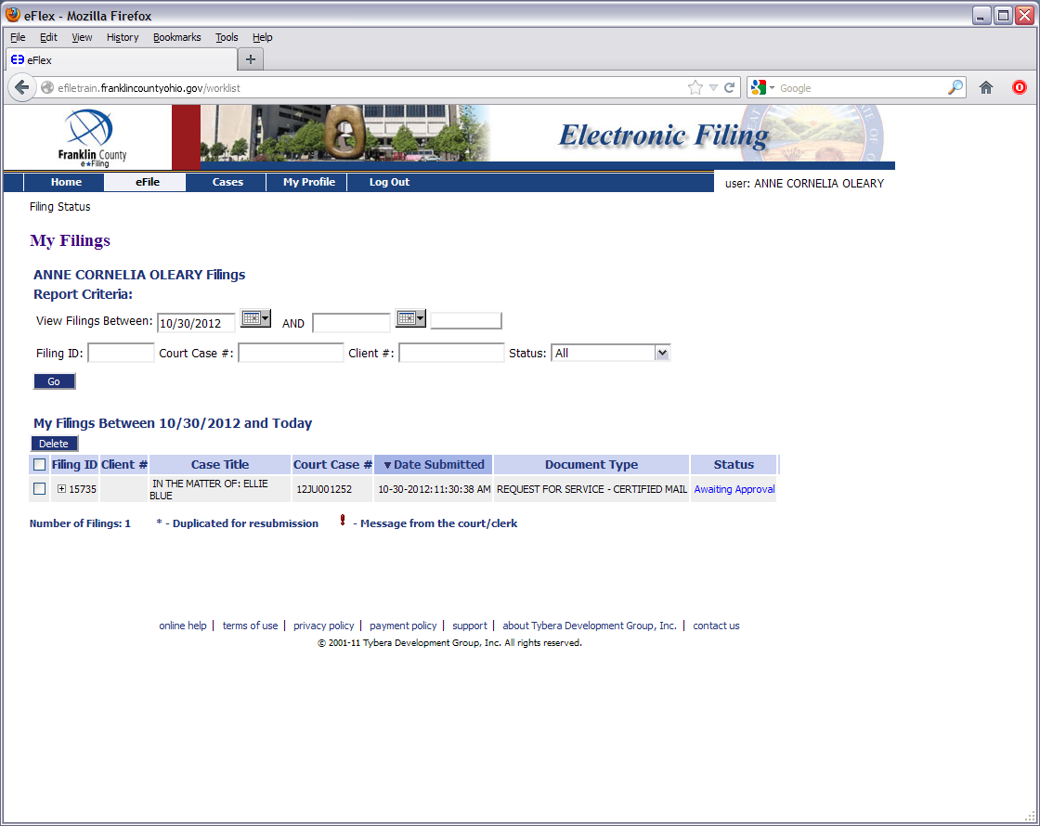

Slide 23

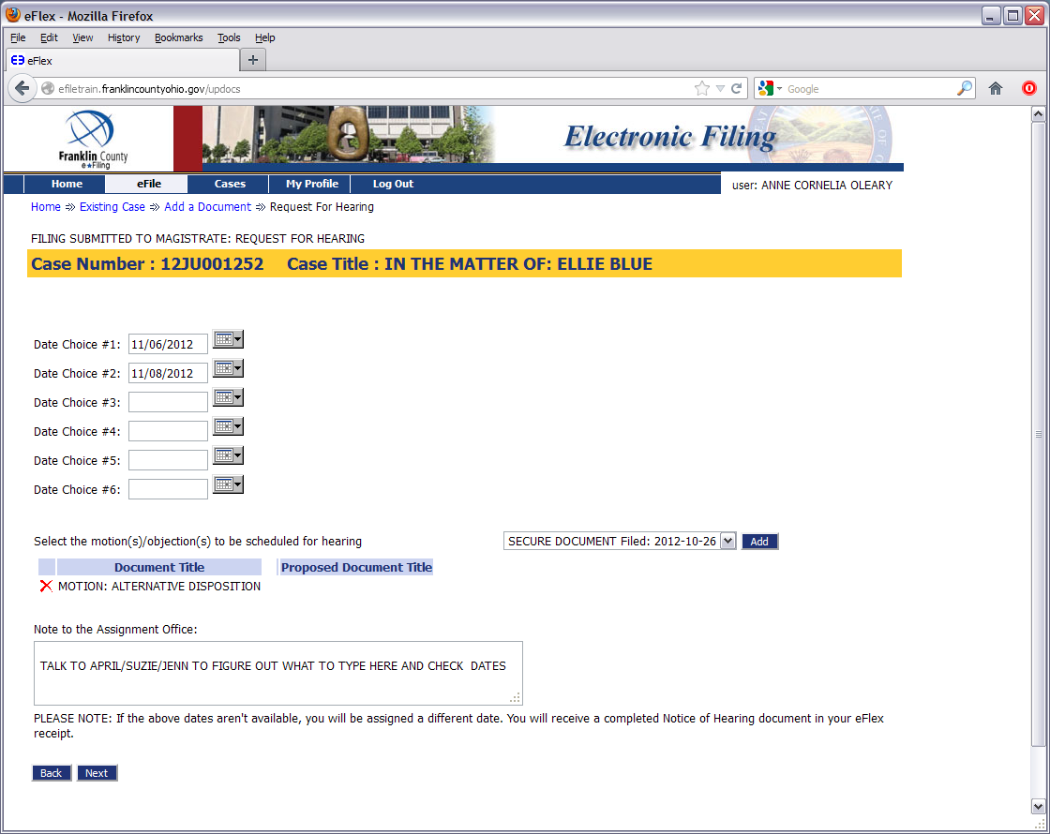
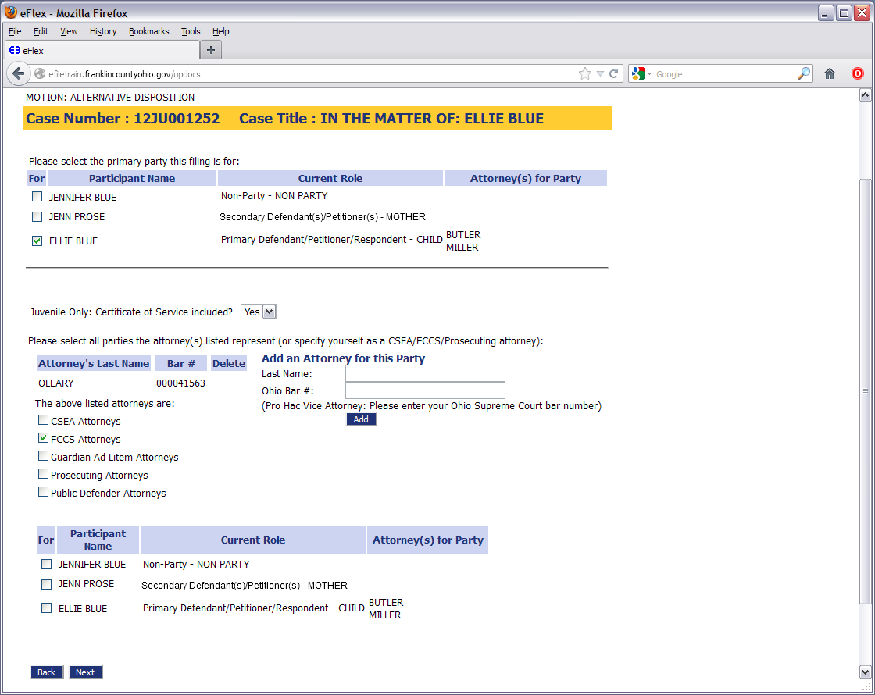
Filing to Existing Cases
Motions & Hearings

Slide 25
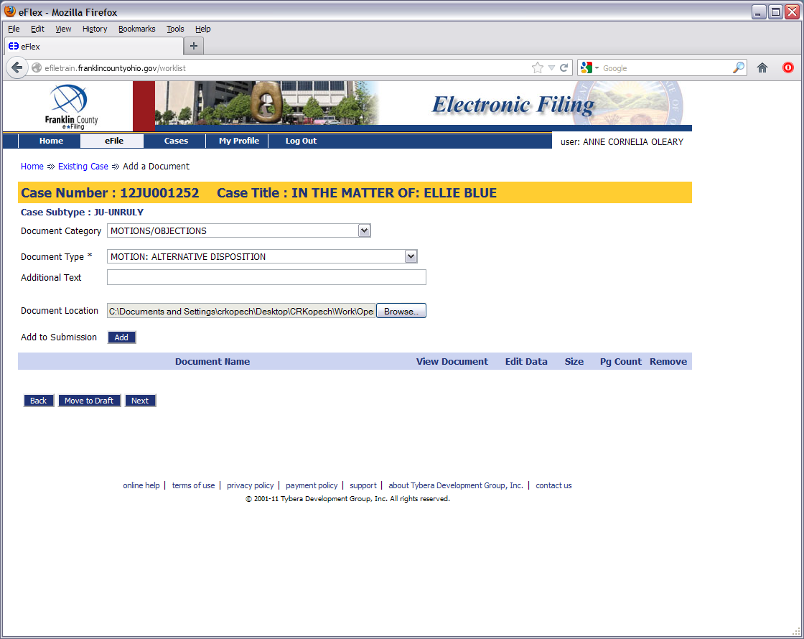

Slide 26


Slide 27


Slide 28
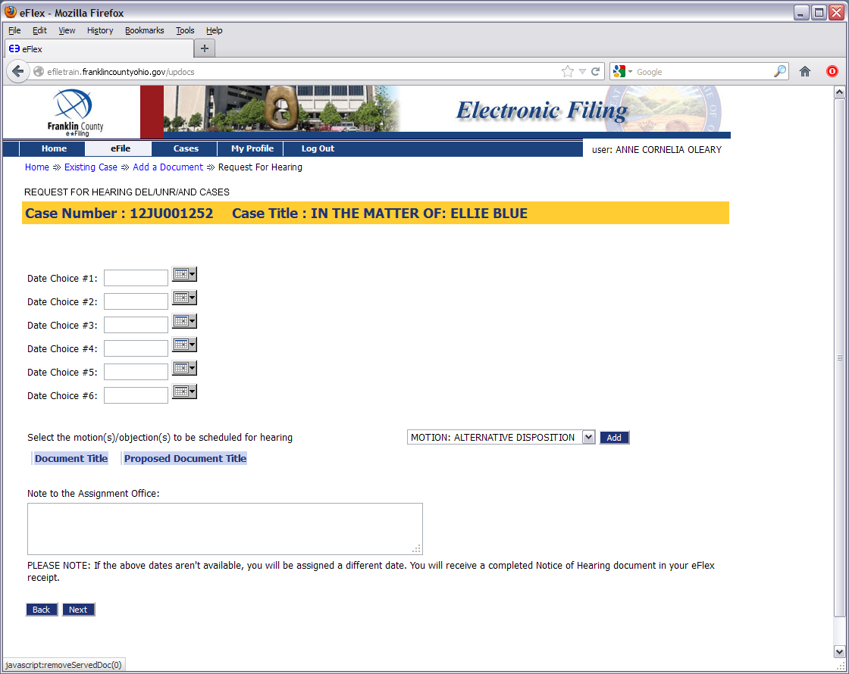

Slide 29


Slide 30
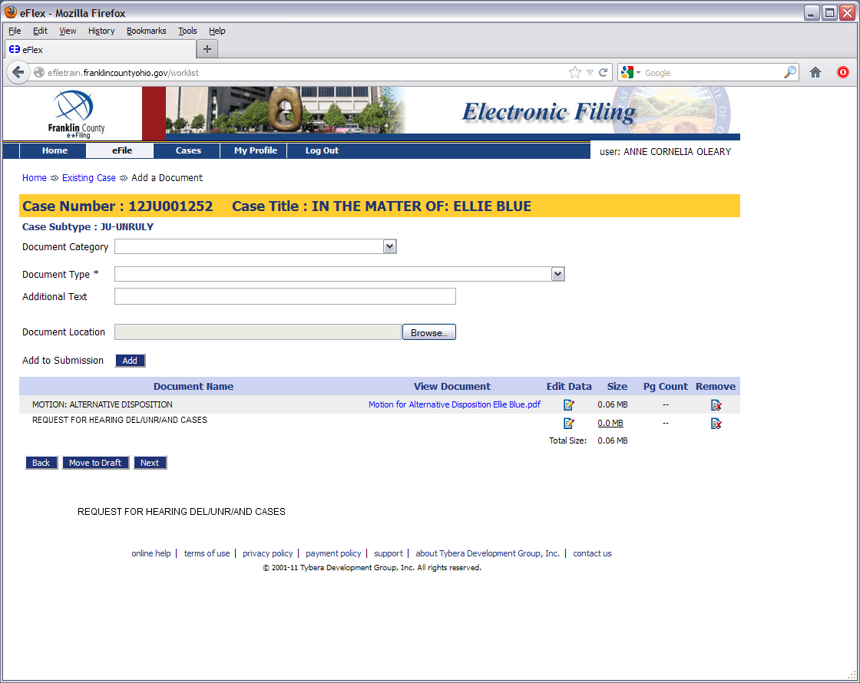

Slide 31
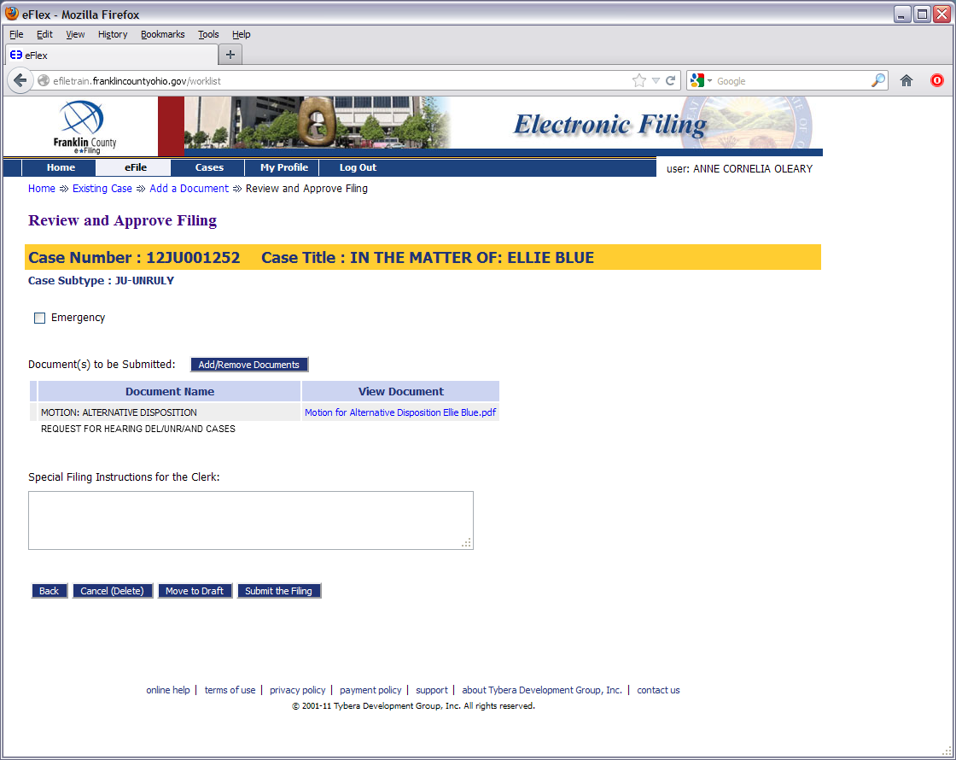

Slide 33
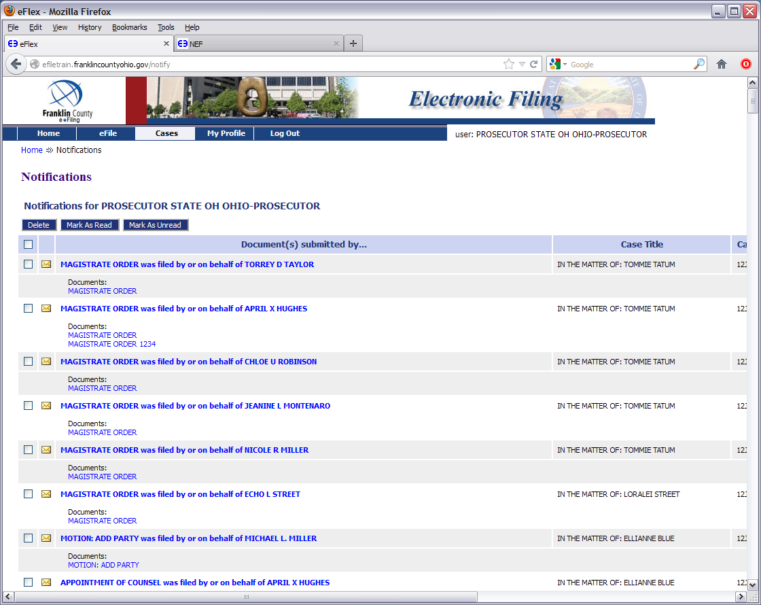
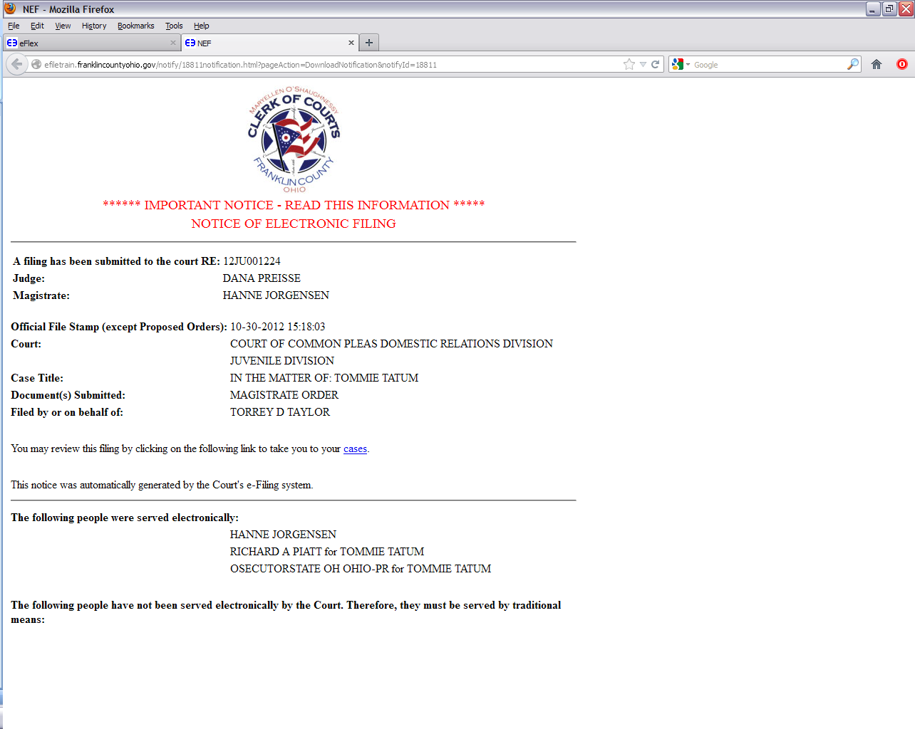
How To: Checking Notifications

Slide 34


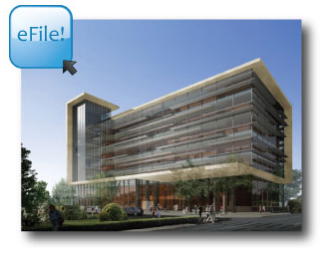


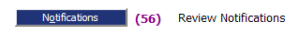
When YOU e-File…YOU are Notified!
Via email…
…And our system

Slide 35
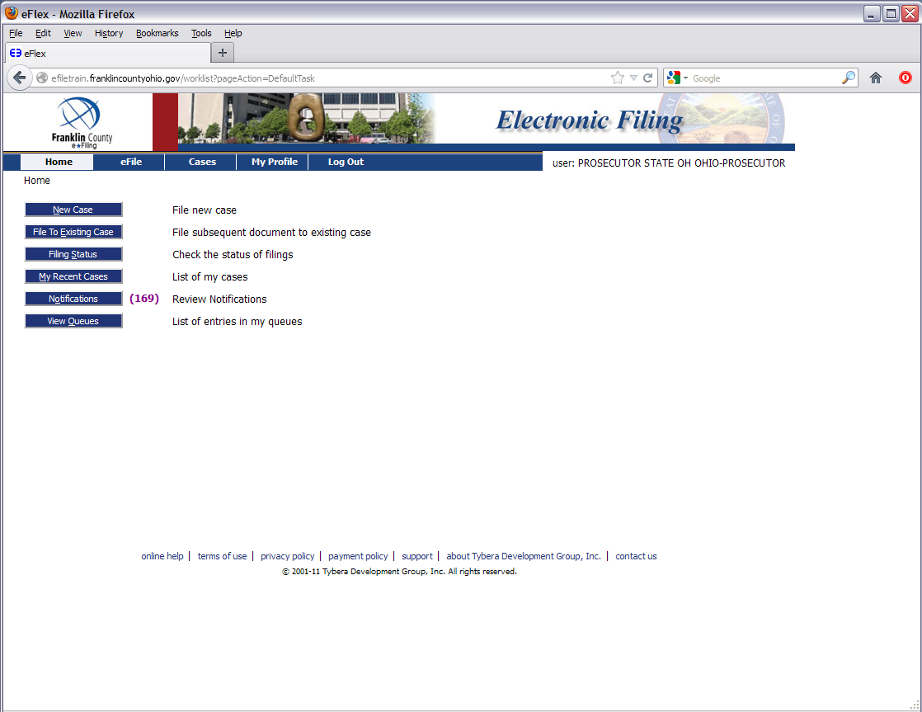

Slide 37


Slide 38
For More Information…
Online Help Through the System
https://efiling.franklincountyohio.gov/onlineHelp/fiDefault.htm
Clerk of Courts YouTube Channel
Youtube.com/clerkfranklincounty
For Procedural & Technical Issues
Juvenile Division Number:
614.525.4411
*Available Monday-Friday, 8am-5pm*
  http://clerk.franklincountyohio.gov/e-File.cfm

Slide 39

This Presentation Was Produced by:
Franklin County Clerk of Courts
Communications and Operations Staff

