Slide 1
Introduction Criminal e-Filing

Slide 2
Welcome to e-Filing
We hope this guide will assist you in becoming familiar with our County’s e-Filing system. Please view this presentation as a slide show to get the best user experience.
For information regarding registering for an account, navigating our home page, you can watch our “Introduction to e-Filing” video series here:
Clerk's e-Filing Videos

Slide 3
What to Expect From This Presentation
What technology you need to e-File in the Criminal Division
Online resources and helpful links from our IT Staff
Detailed Instruction on:
How to file in the Criminal Court
Filing to Existing Cases
Filing with Hearing Requests
Reviewing Notifications

Slide 4
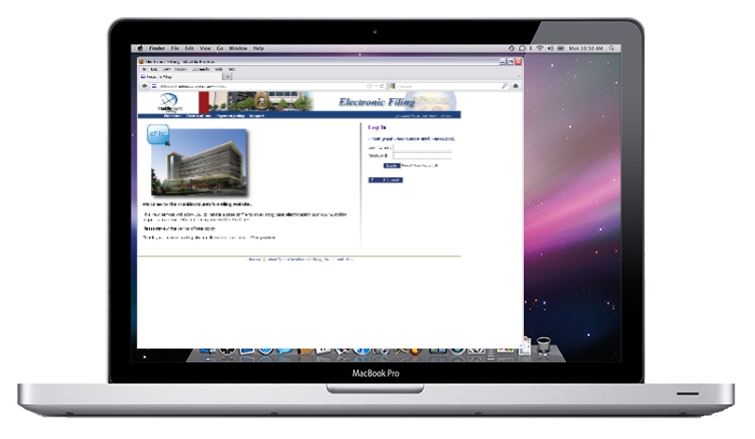
What do you need to e-File?
Computer with Internet browsing capabilities
Scanner
Ability to create .PDF files
Recommended setting: 300 DPI
Word Processer capable of exporting to MS Word 97-2003 format or later
The system will only accept .DOC or .DOCX
Other documents types (e.g. Corel Word Perfect or Apple Pages) must be re-formatted to .DOC or .DOCX

Slide 5
Online Resources & Helpful Links
Adobe Acrobat:
http://www.adobe.com/products/acrobat.html
Adobe Acrobat is the recommended software for creating .PDF files.
PDF Conversion Plug-In for Microsoft Office 2007: http://www.microsoft.com/download/en/details.aspx?id=7
This plug-in will give you the ability to save your files in .PDF format if you are running Office 2007.
Corel WordPerfect:
http://apps.corel.com/lp/wpo/
Corel WordPerfect will allow you to convert your files to .DOC or .PDF.
Newer versions will also allow you to convert your files to .DOCX.

Slide 6
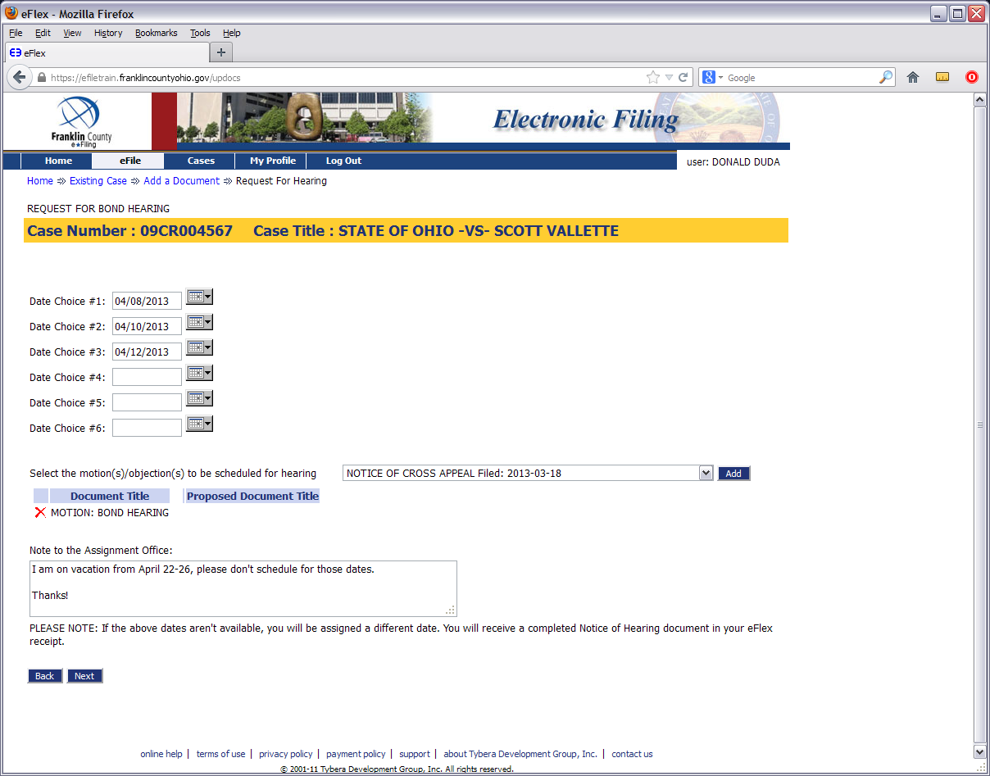
Introduction to Criminal e-Filing: Filing a Bond Hearing Request

Slide 7
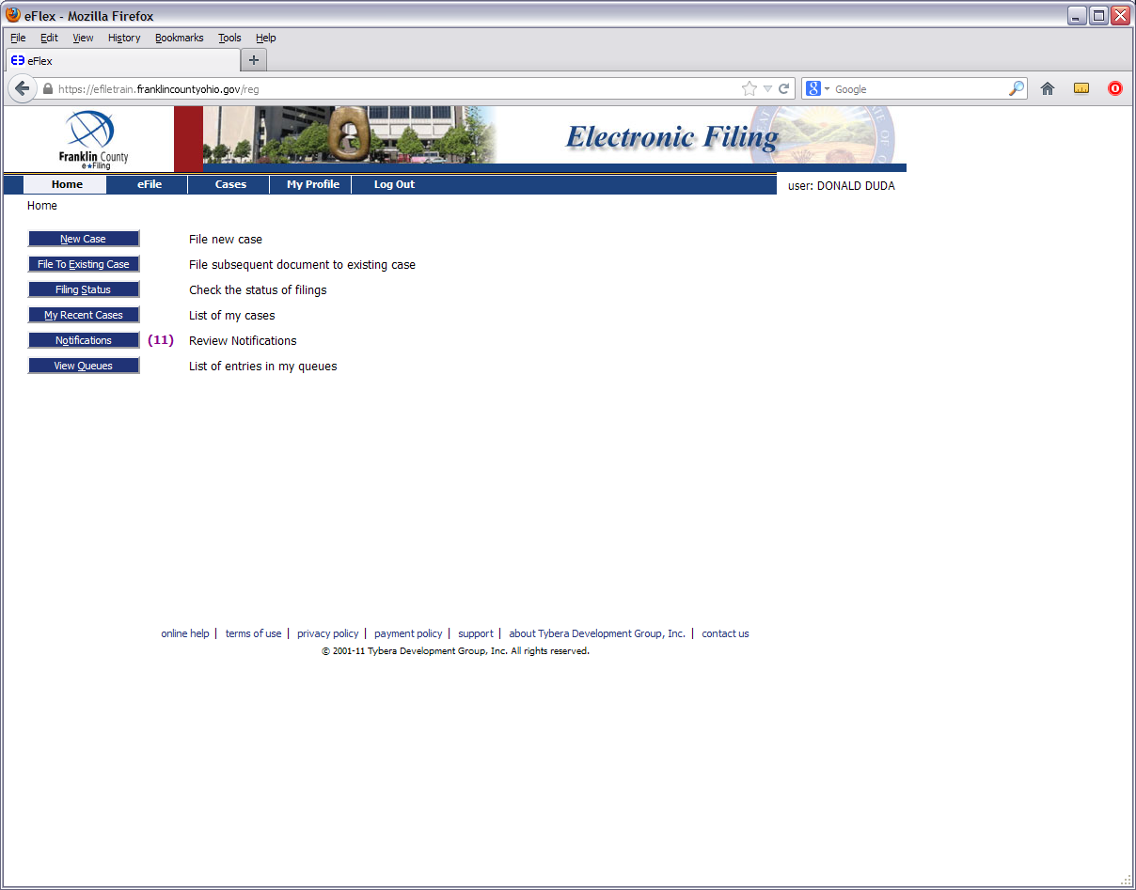

Slide 8
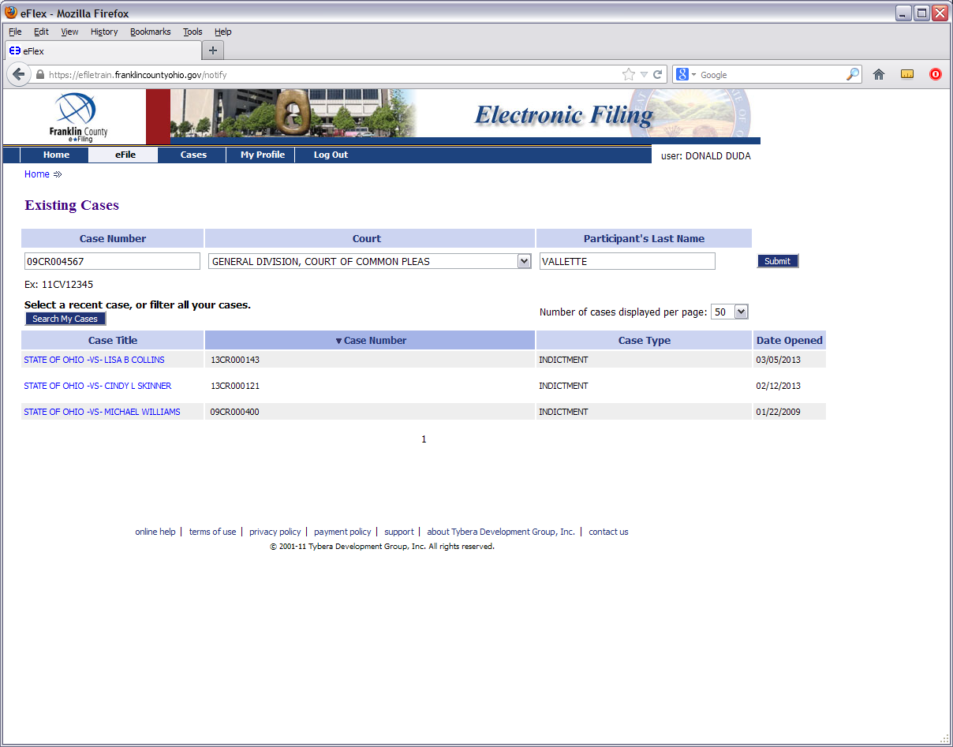

Slide 9
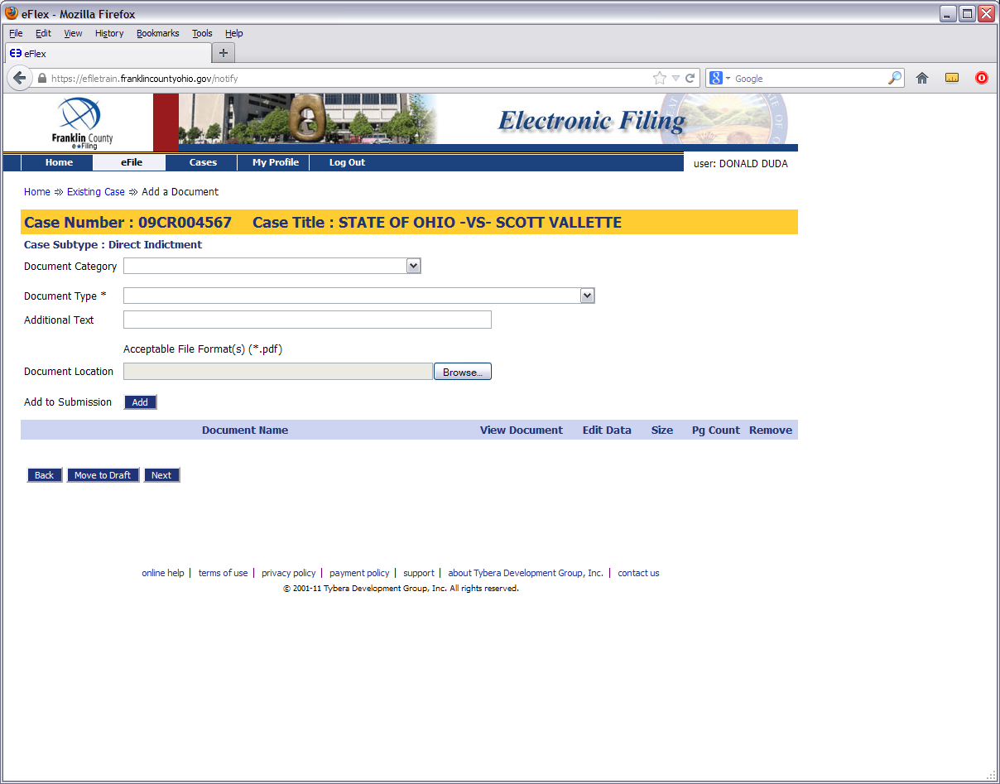

Slide 10
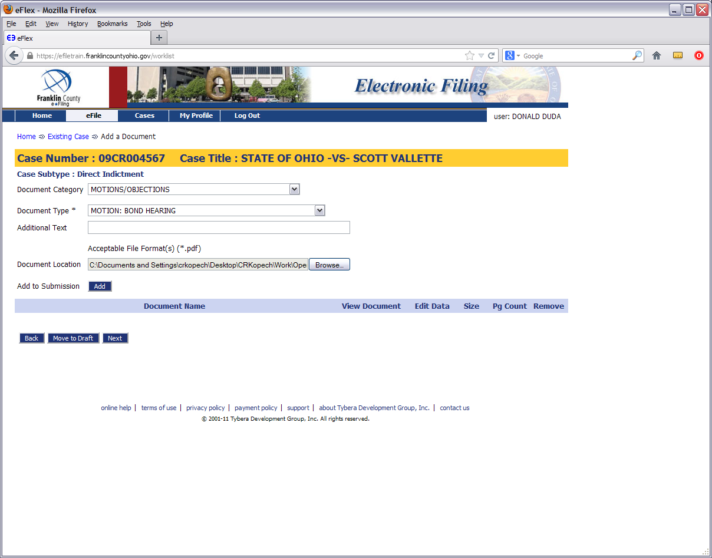

Slide 11
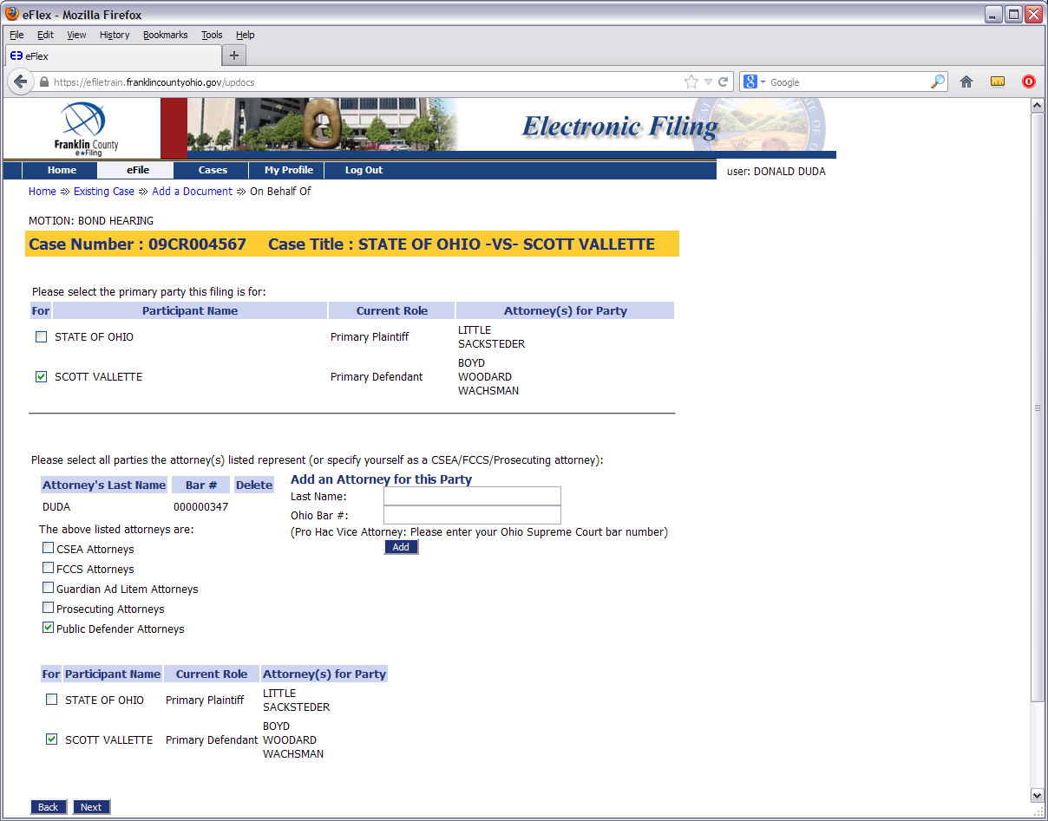

Slide 12
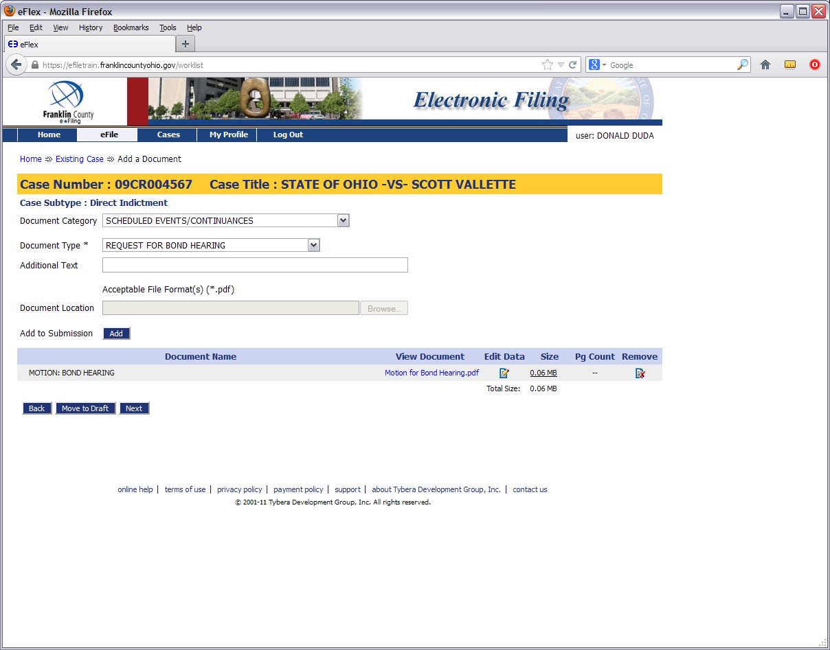

Slide 13
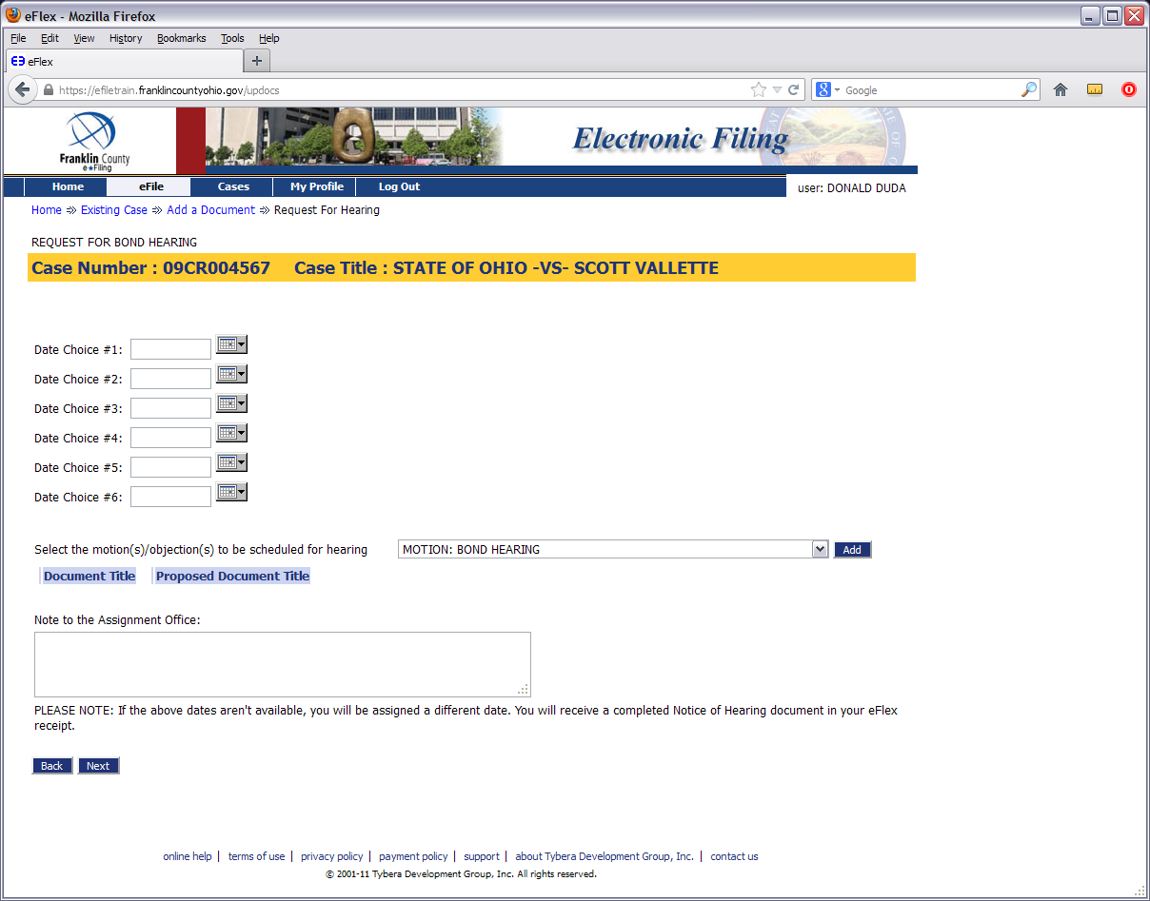

Slide 15
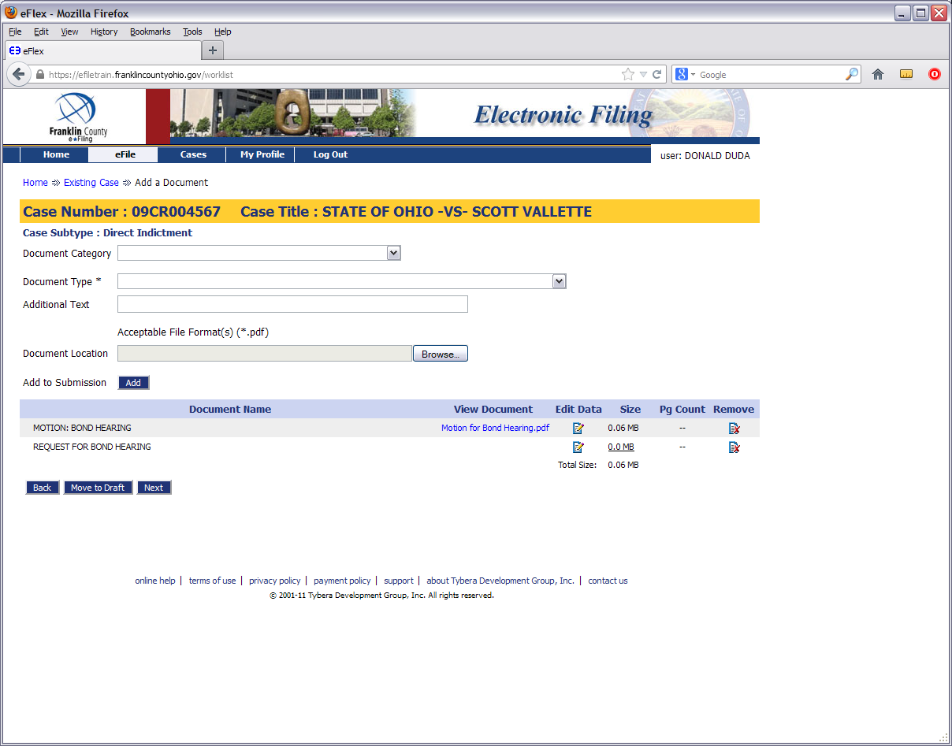

Slide 17
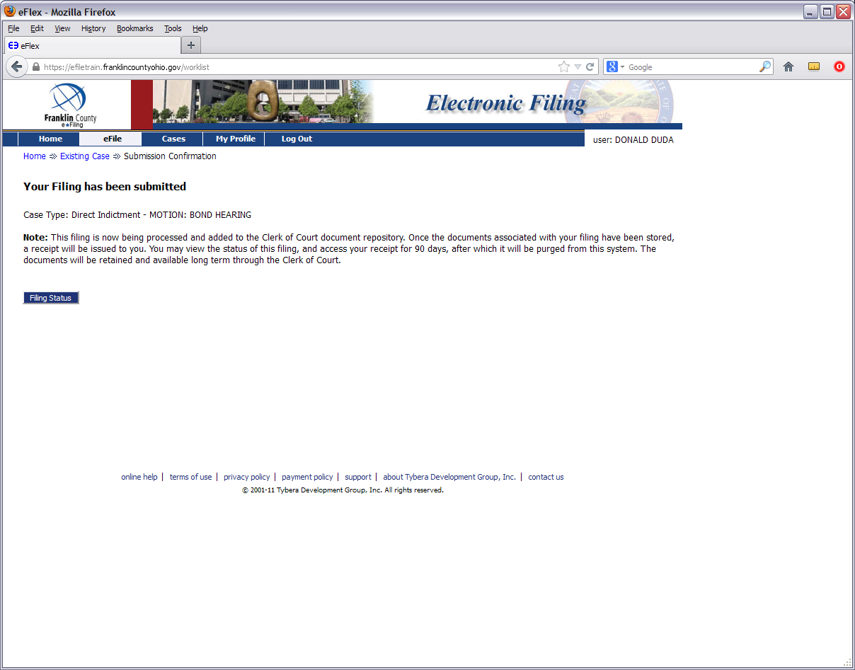

Slide 18
Introduction to Criminal e-Filing: Filing a Motion to an Existing Case

Slide 23
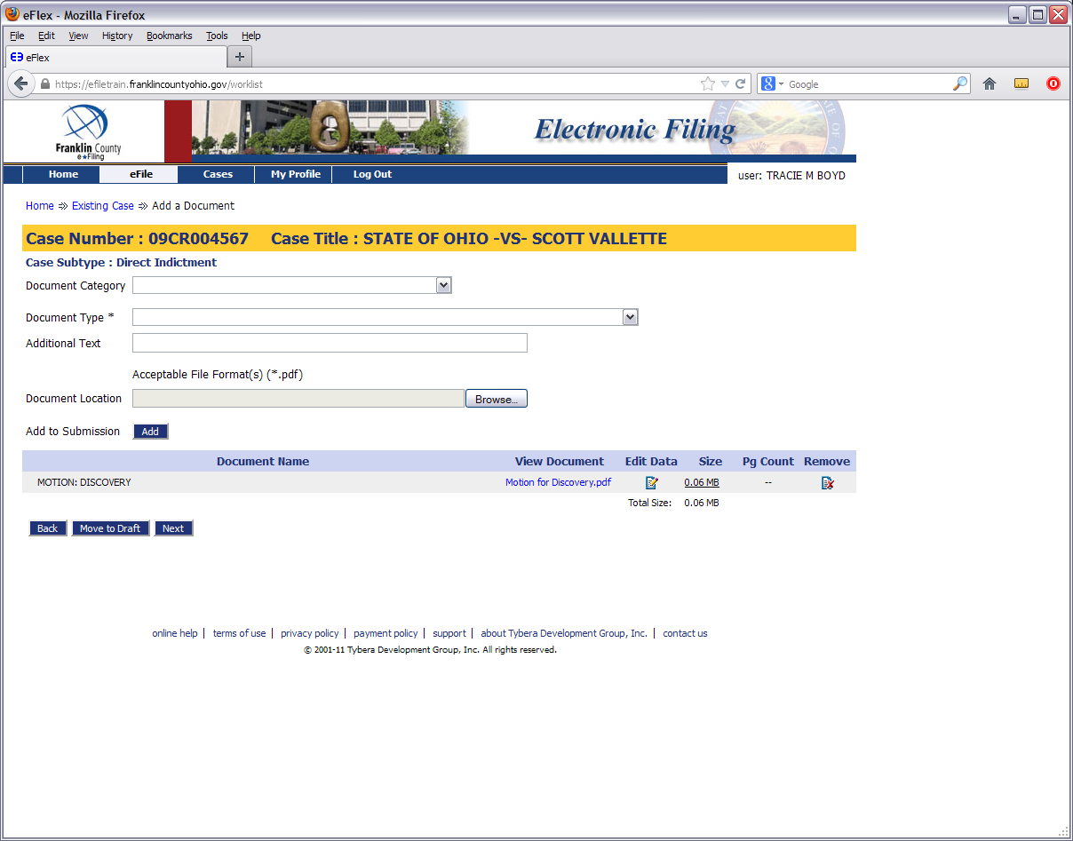

Slide 24
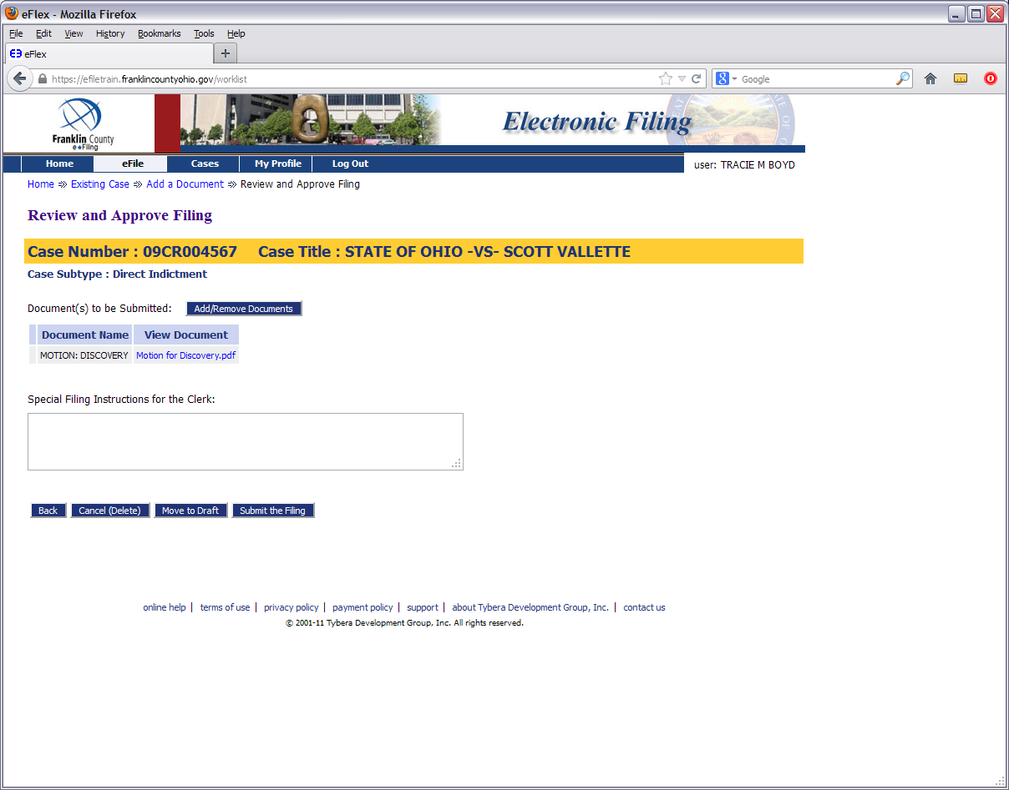

Slide 26
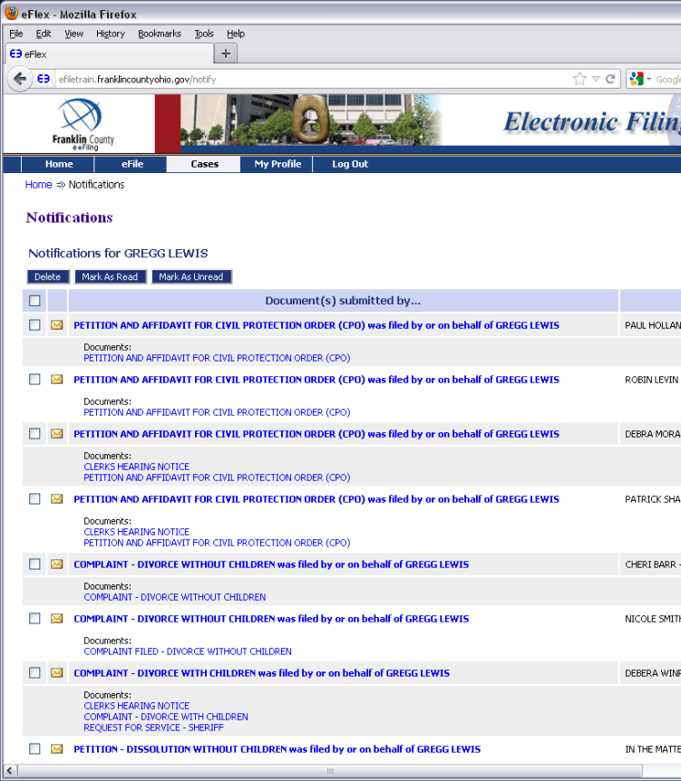
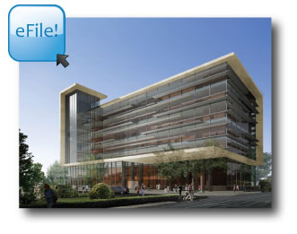
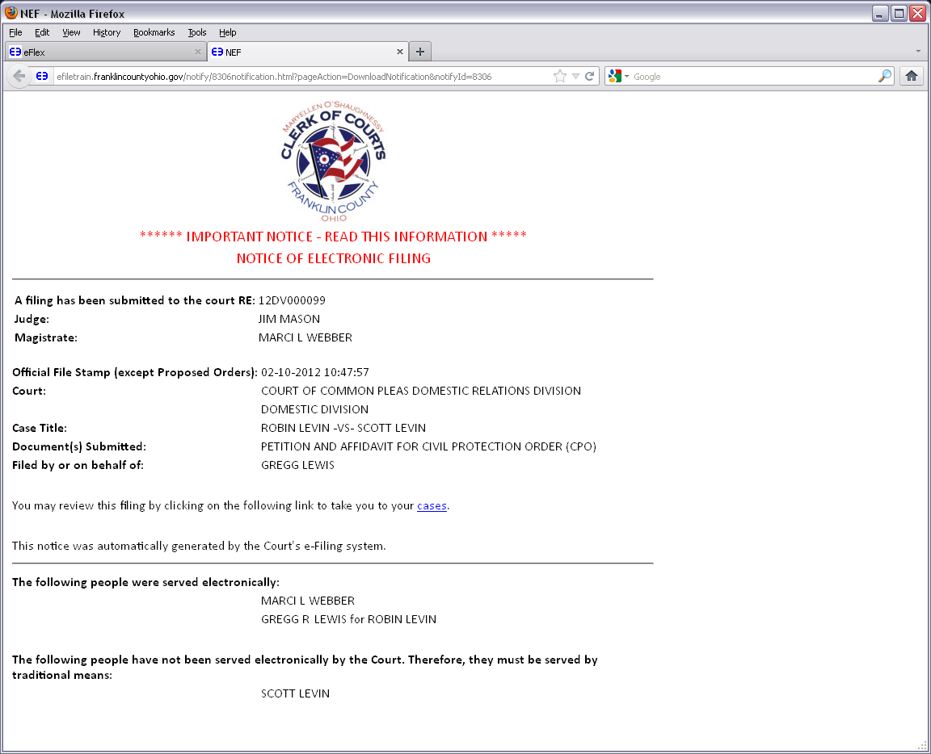
Introduction to Criminal e-Filing: Checking Notifications

Slide 27
When YOU e-File…YOU are Notified!
Via email…
…And our system

Slide 29
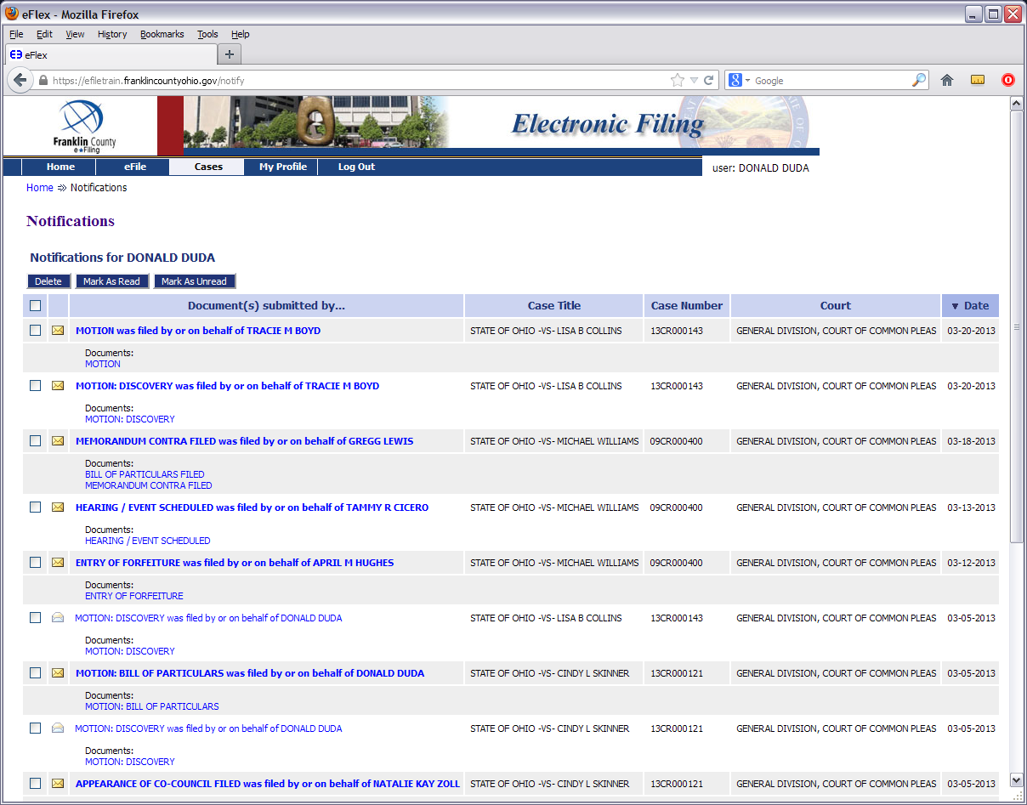

Slide 30
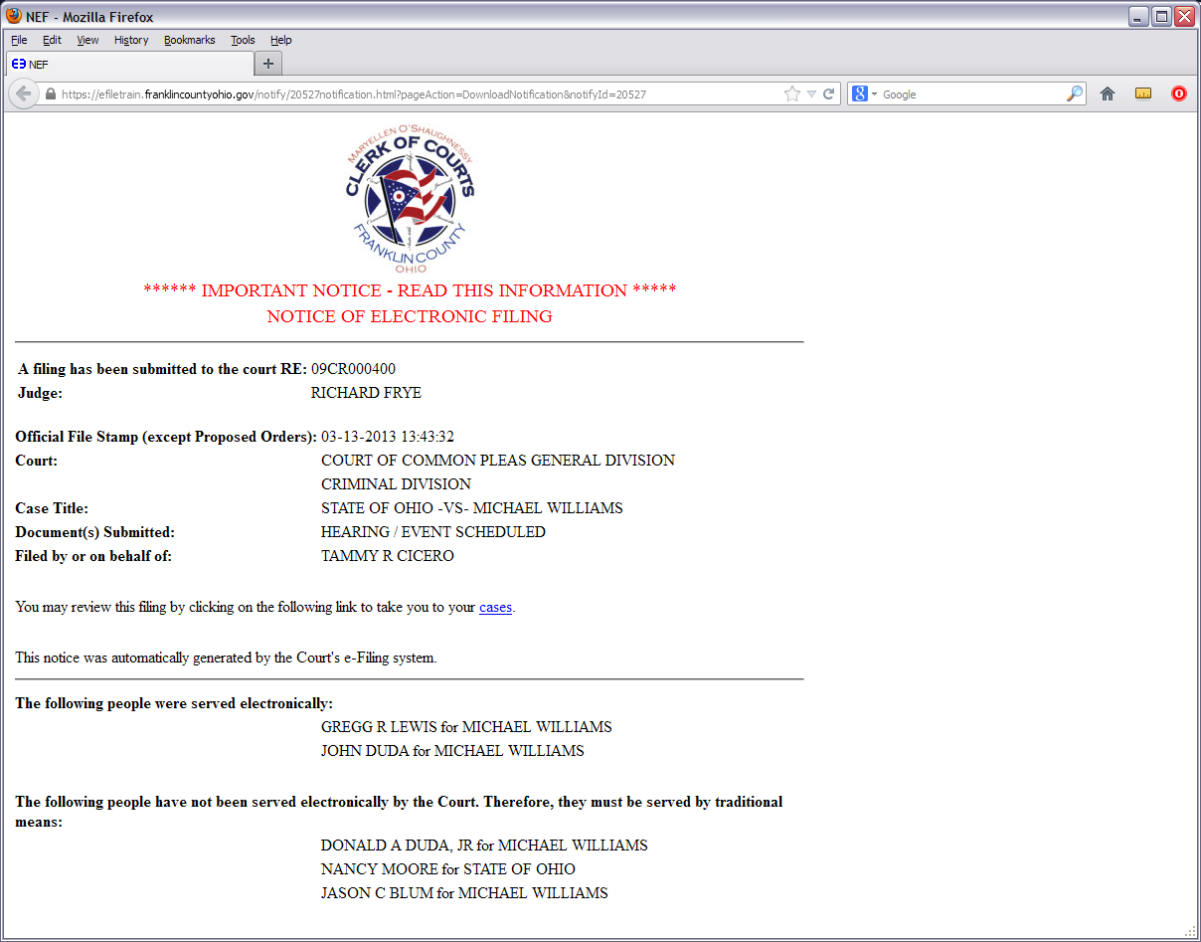

Slide 31
For More Information…
Online Help Through the System
https://efiling.franklincountyohio.gov/onlineHelp/fiDefault.htm
Clerk of Courts YouTube Channel
Youtube.com/clerkfranklincounty
For Procedural & Technical Issues
Juvenile Division Number:
614.525.4411
*Available Monday-Friday, 8am-5pm*
http://clerk.franklincountyohio.gov/e-File.cfm

Slide 32
For Legal Inquiries…
Consult the Criminal e-Filing Administrative Order
Note: Administrative Order is currently being drafted. Please check the Clerk of Courts website for updates.
Common Pleas Court Administration Website
http://www.fccourts.org/gen/WebFront.nsf//wp/Home?open
Or Contact…
Stacy Worthington
Director of Court Support Services
Stacy_Worthington@fccourts.org
(614) 525-2529
Elizabeta Saken
Staff Attorney, Hon. Judge Reece
Elizabeta_Saken@fccourts.org
(614) 525-4511

Slide 33
This Presentation Was Produced by:
Franklin County Clerk of Courts
Communications and Operations Staff

